Slide 1
资本流动、货币危机和银行危机
（以亚洲金融危机为例）
钱军辉

Slide 2
内容
汇率基本概念和理论
金融自由化和资本账户开放
亚洲金融危机始末
危机影响和教训

Slide 3
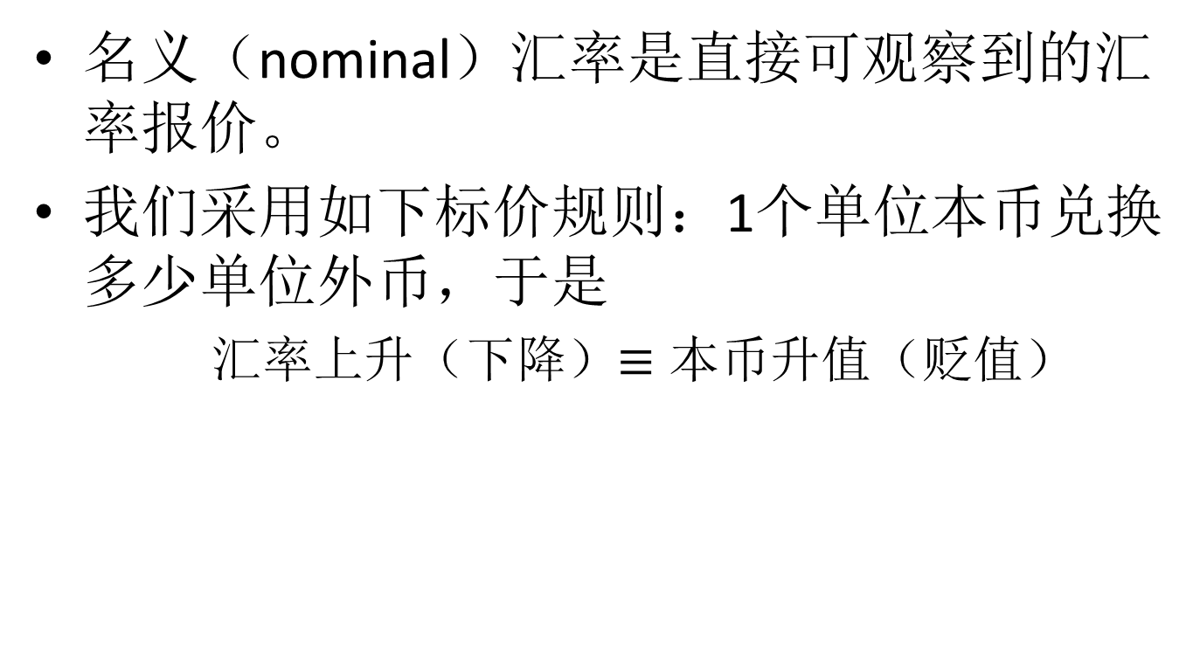
名义汇率
名义（nominal）汇率是直接可观察到的汇率报价。
我们采用如下标价规则：1个单位本币兑换多少单位外币，于是
  汇率上升（下降）$≡$ 本币升值（贬值）

Slide 4
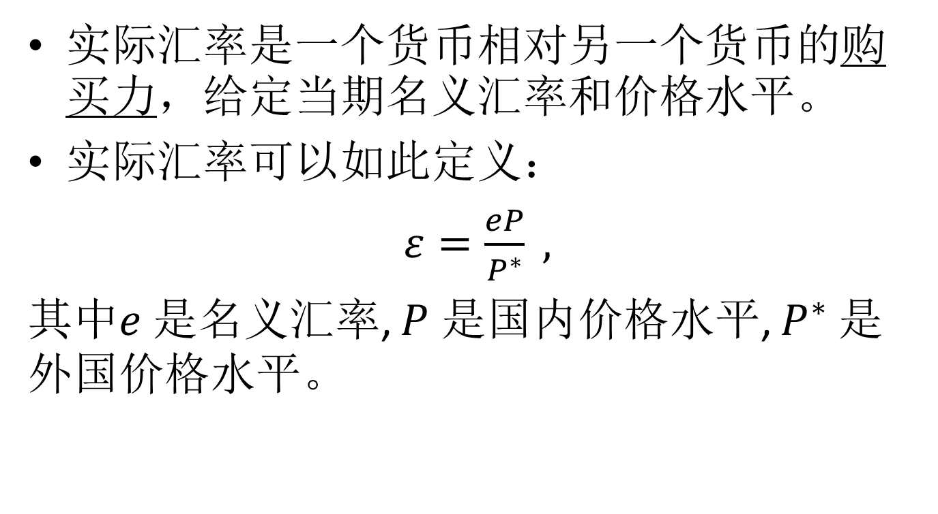
实际汇率
实际汇率是一个货币相对另一个货币的购买力，给定当期名义汇率和价格水平。
实际汇率可以如此定义：
$ε=\frac{eP}{P^{∗}} ,$
其中$e$是名义汇率, $P$ 是国内价格水平, $P^{∗}$ 是外国价格水平。
Notes:
$eP$ 是以外国货币为单位的本国商品价格，$P^{∗}$ 是以外国货币为单位的外国商品价格。如果 $\frac{eP}{P^{∗}}$ 小于1，那么本国商品更便宜，即本国货币汇率“低估”，更“值钱”。

Slide 5
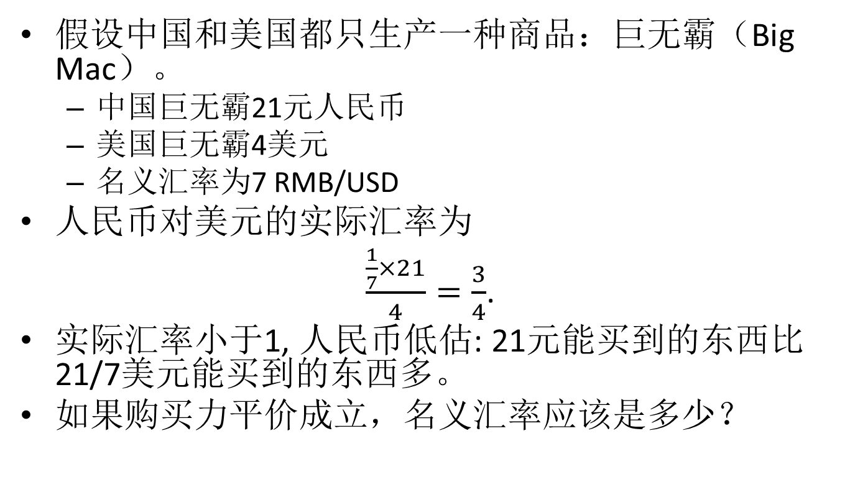
一个例子
假设中国和美国都只生产一种商品：巨无霸（Big Mac）。
  中国巨无霸21元人民币
  美国巨无霸4美元
  名义汇率为7 RMB/USD
人民币对美元的实际汇率为
$\frac{\frac{1}{7}×21}{4}=\frac{3}{4}$.
实际汇率小于1, 人民币低估: 21元能买到的东西比21/7美元能买到的东西多。
如果购买力平价成立，名义汇率应该是多少？

Slide 6
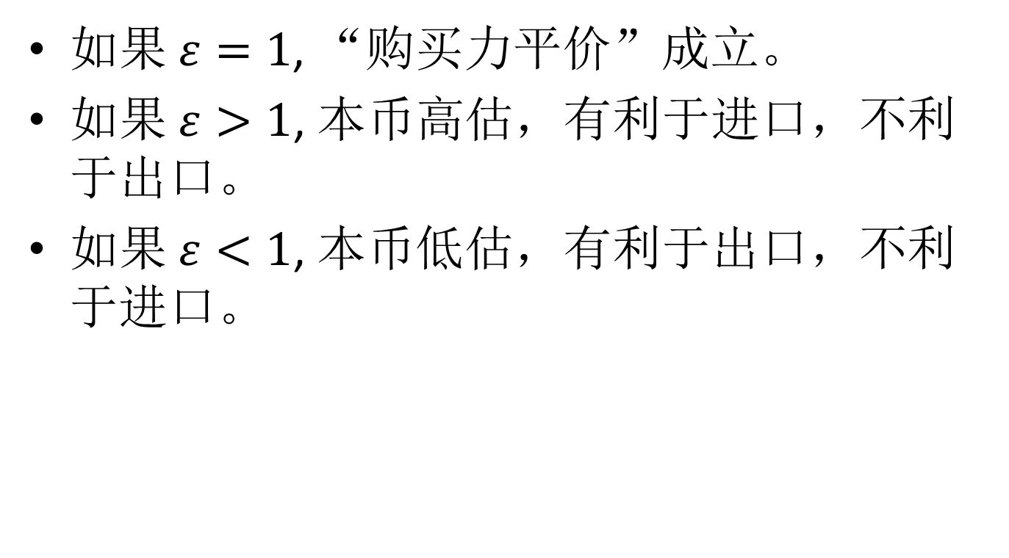
购买力平价（Purchasing Power Parity）
如果 $ε=1$, “购买力平价”成立。
如果 $ε>1$, 本币高估，有利于进口，不利于出口。
如果 $ε<1$, 本币低估，有利于出口，不利于进口。

Slide 7
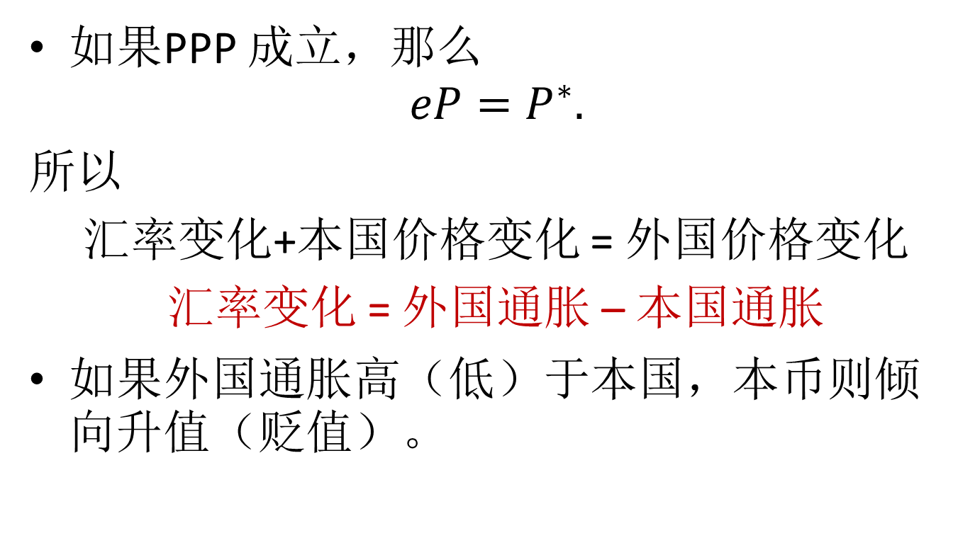
汇率和通胀
如果PPP 成立，那么
$$eP=P^{∗}.$$
所以
汇率变化+本国价格变化 = 外国价格变化
汇率变化 = 外国通胀 – 本国通胀
如果外国通胀高（低）于本国，本币则倾向升值（贬值）。
Notes:
如果PPP 成立，那么
$$e_{t}=\frac{P_{t}^{∗}}{P_{t}}.$$
经过对数差分（log difference）, 得到
$$\frac{Δe_{t}}{e_{t−1}}≈\log{\frac{e_{t}}{e_{t−1}}}=π_{t}^{∗}−π_{t},$$
其中 $π_{t}^{∗}$ 和 $π_{t}$ 分别为外国和国内的通胀率.
Note that $\log{\frac{e_{t}}{e_{t−1}}}≈\frac{Δe_{t}}{e_{t−1}}$ .
因为 eP=P* ，所以 汇率变化+本国价格变化 = 外国价格变化，
所以 汇率变化 + 本国通胀 = 外国通胀
所以 汇率变化 = 外国通胀 – 本国通胀

Slide 8
PPP的经验事实
一般而言，PPP在长期接近成立，短期则有较大偏离。
PPP基于一价原理（Law of One Price），即同样的商品有同样的价格，但是现实世界存在各种贸易成本和障碍，阻碍价格收敛，尤其是不可贸易的品种（如生活服务）。
  Balassa–Samuelson效应：发达国家的物价会系统性地高于发展中国家。
Notes:
可以把经济分为两个行业：可贸易行业（如制造业）和不可贸易行业（如生活服务，等）。发达国家的可贸易行业劳动生产率高于发展中国家，因此劳动力成本高于发展中国家。虽然不可贸易行业的劳动生产率差距小，但是发达国家不可贸易行业劳动力成本远高于发展中国家，于是发达国家的不可贸易品价格也远高于发展中国家。因为CPI篮子既包括可贸易品和不可贸易品，所以发达国家价格水平也远高于发展中国家。

Slide 9
汇率和利率
如果进一步假设存在一个共同的实际利率，那么
汇率变化 = 外国利率 – 本国利率
如果外国利率高于本国，本国汇率倾向于升值。
该方程被称为（无抛补）利率平价（Uncovered interest rate parity）。
Notes:
如果进一步假设存在一个共同的实际利率，那么
$$\frac{Δe_{t}}{e_{t−1}}≈i_{t}^{∗}−i_{t}.$$
其中 $i_{t}^{∗}$ 和 $i_{t}$ 分别为外国和国内的利率.
The common real interest rate implies that there are no arbitrage opportunities in investing.

Slide 10
利率平价的经验事实
在经验研究中，利率平价很少得到支持。即，高利率货币经常升值而不是贬值。
此经验规律是套息交易（Carry trade）的基础。
  做空低息货币（贷款），做多高息货币。

Slide 11
超调（Overshoot）
如果外国利率上升，本币瞬时贬值，且超过长期均衡，从而维持无抛补利率平价。
超调是汇率波动较大的一个理论解释。
Exchange rate
长期均衡
Notes:
超调理论由Rudi Dornbusch (1976)提出。

Slide 12
一个小型开放经济体模型
假设本国经济规模较小，资本自由流动，汇率浮动。外国（大国）加息对小国产生什么影响？
为研究这个问题，我们引入一个具有两个均衡条件的模型。
  外汇市场均衡（外汇供应=外汇需求）
  货币市场均衡（货币供应=货币需求）

Slide 13
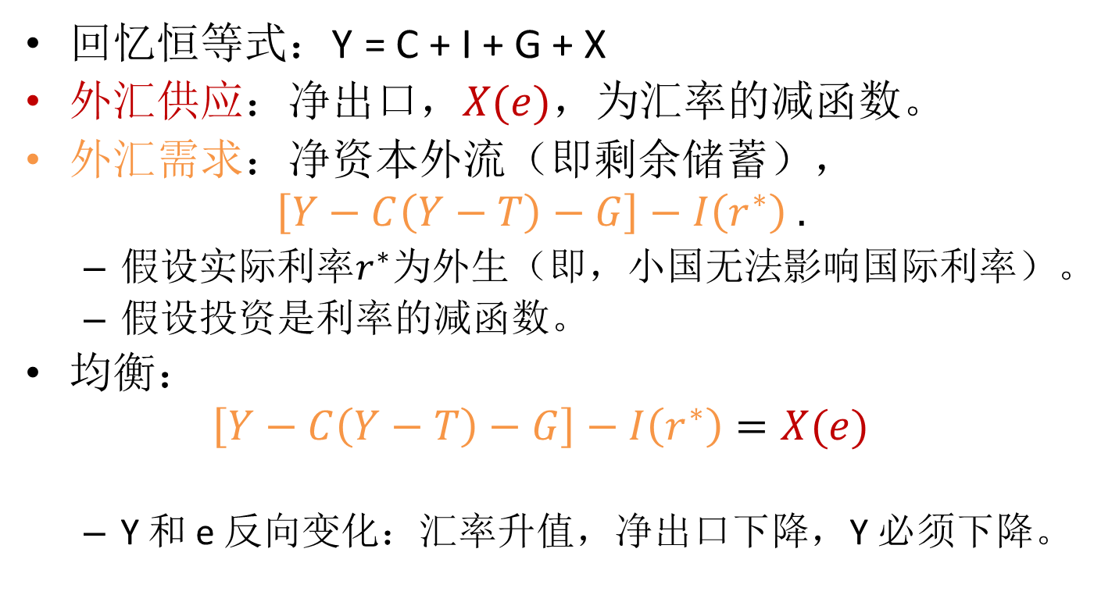
外汇市场
回忆恒等式：Y = C + I + G + X
外汇供应：净出口，$X(e)$，为汇率的减函数。
外汇需求：净资本外流（即剩余储蓄），
$$\left[Y−C\left(Y−T\right)−G\right]−I\left(r^{∗}\right) .$$
  假设实际利率$r^{∗}$为外生（即，小国无法影响国际利率）。
  假设投资是利率的减函数。
均衡：
$$\left[Y−C\left(Y−T\right)−G\right]−I\left(r^{∗}\right)=X(e)$$
  Y 和 e 反向变化：汇率升值，净出口下降，Y 必须下降。
Notes:
When $e↑$, $Y↓$

Slide 14
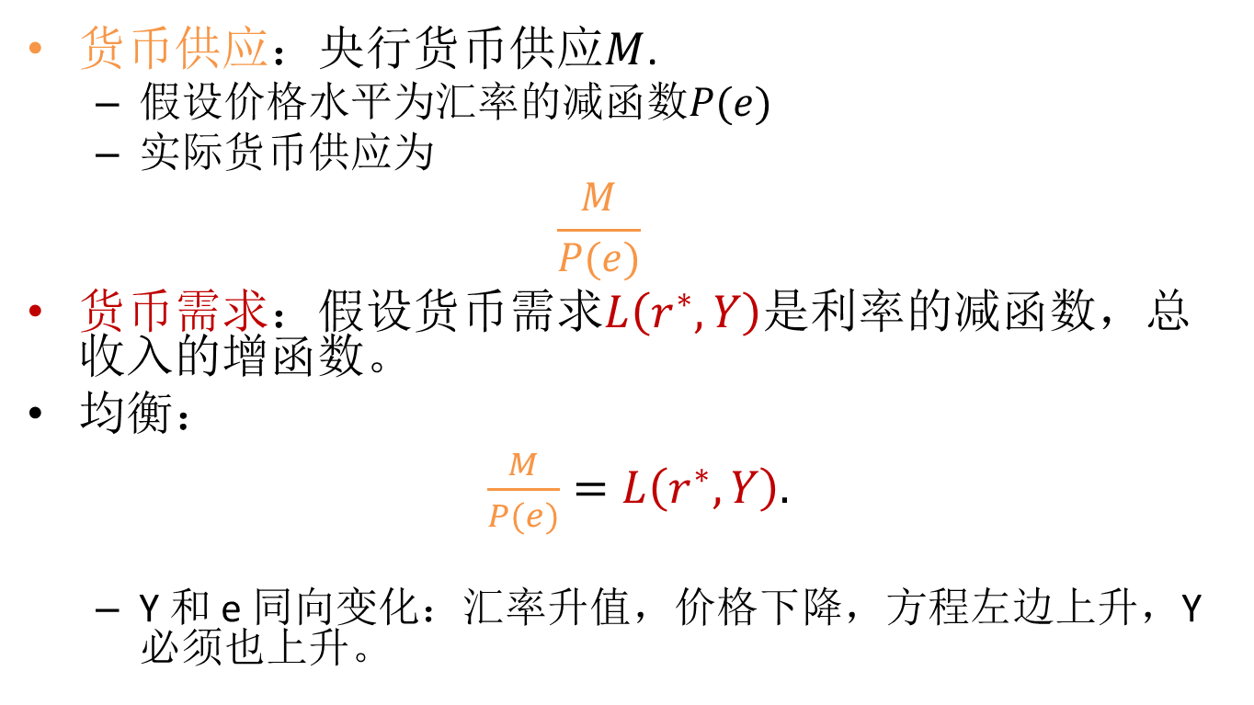
货币市场
货币供应：央行货币供应$M$.
  假设价格水平为汇率的减函数$P(e)$
  实际货币供应为
  $$\frac{M}{P(e)}$$
货币需求：假设货币需求$L\left(r^{∗},Y\right)$是利率的减函数，总收入的增函数。
均衡：
$\frac{M}{P(e)}=L\left(r^{∗},Y\right).$
  Y 和 e 同向变化：汇率升值，价格下降，方程左边上升，Y必须也上升。
Notes:
When $e↑$, $Y↑$

Slide 15
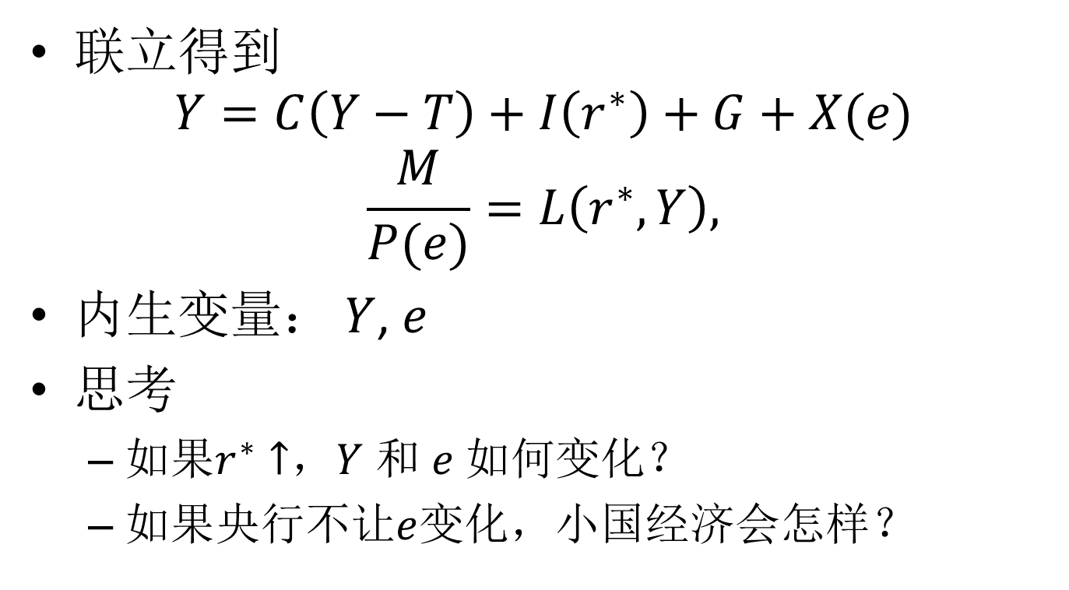
一个小型开放经济体模型
联立得到
$$Y=C\left(Y−T\right)+I\left(r^{∗}\right)+G+X(e)$$
$$\frac{M}{P(e)}=L\left(r^{∗},Y\right),$$
内生变量： $Y$, $e$
思考
  如果$r^{∗}↑$，$Y$ 和 $e$ 如何变化？
  如果央行不让$e$变化，小国经济会怎样？

Slide 16

当世界利率（$r^{∗}$）上升
Exchange rate e
1
1’
2
2’
Output Y

Slide 17
当央行阻止贬值
央行为什么干预？
  如果金融机构和实体企业有大量外债，一旦开始贬值，会引发债务危机，进一步加强贬值预期。
央行如何干预？
  加息
  在外汇市场卖出外汇（买入本币）
两者均为货币紧缩，可能导致经济基本面恶化，进一步加强贬值预期。
  需要庞大的外汇储备

Slide 18
战，还是降
捍卫汇率的意愿
  经济基本面、面子
捍卫汇率的能力
  外汇储备
博弈
  市场衡量政府的意愿和能力
  政府衡量市场参与者的预期
  市场参与者衡量其他参与者的预期

Slide 19
一个多重均衡模型
政府试图维持固定汇率，但外汇储备有限。
单个投资者做空，汇率维持固定，做空者成本为-1.
两个投资者同时做空，汇率贬值，做空者收益为0.5.
两个均衡都可能发生。
投资者1
hold
sell
(0, 0) | (0, -1)
(-1, 0) | (0.5, 0.5)
hold
投资者2
sell
Notes:
该模型告诉我们，基本面良好情况下也可能发生货币危机。危机的制度背景是，资本账户开放，以及不存在国际最后贷款人。货币危机实质上就是对一个国家的bank run.
该模型假设“common knowledge”，于是得到多重均衡。该模型无法用来判断什么情况下危机会发生。
如果假设参与者的信号有噪声，那么能得到唯一均衡，能在什么情况下会发生危机，在什么情况下不会发生。
Stephen Morris and Hyun Song Shin, 1998, Unique Equilibrium in a Model of Self-Fulfilling Currency Attacks, The American Economic Review, Vol. 88, No. 3 (Jun., 1998), pp. 587-597.

Slide 20
内容
汇率基本概念和理论
金融自由化和资本账户开放
亚洲金融危机始末
危机影响和教训

Slide 21
从压迫到自由化
二战以后金融压迫（Financial Repression）相当普遍，尤其在发展中国家。
  政府决定谁能得到贷款
  政府决定利率
  政府决定谁能进入金融行业
  政府拥有或控制金融机构运营
  政府决定谁能在境外融资
在发展中国家，金融压迫被认为是一种发展策略。
从1970s开始，风向开始变化。
Notes:
The modern economic analysis of financial policy in developing countries started with the seminal works of McKinnon (1973) and Shaw (1973).
McKinnon, Ronald I. (1973), Money and Finance in Economic Development, Brookings Institution, Washington.
Shaw, Edward S. (1973), Financial Deepening in Economic Development, Oxford University Press, New York.

Slide 22
金融自由化
主要内容有：
  取消信贷管制
  利率市场化
  自由准入金融行业
  银行私有和自主经营
  资本自由跨境流动

Slide 23
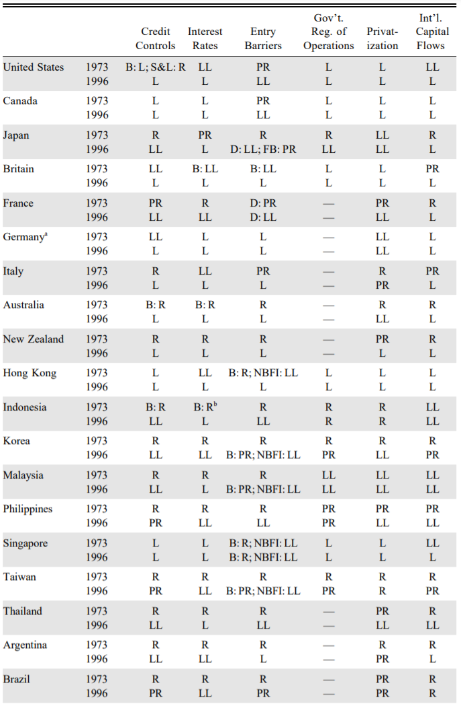
从1973到1996
L: liberalized
R: repressed
LL: largely liberalized
PR: partly repressed
B: banks
F: foreign
D: domestic
NBFI: non-bank financial institutions
Notes:
来自：Williamson, John, and Molly Mahar (1998), A Survey of Financial Liberalization, World Bank, Washington.
韩国在1996年加入OECD，见面礼是放松资本账户管制。
资本账户开放的一般顺序应该是，先浮动汇率，放松FDI，银行跨境业务，最后才是证券。但是韩国反过来了。

Slide 24
资本账户开放
资本账户开放也被称为资本账户可兑换（Capital Account Convertibility），指金融产品跨境自由交易。
  直接投资
  货币自由兑换
  银行等金融机构跨境经营
  证券市场准入

Slide 25
资本账户开放的好处
资金流入国
  获得更便宜的融资
  直接投资带来技术、市场、管理经验等
资金流出国
  获得更多资产分散（diversification）机会
  分享发展中国家的高成长
促进全球资金有效分配
Notes:
在亚洲，因为各国稳定汇率，所以更加吸引资本流入。资本流入导致经济繁荣，进一步吸引资金流入。

Slide 26
资本账户开放的坏处
短期资本流动导致流动性周期。
  发展中国家通常监管不力，金融系统容易变得脆弱。
因为缺少全球最后贷款人（lender of last resort），发展中国家容易遭到挤兑。
Notes:
证券投资者和银行家的短视和跟风，因为资本账户开放，被扩大到全球。

Slide 27
亚洲金融危机的“前世”
从1975到1982年，拉丁美洲外债达到GDP的50%左右。
墨西哥面临油价大跌、国际利率上升，外贸逆差等经济问题，首先宣布暂停付息，并且要求债务减免。
危机迅速扩大到其他拉美国家，造成拉美的“丢失十年”。

Slide 28
内容
汇率基本概念和理论
金融自由化和资本账户开放
亚洲金融危机始末
  背景
  泰铢危机及扩散
  印度尼西亚
  韩国
  香港
危机影响和教训

Slide 29
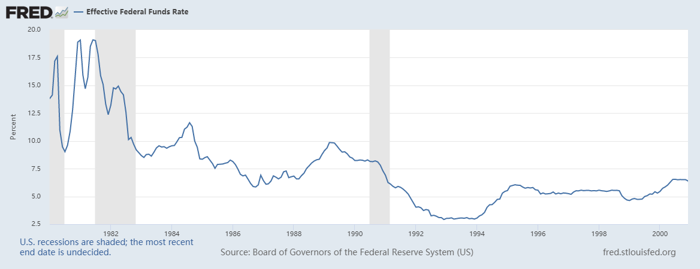
美国货币政策利率（1980-2000）

Slide 30
美元指数

Slide 31
泰国
从1985到1996，泰国平均GDP增长率超过9%，通胀率在3.4–5.7%之间，被誉为第5条小龙。
但贸易维持赤字，反映汇率（固定在25泰铢/美元左右）高估。
银行借外债（低利率），借给国内企业（高利率），通常以房地产为抵押。
外债不断积累。
Notes:
政治分裂，不稳定，政策被各种利益集团左右。这是为什么泰国政府迟迟未能对经济问题（汇率、资本流入、房地产泡沫）做出反应。

Slide 32
泰国的经常账户

Slide 33
泰国的外债
Notes:
在1997年之前，短期外债比例不断升高，表明外国投资者的信心在下降。
The first Chuan Leekpai (川·立派) government, in office from September 1992 to May 1995, tried to solve this problem (资金短缺) by granting Bangkok International Banking Facility (BIBF) licenses to Thai banks in 1993. This allowed BIBF banks to benefit from Thailand's high-interest rate by borrowing from foreign financial institutions at low interest and loaning to Thai businesses.
虽然之后泰国政府加强了对银行的监管，抑制举借外债，尤其是短期外债，但是效果不佳。很多企业转而直接举借外债。
金融危机爆发后，川·立派再次上台。第二任得罪了平民，后被Thaksin Shinawatra（他信）取而代之。

Slide 34
泰国的危机（1996）
1996年5月10日，管理混乱的第9大银行Bangkok Bank of Commerce 濒临破产，但得到央行挽救。泰铢贬值“谣言”很快传来。
很快做空者开始袭击泰铢，泰铢流动性紧张。
泰国央行一方面提高短期利率，另一方面干预外汇市场。
因为国内信用紧张，资产价格下跌，抵押物价值下降，出现更多外账和金融机构的破产。
到1996年12月，超过一半上市公司盈利下降，贬值谣言再起。
Notes:
危机发生前，日元-泰铢套息交易很活跃，但是日元在1997-4后开始升值。Thailand was most vulnerable to the yen carry trade because about 55 percent of its external debt was in yen.
在现货市场，借入泰铢，借出美元；在远期市场，泰国央行是远期合同的卖方。之所以选择在远期市场干预，是因为担心短期利率上涨过快。
The Wall Street Journal on 22 May2 identified the key players as hedge funds
run by George Soros’ key lieutenant Stan Druckenmiller, Julian Robertson,
Bruce Kovner and Lee Cooperman, as well as trading operations at dealers
such as BZW, JP Morgan, Citibank and Goldman Sachs.
By the second quarter
of 1996 the considerable appreciation of the baht against non-US currencies
induced active speculation, as the non-resident baht account (NRB) became
heavily used by foreigners as a means of speculative transactions. It was now
a matter of time before more sustained speculative attacks would begin.
While the collapse of the Bangkok Bank of
Commerce was the result of gross mismanagement and fraud, the govern-
ment’s decision to bail out depositors, creditors and shareholders of the
failed bank, and its reluctance to prosecute those responsible, sent a bad
signal to the financial community.

Slide 35
泰国的危机（1997）
1997年2月，最大的金融公司之一，Finance One, 濒临破产。3月，被 Thai Danu Bank 合并。央行要求其他10家金融公司增加资本金。
2月，Somprasong Land Company 外债违约，房地产泡沫正式破灭。
为捍卫固定汇率，央行将隔夜利率提高到30%。外汇储备从1996Q3的400亿美元下降到380亿美元。算上120亿远期空头，仅剩260亿美元。
泰国政府开始救市（股市和房地产），但是无法挽回信心。4月和5月金融公司遭到挤兑。
5月，索罗斯的Quantum Fund, 以及其他美国对冲基金做空泰铢，头寸达到100亿美元。
到6月底，外汇储备只剩28亿美元。贬值预期高涨。
6月30日，泰国总理表示泰铢不会贬值。
Notes:
Blustein (2001, 70–71) notes that “May 14, 1997 was an unforgettable day
for the top management of the Bank of Thailand . . . everyone panicked,
and some even cried. On that day, the central bank threw $10 billion into the
fray, using various markets, without beating back the speculators.” Now
having almost exhausted its reserves, the BOT desperately imposed selective
capital controls (on May 15, 1997), prohibiting commercial bank lending
on bahts to non-residents, and segmented the onshore and offshore foreign-
exchange markets in order to make it more costly for offshore speculators
to borrow the baht.
These measures effectively created a two-tier foreign exchange market:
the onshore market, where there was normal supply of baht, and the off-
shore, where the baht was scarce.
in the absence of extensive liquidation by domestic holders
of baht positions, the authorities were able to withstand the pressures on the
baht by relying on extensive application of the selective capital controls
until early June.
However, as DeRosa (2001, 94) notes, while “the Bank of Thailand had
won the battle, it was soon going to lose the war.”
Now hedge funds were no longer the problem. Rather,
it was the domestic borrowers, namely, Thai banks and corporations, that
needed to acquire billions of dollars to pay their short-term debts that were
falling due soon. Compounding the problem was the fact that foreign cred-
itors (who had earlier lent willingly) were now demanding immediate repay-
ment, besides refusing to extend further loans. By mid-June the pressures
regained momentum as panicked local corporations continued to buy US
dollars to hedge their foreign-exchange exposure.
On June 26, 1997, in an effort to stop further liquidity drain, the Bank of
Thailand suspended for 30 days the operations of 16 finance companies
(including Finance One) on the basis of their capital inadequacy and the
need for liquidity. These 16 companies were required to submit rehabilita-
tion plans to the Bank of Thailand by July 11. Companies that failed to
submit plans, or whose plans were rejected by the BOT/Ministry of Finance,
would have their licences revoked and be absorbed by Krung Thai Thanakit,
a majority-government-owned finance company.
In the early hours of July 2, 1997
“Bangkok’s top bankers were awakened before dawn and summoned to a
6.30 a.m. meeting . . . the nervous group was told that the government was
abandoning the baht’s peg to the US dollar” (Chanda 1998, 8).

Slide 36
危机爆发
1997年7月2日，泰国政府放弃固定汇率，泰铢开盘下跌18%，24.5到28.8泰铢/美元。
泰国总理曾秘密向日本和中国求助，但被拒绝。
7月末，泰国政府向IMF求助。

Slide 37
IMF
1997年8月，IMF宣布有条件的172亿美元救助方案。
  财政紧缩
  货币紧缩
  金融改革
  市场化改革
IMF方案未能拯救泰国经济
  经济迅速恶化
  资本外流加剧
  股市大跌
Notes:
救助额度仅为墨西哥方案的1/3，对此，The US Deputy Treasury Secretary, Lawrence Summers, explained, ‘Thailand is not on our border’.
财政紧缩：1% budget surplus and caps on public sector borrowing. 但泰国的问题并不是政府借钱过多。IMF把之前拉美危机的解决方案拷贝到了泰国。加税和缩减开支导致经济更差。
货币紧缩：是为了稳住汇率。
金融改革：重组和监管金融公司。
市场化改革包括出售航空公司和石油公司的国有股权，取消外国公司购买资产的限制。
股市：The stock market index fell from 550 at the float to 207 a year later, largely as a result of foreign withdrawals.
From: Financial Liberalization and the Asian Crisis, 第6章
As the Thai economy fell, the neo-liberal agenda rose. On the day
after the IMF entry into Thailand, the US deputy treasury secretary,
Lawrence Summers, said ‘countries will only enjoy the benefits of a
truly global marketplace if our [financial] firms are given greater access
to their markets’ (speech at Congressional Leadership Institute, Nation,
16 August 1997). American journalists claimed ‘the latest crisis marks
the triumph of the American economic system of open markets over
[Asian] state-run economies’ (James Flanagan of LA Times in Nation,
5 November 1997). On 2 December at the New York Club, Alan
Greenspan claimed that market liberalization had ‘fostered the growth
of trade and standards of living worldwide’ and hectored: ‘markets
should be allowed to work’.
Not surprisingly, by the spring of 1998 public support for the Thai gov-
ernment’s IMF program began to deteriorate. Business leaders “mounted
a broad attack on the IMF program for concentrating too much on
fiscal discipline, external stability, financial restructuring, while paying no
attention to the real economy.” Some even accused the IMF program of
being “neo-colonial” and “imperialist” – designed to “decimate local firms
and create fire-sale conditions for foreign purchasers.” Rather, the critics
proposed that “Thailand should declare a debt moratorium to give domestic
firms a breathing space to recover” (Phongpaichit and Baker 2000, 46–7).
In the countryside, farmers’ organizations came together on a call for agri-
cultural debt relief, and “then proposed to mount a massive demonstration
in the capital if their demands were not met.” Similarly, in the urban areas
the hard-hit middle-classes and the growing ranks of the urban unemployed
were quickly mobilized against the IMF program, widely perceived as
“saving the rich at the expense of the poor” (Phongpaichit and Baker 2000,
47, 94).
1998年5月泰国政府转向稳定总需求，经济才开始企稳。
the Thai authorities increased the target fiscal deficit to 3 per
cent of GDP in May 1998.
From June through to August 1998, while the Thai government began
publicly (yet politely) to suggest that in the light of the huge negative
aggregate demand shocks, the IMF’s insistence on tight monetary and fiscal
policies was misplaced, behind the scenes it “fought a pitched battle with
the IMF over the crisis strategy.” It seems that after much “hard bargaining”
the Thai authorities were eventually able to persuade the IMF to “overturn
its stringent macro conditions” (Phongpaichit and Baker 2000, 48). Indeed,
in the summer of 1998, the strategy for economic recovery was broadened to
halt the collapse of aggregate demand. This goal was to be met by relaxing
contractionary fiscal policy, extending the ongoing reform of the financial
sector, addressing the problems of Thai firms mired in debt, strengthening
corporate governance, reforming state enterprises in preparation for pri-
vatization, and a major relaxation of the macroeconomic policy regime,
especially on the revenue side.
In keeping with the new policy thrust, the fiscal deficit targets were
further reduced to −3.5 per cent on August 25 and −5 per cent on December
1, 1998. Monetary policy was switched from targeting the exchange rate to
targeting money growth – with a view to producing sharp reductions in
interest rates and increases in bank lending.

Slide 38
实际GDP增长率
2009

Slide 39
危机扩散

Slide 40
印度尼西亚
当泰铢危机爆发时，印尼经济形势稳定
  从1990到1996，经济增长平均达到8%，初步实现工业化。
  1996年经常账户赤字为GDP的3.5%。
  财政保持盈余多年。
  汇率弹性扩大，不存在高估。
隐患是金融自由化后，金融系统脆弱
  银行业缺乏监管，缺少资本金
  银行和企业外债过多
Notes:
As recently as June
1997 the country was still winning praise from the IMF for ‘prudent
macroeconomic policies, high investment and savings rates, and
reforms to liberalise markets’ (Wessel et al., 1997).
Mills (1995, 7) sums up
Indonesia’s achievements in these words:
Indonesia’s growth rate over the past 25 years has transformed a desperately
poor society in which malnutrition, illiteracy and infant mortality were wide-
spread into one with a large middle class, one in which nearly all children are
educated and in which infant mortality and malnutrition have decreased dram-
atically. The benefits of such relatively rapid growth are not shared equally
in any society, but all major groups benefitted greatly: farmers, factory workers,
industrialists, small business owners, government employees and the urban
poor.
印尼的汇率制度：crawling peg
From
the mid-1980s until August 14, 1997, the Indonesian government main-
tained an intervention band system (the so-called “crawling peg regime”)
under which the government pledged to intervene in the markets through
means such as foreign-exchange purchases and interest-rate adjustments
if the rupiah depreciated or appreciated against the US dollar beyond a
set percentage.
当经济高增长，印尼的政商关系被誉为“government–private sector nexus”, East Asian “developmental states” .
当危机爆发后，被称为裙带资本主义，crony capitalism.

Slide 41
印尼的外债
Notes:
Radelet (1999) aptly notes that
Indonesia’s vulnerability was all the greater because its largest creditors
were Japanese banks, which provided about 40 per cent of the total credit
from foreign banks. The underlying weaknesses of Japanese banks made
them more likely to try to pull their loans quickly once the crisis began.
In mid-August 1997, as Thailand
reached agreement with the IMF on its first program, Japanese banks agreed
to keep US$19 billion in trade and other credit facilities open for certain
Thai commercial bank borrowers. Not wanting to be caught again in similar
situations in other countries in the region, the Japanese banks began to
withdraw their credits from Indonesia, Malaysia, Korea and other countries
– helping to spread the crisis further.
Vulnerability also came from the way the capital inflows were utilized. A significant portion (capital inflow) also found its way into the
non-tradeable sector and, in particular, real estate. As Dominique Fischer
(2000, 225) notes, “from an almost non-existent stock in 1987, modern
office space grew to 2.8 million square meters, shopping centers reached
1.2 million square meters and the stock of luxury condominiums was estim-
ated at 15,000 units.” Such aggressive development only fueled speculative
overbuilding, particularly in Jabotabek, or the greater Jakarta area.

Slide 42
印尼的危机
泰铢危机爆发后，马拉西亚和菲律宾迅速贬值，印尼盾受压。
印尼央行扩大汇率波动空间（8%到12%），禁止非居民远期汇率交易，收紧货币和信用。
但汇率持续贬值，引发外资外逃和国内公司对冲外债，导致汇率进一步贬值。
8月14日，印尼盾浮动，大幅贬值，印尼央行大幅加息，引发流动性危机。
10月份，IMF宣布430亿美元救助方案，但携带苛刻条件。
  92家银行，占85%银行业总资产，被关闭，造成恐慌。
Notes:
on August 11, 1997, the overnight Jakarta inter-
bank rupiah rate (or JIBOR) was 15.8 per cent. A week later, on August 18,
the overnight JIBOR was 51.4 per cent, and by August 22, the overnight
JIBOR was 87.7 per cent.

Slide 43
印尼的实际GDP增长率
2008金融危机
亚洲金融危机

Slide 44
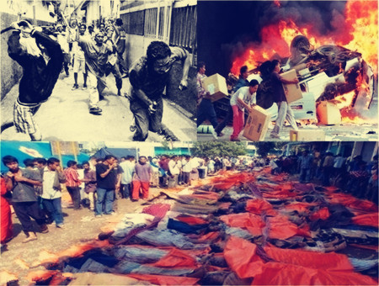
从经济危机到社会危机
大规模失业，通货膨胀，居民和学生游行示威。
苏哈托的支持者将危机嫁祸于印尼华侨，1998年5月发生针对华裔的骚乱、屠杀和强奸。

Slide 45
韩国危机的背景
金融自由化改革
  国内企业需求（随着在国际市场的评级上升，希望能直接在国际市场融资）
  美国压力（1992年美韩双边会谈）
  申请加入OECD。
韩国的外债并不高
  debt/GNP ratio 22% in 1996
  debt service ratio 5.8% in 1996
债务期限较短
  短期债务融资的主力：新成立的商业银行（监管松弛）。
  长期债务监管相对严格
  预期未来利率下降（信用评级上升）
Notes:
debt service ratio：total debt service to exports of goods and services
The share of short-term debt (which is defined as debt with less than a year’s maturity) in total debt rose from an already high 43.7% in 1993 to an astonishing 58.3% at the end of 1996
Leading this rapid build-up of short-term foreign debt were the inexperienced merchant banks (officially called ‘merchant banking corporations’), newly licensed by the Kim government in the name of financial liberalization – nine of them in 1994, and fifteen in July1996, in addition to the six that existed before the 1993 financial liberalization programme.

Slide 46
韩元汇率

Slide 47
韩国危机
1997年初，韩宝钢铁丑闻爆发
1997年7月，起亚（Kia）陷入困境，请求紧急救助。
1997年11月和12月，穆迪下调韩国信用等级。
1997年11月，IMF赴韩，最终给出584亿美元救助方案：
  增加汇率弹性
  紧缩货币政策
  削减政府开支
  进一步开放国内金融市场
Notes:
Moody's lowered the credit rating of South Korea from A1 to A3, on 28 November 1997, and downgraded again to B2 on 11 December.

Slide 48
韩国实际GDP增速
亚洲金融危机

Slide 49
港币保卫战
港币基本面良好
  1982-1983货币危机后，香港改革了金融系统，到1997年，已经经历各种考验
    采用联系汇率制度（linked exchange rate, LER）
    加强对银行业和证券市场的监管
    拥有超过400亿美元外汇储备
  经济基本面稳定
  7月1日，顺利回归祖国
1997年10月17日，新台币贬值，港币开始受压。
Notes:
LER 是currency board 的一种。
On Octo-ber 15, 1983, the government unveiled a two-point program. The first
measure, of overriding importance, was the reimposition of the foreign
exchange constraint by requiring note-issuing banks to pay U.S. dollars
to the Exchange Fund to obtain the Certificates of Indebtedness (CIs) as
cover for banknotes issued, at a fixed rate of US$1 = HK$7.8. The other
measure was the abolition of the 10% withholding tax on interest
income from Hong Kong dollar–denominated deposits with financial
institutions, thereby removing the tax advantage from holding foreign
currency–denominated deposits.
顺利回归，巨大不确定性消除
The primary objective of the new monetary regime was the stabilization of the exchange rate.
Milton Friedman, 以及 Obstfeld and Rogoff，都认为香港的联系汇率不会维持。
香港在巴塞尔协定之前引入最低资本充足率（capital adequacy ratio）要求，5%。巴塞尔协定规定8%。
At the end
of 1996, six months before the Asian crisis, the average CAR of the
banking system stood at 17.8%, one of the highest ratios in the world.
Like banking, Hong Kong’s securities markets were at first totally
unregulated.
1986年，4个交易所合并成为Stock Exchange of Hong Kong (SEHK)。
1987股灾后成立Securities and Futures Commission (SFC)，监管证券业。
In the week beginning October 20, many hedge funds (mostly United States–based) and other assorted speculators mounted a massive onslaught on the Hong Kong dollar by selling it short or forward (typically for three or six months).

Slide 50
流动性危机
香港金管局（HKMA）动用外汇储备支持港币，但是造成银行间市场流动性紧张。
  10月23日中午，隔夜HIBOR飙升到280%。
  恒生指数下跌10.4%，香港的“黑色星期四”。
  10月28日，再次下跌13.7%。
汇率保住，但是资产价格暴跌，利率高企，冲击了实体经济。

Slide 51
香港的实际GDP增长率
亚洲金融危机

Slide 52
恒生指数（1996-1999）
黑色星期四
金管局入场

Slide 53
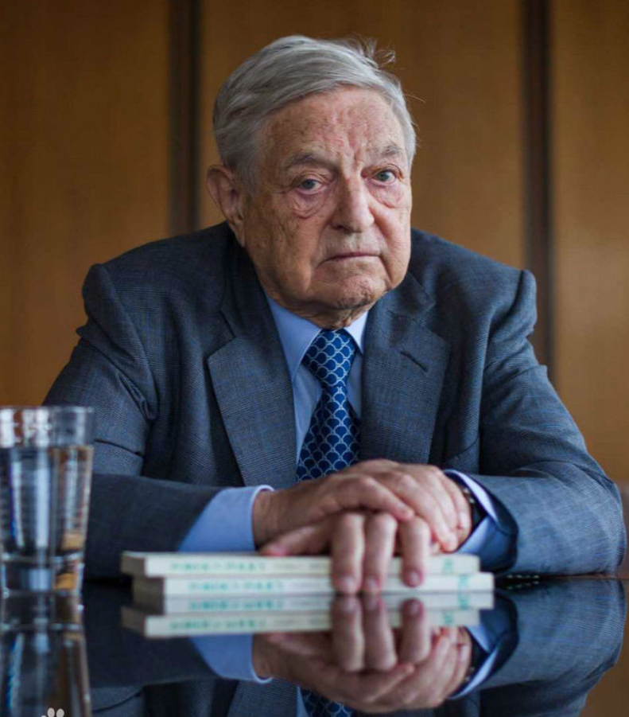
空头的“双市做空”策略
1998年上半年，港内外经济低迷，港币空头卷土重来，同时做空港币和股市。
  要救股市，就要放弃汇率
  要保汇率，股市就要下跌
散布谣言，制造恐慌

Slide 54
港府回击
之前救市措施的局限性
  利率政策的两面性
  出售美元影响港币流动性
1998年8月14日，香港金管局入场买恒生指数成分股。
  将出售美元获得的港币买入股票
1998年9月7日，港府出台30条，加强对股市和期市的监管，限制做空。
Notes:
8月14日的会议包括曾荫权，任志刚，饶余庆（Y. C. Jao）。饶后来写了：The Asian financial crisis and the ordeal of Hong Kong.
Joseph Yam （任志剛）如是说：
We had reason to believe that they (the hedge funds) had been building
and maintaining quite large short positions in stock index futures. With
an estimated 80,000 short contracts held among these hedge funds, for
every thousand-point fall in the stock market index, they stood to profit
HK$4 billion. The cost and benefit calculation is clear. And this is the case
regardless of economic or market fundamentals. So they waited for a good
opportunity to sell the Hong Kong dollars they had borrowed, in the hope
of creating a severe shortage in the money market and sharply higher
interbank interest rates, thereby sending the stock market into a nosedive.
And as if this was not blatant enough, all this occurred in a climate of
malicious rumors about the RMB and the Hong Kong dollar, glorified by
publications and the so-called in-house currency strategies and analysts,
and by the usual “reliable information from authoritative sources.”
"The authorities of Chinese mainland have also expressed unequivocal support for the HK dollar's link to the U.S. dollar," said HKMA chief Joseph Yam in a speech in March. "There is a standing offer for extending help, if help is required, in the use of the mainland's foreign reserves (140 billion U.S. dollars).“

Slide 55
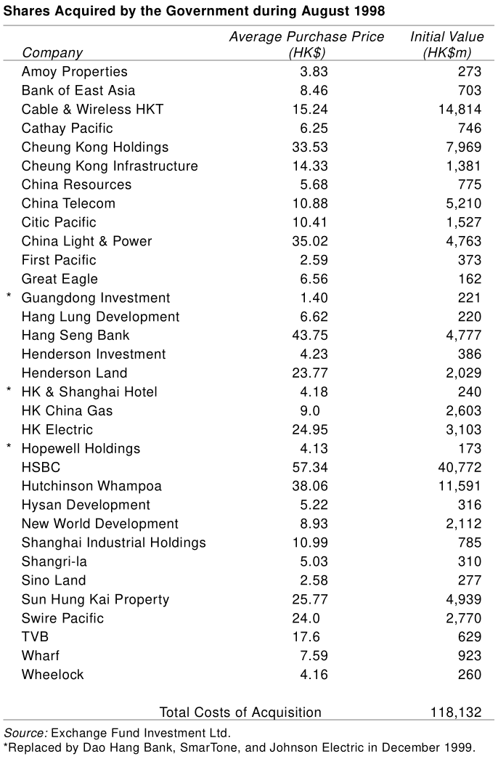
胜果
港府的出击遭到广泛批评，但效果很好。
1999年10月成立“盈富 ETF 基金”，平稳退出，获利达983亿港元。
Notes:
弗里德曼说，香港疯了。格林斯潘也质疑香港政府行为的合理性。
A decade later, Greenspan wrote that the HKSAR had made the right call. Soros himself also admitted in 2001 that the authorities did "a very good job when they intervened to arrest the collapse of the Hong Kong market."

Slide 56
内容
汇率基本概念和理论
金融自由化和资本账户开放
亚洲金融危机始末
危机影响和教训

Slide 57
经济影响
危机导致东南亚以及韩国经济大幅缩水，多年以后美元计价的GDP才回到1996年水平。
除韩国外，东南亚没能延续80年代到1996年的高增长。

Slide 58
美元计价的人均GDP（1996-2019）

Slide 59
政策影响
对IMF失去信心，积累外汇储备以“自我保险”。
  美国储蓄“堰塞湖”（savings glut）
“华盛顿共识”走下神坛，发展中国家重新审视发展政策。
民间反对全球化的声音高涨。

Slide 60
对发展中国家的教训
金融自由化要循序渐进
资金分配不能只靠市场
  资本流入不管不行
汇率要有一定弹性
金融监管要有独立性，要从严

