Slide 1
Economic Fluctuation
Junhui Qian

Slide 2
Content
Overview
The IS-LM Models
The AD-AS Model
Keynes Theory
Concluding Remarks

Slide 3
Business Cycle
The business cycle refers to the cyclical fluctuation of economic activities.
Most often, it is understood as the cyclical movement of output (real GDP) around the long-term trend of output potential.

Slide 4






Stylized Business Cycles
Peak
Output
Peak
$${\overline{Y}}_{t}$$
$$Y_{t}−{\overline{Y}}_{t}$$
$$Y_{t}$$
Trough
Growth
$$t$$
$$\frac{ΔY_{t}}{Y_{t}}$$
0
$$t$$

Slide 5
Macroeconomic Fluctuations: China

Slide 6
Macroeconomic Fluctuations: China

Slide 7
Macroeconomic Fluctuations: China

Slide 8
Macroeconomic Fluctuations: China
Notes:
非农业就业=第二产业就业人数+第三产业就业人数。1990年数据有异常（同年“经济活动人口增加1亿人左右”），因此该年非农就业增长率用1989年值。

Slide 9
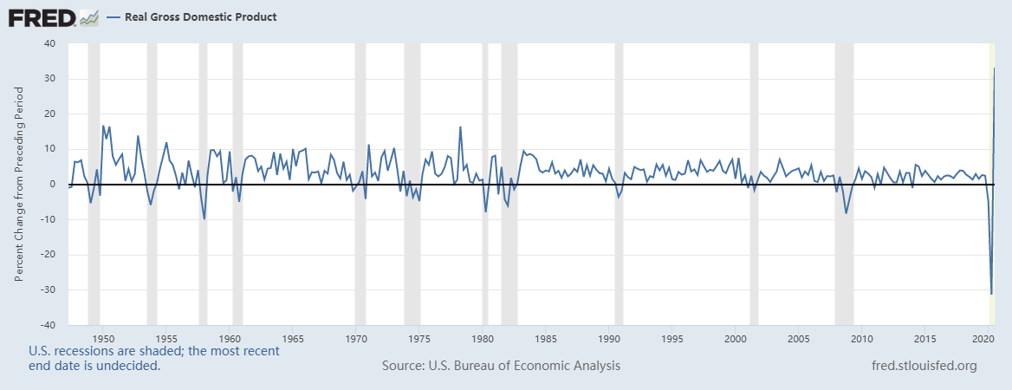
Macroeconomic Fluctuations: US
Quarterly RGDP Growth (Seasonal Adjusted Annual Rate (SAAR))

Slide 10
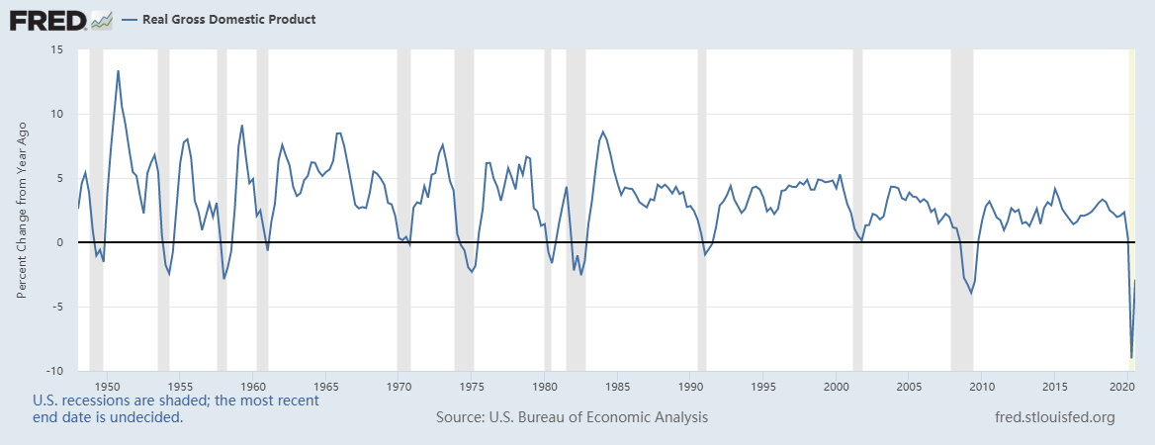
Macroeconomic Fluctuations: US
Quarterly YoY RGDP Growth

Slide 11
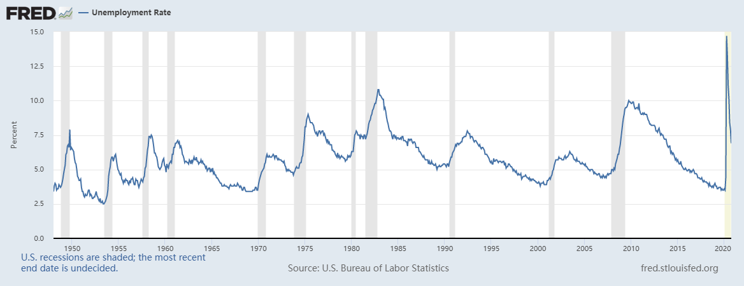
Macroeconomic Fluctuations: US

Slide 12
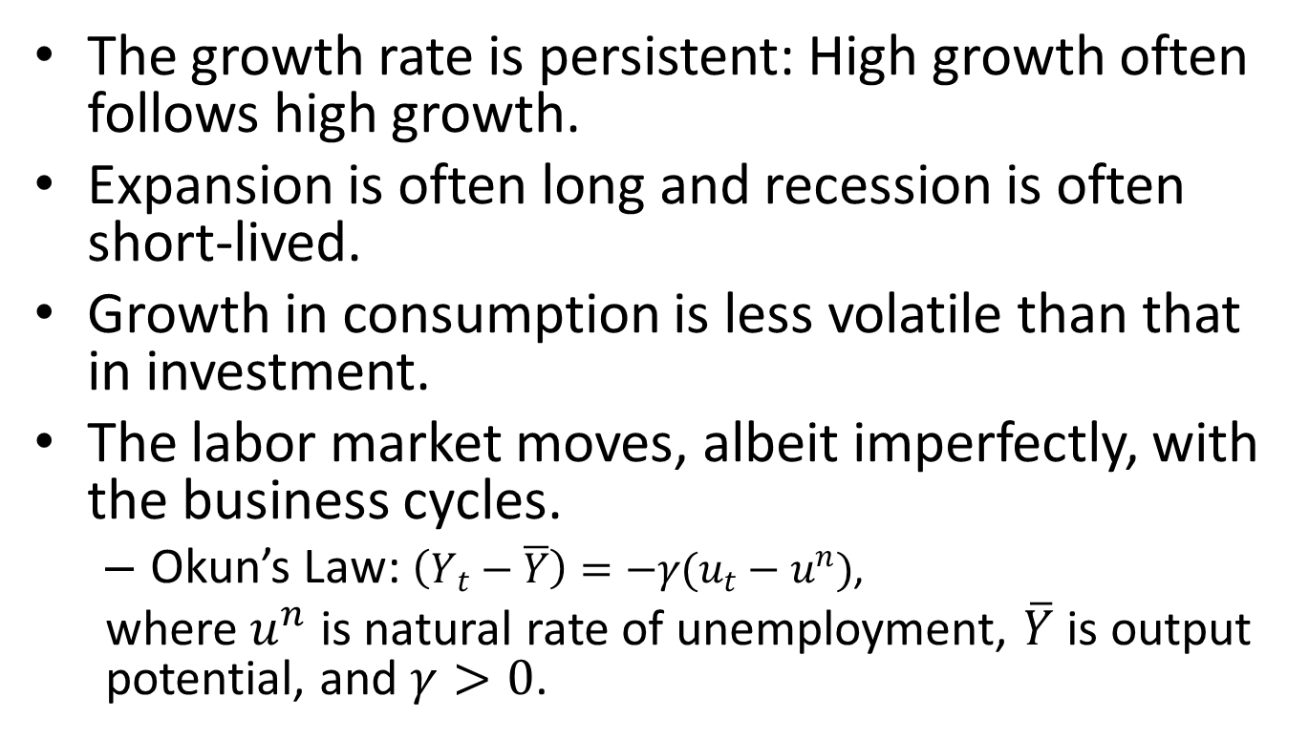
Some Facts About Business Cycle
The growth rate is persistent: High growth often follows high growth.
Expansion is often long and recession is often short-lived.
Growth in consumption is less volatile than that in investment.
The labor market moves, albeit imperfectly, with the business cycles.
  Okun’s Law: $\left(Y_{t}−\overline{Y}\right)=−γ(u_{t}−u^{n})$,
  where $u^{n}$ is natural rate of unemployment, $\overline{Y}$ is output potential, and $γ>0$.

Slide 13
Identifying Recessions
In the United States, the official arbiter of when recessions begin and end is the NBER (National Bureau of Economic Research), a nonprofit economic research group.
The old rule of thumb: a recession is a period of at least two consecutive quarters of declining real GDP.
However, the NBER does not follow any fixed rule but use discretion in identifying recessions.

Slide 14
Forecasting Business Cycles
Economists rely on empirical models and leading indicators to forecast business cycles.
Most often, forecasts differ because economists use different models and different indicators.
A well-known leading indicator is the Conference Board Leading Economic Index, which compiles 10 time series (themselves leading indicators) into an index for various regions in the world.
  Average workweek of production workers in manufacturing.
  Average initial weekly claims for unemployment insurance.
  New orders for consumer goods and materials, adjusted for inflation.
  New orders for nondefense capital goods.
  Index of supplier deliveries.
  New building permits issued.
  Index of stock prices.
  Money supply (M2), adjusted for inflation.
  Interest rate spread: the yield spread between 10-year Treasury notes and 3-month Treasury bills.
  Index of consumer expectations.

Slide 15
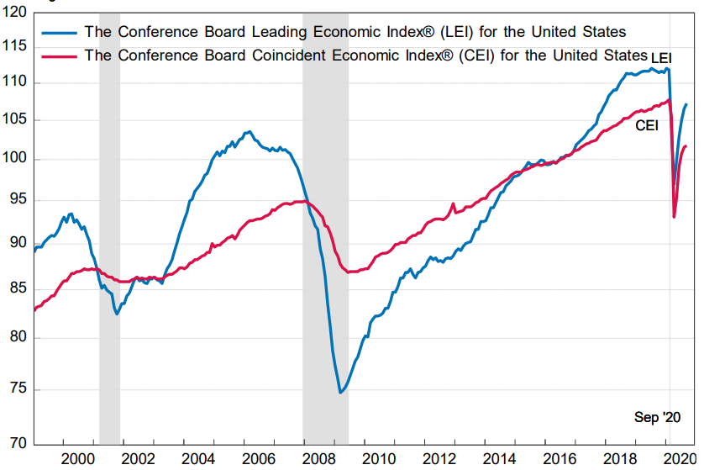
The Conference Board Leading Economic Index

Slide 16
Content
Overview
The IS-LM Models
  The Keynesian Cross
  The Sticky-Price Assumption
  The IS-LM Model
  Open Economy
The AD-AS Model
Keynes Theory
Concluding Remarks

Slide 17
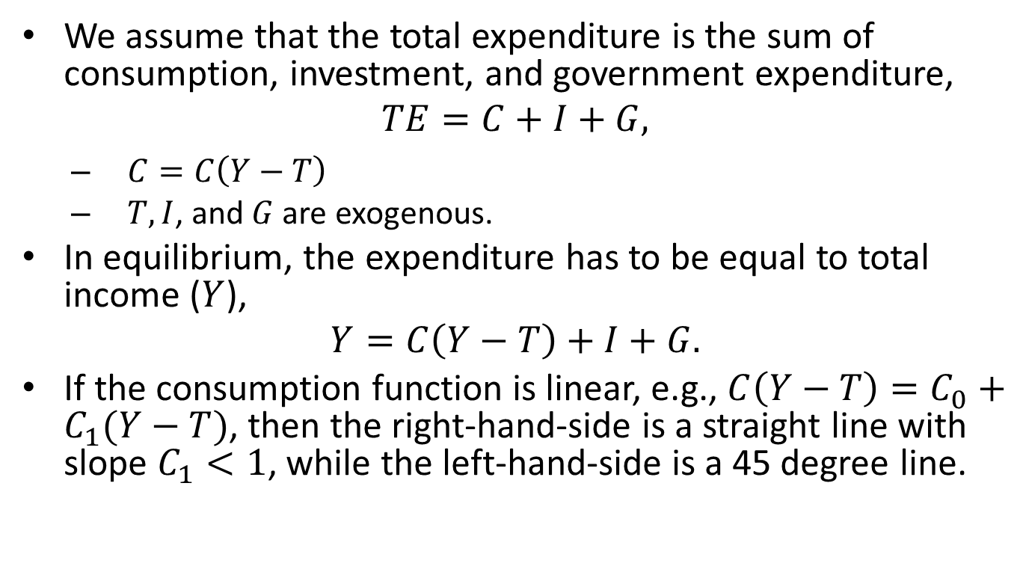
The Keynesian Cross Model
We assume that the total expenditure is the sum of consumption, investment, and government expenditure,
$$TE=C+I+G,$$
  $C=C\left(Y−T\right)$
  $T,I$, and $G$ are exogenous.
In equilibrium, the expenditure has to be equal to total income ($Y$),
$$Y=C\left(Y−T\right)+I+G.$$
If the consumption function is linear, e.g., $C\left(Y−T\right)=C_{0}+C_{1}(Y−T)$, then the right-hand-side is a straight line with slope $C_{1}<1$, while the left-hand-side is a 45 degree line.

Slide 18






The Keynesian Cross
Expenditure
$$Y$$
$$TE=C+I+G$$
${45}^{°}$
$$Y′$$
$$\overline{Y}$$
$$Y$$

Slide 19
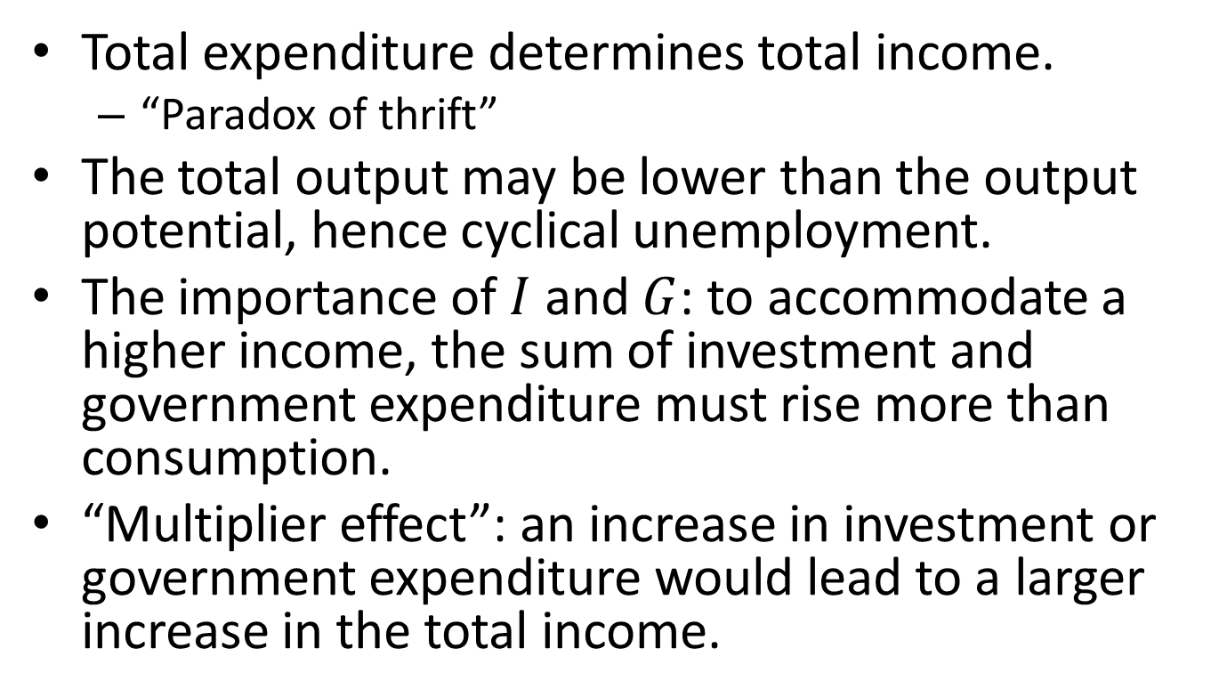
Insights from the Keynesian Cross Equation
Total expenditure determines total income.
  “Paradox of thrift”
The total output may be lower than the output potential, hence cyclical unemployment.
The importance of $I$ and $G$: to accommodate a higher income, the sum of investment and government expenditure must rise more than consumption.
“Multiplier effect”: an increase in investment or government expenditure would lead to a larger increase in the total income.

Slide 20
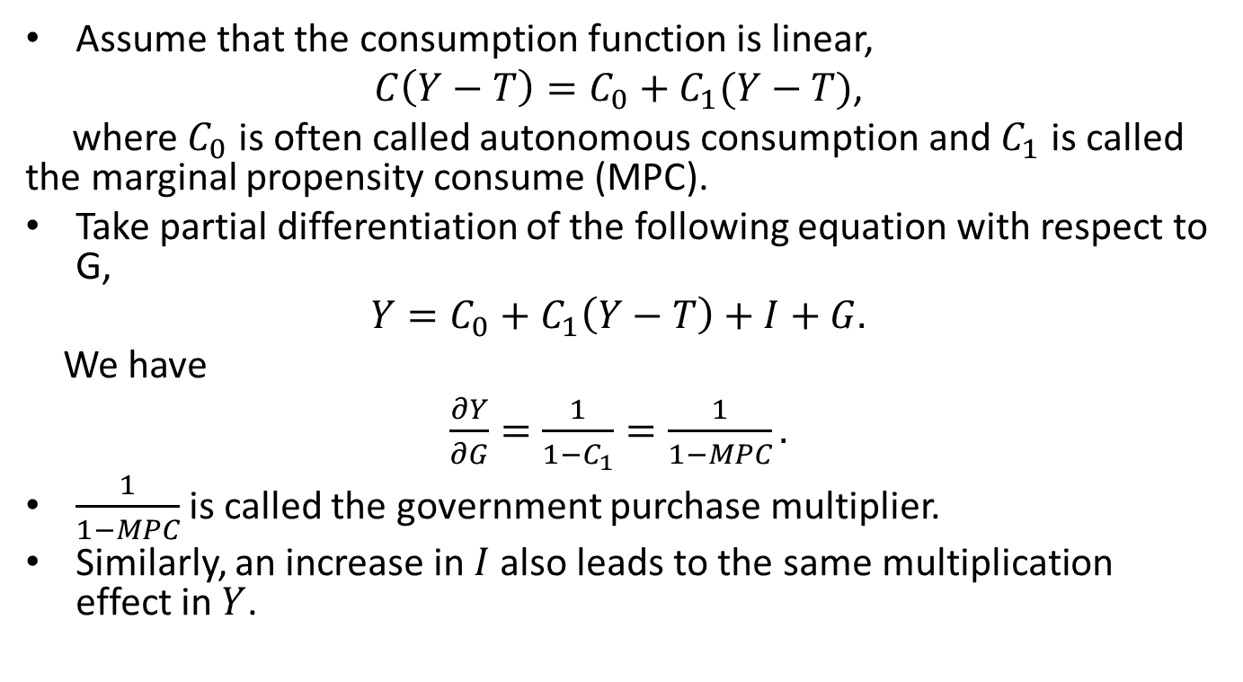
The Government Purchase Multiplier
Assume that the consumption function is linear,
$C\left(Y−T\right)=C_{0}+C_{1}(Y−T)$,
where $C_{0}$ is often called autonomous consumption and $C_{1}$ is called the marginal propensity consume (MPC).
Take partial differentiation of the following equation with respect to G,
$Y={C_{0}+C}_{1}\left(Y−T\right)+I+G.$
We have
$\frac{∂Y}{∂G}=\frac{1}{1−C_{1}}=\frac{1}{1−MPC}.$
$\frac{1}{1−MPC}$ is called the government purchase multiplier.
Similarly, an increase in $I$ also leads to the same multiplication effect in $Y$.

Slide 21




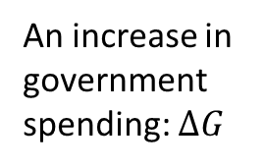



The Effect of Fiscal Stimulus
Expenditure
$$Y$$
$$TE′$$
$$TE$$
An increase in government spending: $ΔG$
Increase in income/out
${45}^{°}$
$$Y′$$
$$Y′′$$
$$Y$$

Slide 22

The Tax Multiplier
Similarly, we obtain
$\frac{∂Y}{∂T}=−\frac{C_{1}}{1−C_{1}}=−\frac{MPC}{1−MPC}.$
$−\frac{MPC}{1−MPC}$ is called the tax multiplier.

Slide 23
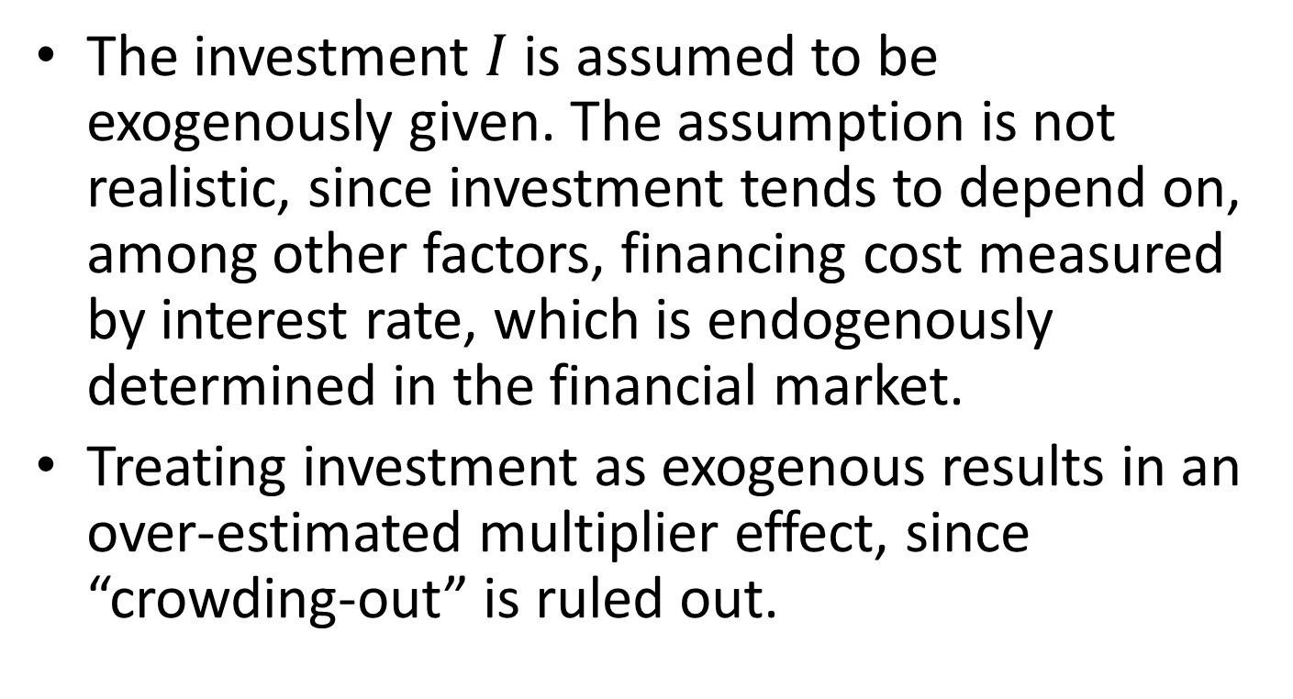
The Limitation of Keynesian Cross
The investment $I$ is assumed to be exogenously given. The assumption is not realistic, since investment tends to depend on, among other factors, financing cost measured by interest rate, which is endogenously determined in the financial market.
Treating investment as exogenous results in an over-estimated multiplier effect, since “crowding-out” is ruled out.

Slide 24
Content
Overview
The IS-LM Models
  The Keynesian Cross
  The Sticky-Price Assumption
  The IS-LM Model
  Open Economy
The AD-AS Model
Keynes Theory
Concluding Remarks

Slide 25
The Sticky-Price Assumption
The assumption says that prices are fixed in the short run.
The sticky-price assumption is crucial in the Keynesian models.
  The price level can be treated as exogenous.
  Markets do not automatically clear.
  Classical dichotomy breaks down.
Notes:
When a negative shock occurs to the aggregate demand, prices would fail to fully adjust, with a consequence that the supply side cannot operate at its full potential.

Slide 26
Time Horizons in Macroeconomics
Long-run: Prices are flexible.
Short-run or medium-run: Prices are “sticky”.
  Short-run: prices are fixed.
  Medium-run: prices may change, but not flexibly.
Under classical assumptions, output is determined by the supply side and changes in the demand side affects only prices. In other words, flexible prices move to accommodate the supply side.
When prices are sticky, output and employment also depend on the demand.

Slide 27
Theories of Price Stickiness
Coordination failure: 60.6% (percentage of managers who accept)
  Firms hold back on price changes, waiting for others to go first
Cost-based pricing with lags: 55.5%
  Price increases are delayed until costs rise
Delivery lags, service, etc.: 54.8%
  Firms prefer to vary other product attributes, such as delivery lags, service, or product quality
Implicit contracts: 50.4%
  Firms tacitly agree to stabilize prices, perhaps out of “fairness” to customers
Source: A.S. Blinder, 1994, “On sticky prices: academic theories meet the real world”, in N.G. Mankiw, ed., Monetary Policy, University of Chicago Press, 117-154.

Slide 28
Content
Overview
The IS-LM Models
  The Keynesian Cross
  The Sticky-Price Assumption
  The IS-LM Model
  Open Economy
The AD-AS Model
Keynes Theory
Concluding Remarks

Slide 29
Overview of IS-LM
IS stands for “investment” and “saving”.
LM stands for “liquidity” and “money”.
The IS-LM model consists two equations that describe the financial market (IS, or equivalently the market for goods and services) and the money market (LM).
The IS-LM model is the leading interpretation of John Maynard Keynes’s theory, which was developed in the depth of the Great Depression.

Slide 30
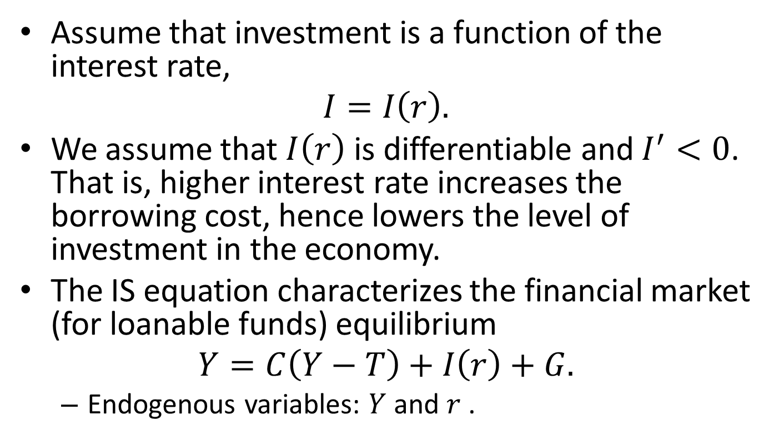
The IS Equation
Assume that investment is a function of the interest rate,
$$I=I\left(r\right).$$
We assume that $I\left(r\right)$ is differentiable and $I^{′}<0$. That is, higher interest rate increases the borrowing cost, hence lowers the level of investment in the economy.
The IS equation characterizes the financial market (for loanable funds) equilibrium
$$Y=C\left(Y−T\right)+I\left(r\right)+G.$$
  Endogenous variables: $Y$ and $r$ .

Slide 31

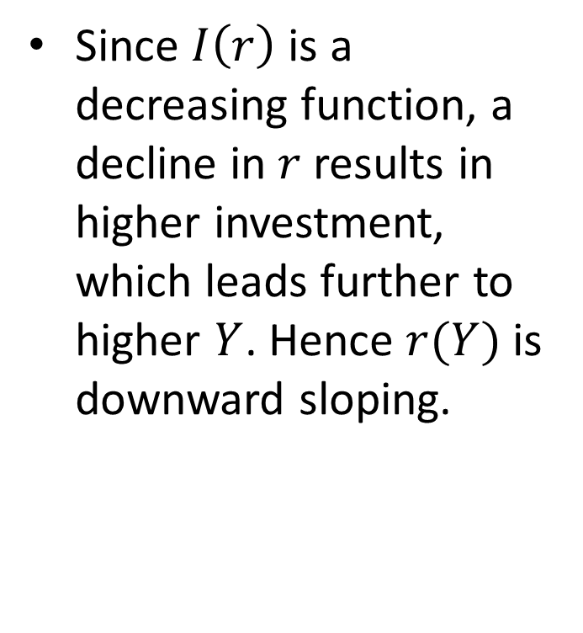

The IS Curve
Since $I\left(r\right)$ is a decreasing function, a decline in $r$ results in higher investment, which leads further to higher $Y$. Hence $r(Y)$ is downward sloping.
$$r$$
IS
$$Y$$

Slide 32
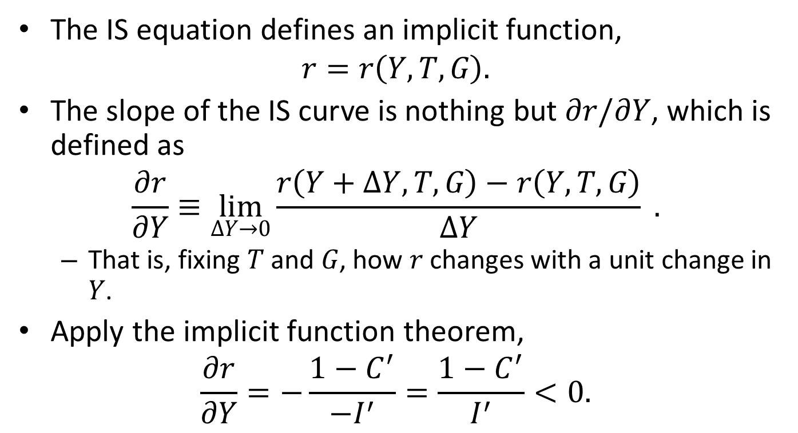
The IS Curve
The IS equation defines an implicit function,
$$r=r\left(Y,T,G\right).$$
The slope of the IS curve is nothing but $∂r/∂Y$, which is defined as
$$\frac{∂r}{∂Y}≡\lim_{ΔY→0}{\frac{r\left(Y+ΔY,T,G\right)−r\left(Y,T,G\right)}{ΔY}} .$$
  That is, fixing $T$ and $G$, how $r$ changes with a unit change in $Y$.
Apply the implicit function theorem,
$$\frac{∂r}{∂Y}=−\frac{1−C^{′}}{−I^{′}}=\frac{1−C^{′}}{I^{′}}<0.$$

Slide 33

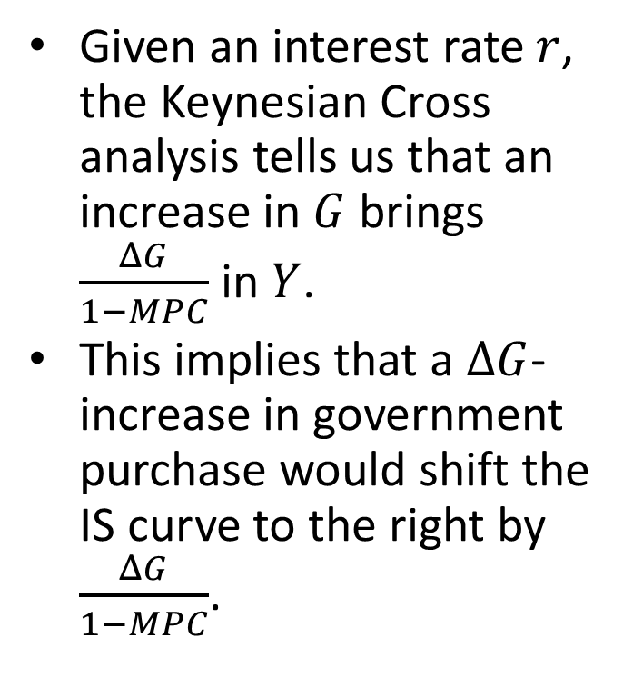


The Effect of Fiscal Policy
Given an interest rate $r$, the Keynesian Cross analysis tells us that an increase in $G$ brings $\frac{ΔG}{1−MPC}$ in $Y$.
This implies that a $ΔG$-increase in government purchase would shift the IS curve to the right by $\frac{ΔG}{1−MPC}$.
$$Y$$
$$r$$
IS’’
IS’
$$Y$$

Slide 34














The effect of an increase in government spending
$$r$$
$$\left(Y_{1},r_{1}\right)$$
$$\left(Y_{1}+\frac{ΔG}{1−MPC},r_{1}\right)$$
$$r_{1}$$
$$r_{2}$$
$$\left(Y_{2},r_{2}\right)$$
$$\left(Y_{2}+\frac{ΔG}{1−MPC},r_{2}\right)$$
$$r_{3}$$
$$\left(Y_{3},r_{3}\right)$$
$$\left(Y_{3}+\frac{ΔG}{1−MPC},r_{3}\right)$$
$$\left(Y_{4}+\frac{ΔG}{1−MPC},r_{4}\right)$$
$$r_{4}$$
$$\left(Y_{4},r_{4}\right)$$
IS
$$Y$$

Slide 35
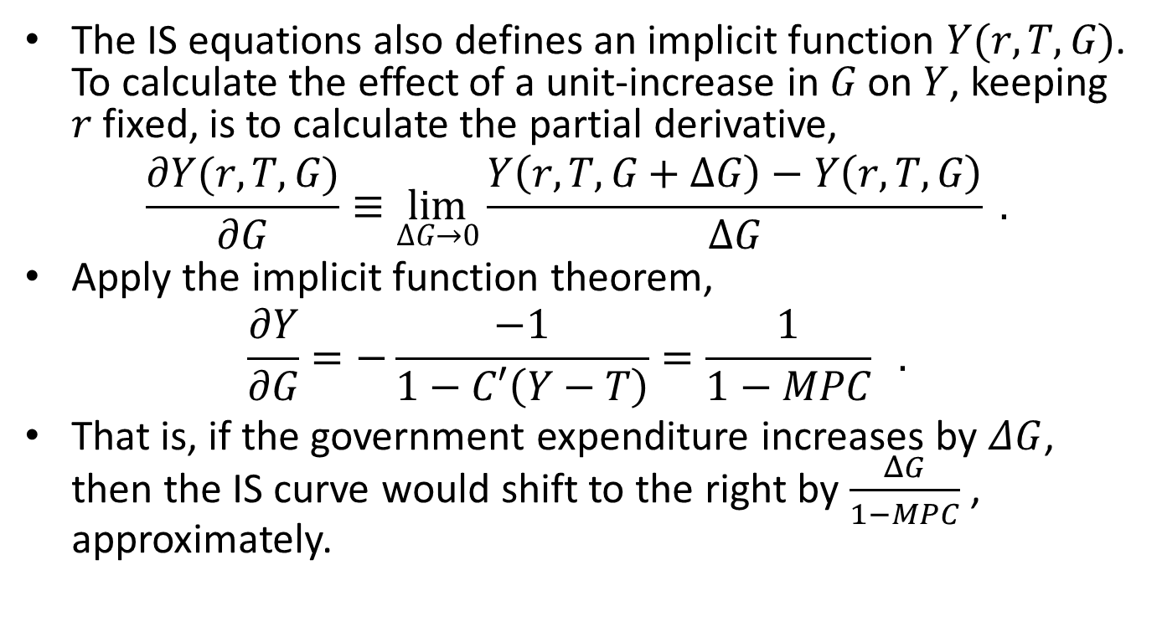
The effect of an increase in government spending
The IS equations also defines an implicit function $Y(r,T,G)$. To calculate the effect of a unit-increase in $G$ on $Y$, keeping $r$ fixed, is to calculate the partial derivative,
$$\frac{∂Y(r,T,G)}{∂G}≡\lim_{ΔG→0}{\frac{Y\left(r,T,G+ΔG\right)−Y\left(r,T,G\right)}{ΔG}} .$$
Apply the implicit function theorem,
$$\frac{∂Y}{∂G}=−\frac{−1}{1−C′\left(Y−T\right)}=\frac{1}{1−MPC} .$$
That is, if the government expenditure increases by $ΔG$, then the IS curve would shift to the right by $\frac{ΔG}{1−MPC}$ , approximately.

Slide 36
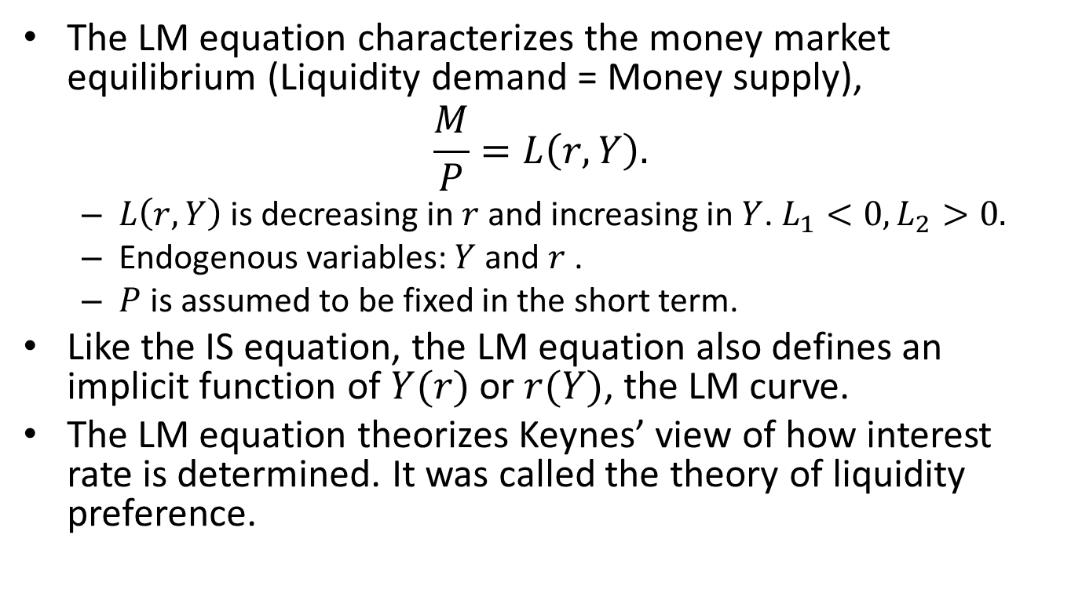
The LM Equation
The LM equation characterizes the money market equilibrium (Liquidity demand = Money supply),
$$\frac{M}{P}=L\left(r,Y\right).$$
  $L\left(r,Y\right)$ is decreasing in $r$ and increasing in $Y$. $L_{1}<0, L_{2}>0.$
  Endogenous variables: $Y$ and $r$ .
  $P$ is assumed to be fixed in the short term.
Like the IS equation, the LM equation also defines an implicit function of $Y(r)$or $r(Y)$, the LM curve.
The LM equation theorizes Keynes’ view of how interest rate is determined. It was called the theory of liquidity preference.

Slide 37
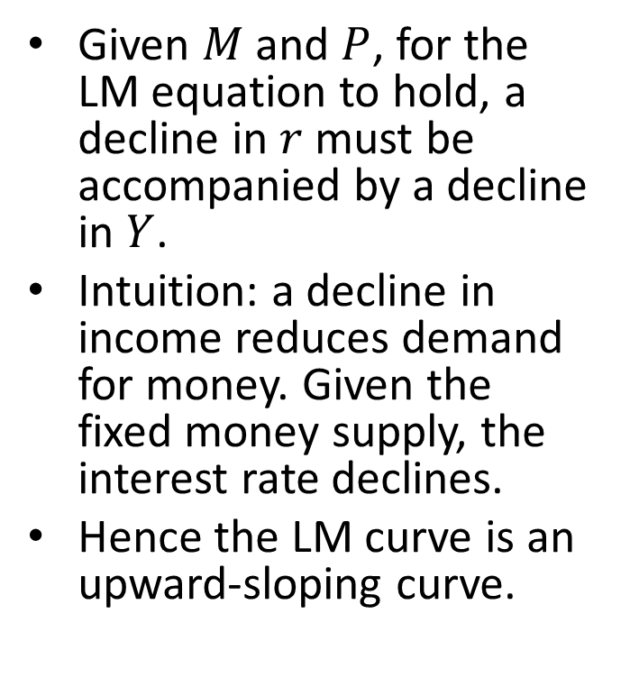

The LM Curve
Given $M$ and $P$, for the LM equation to hold, a decline in $r$ must be accompanied by a decline in $Y$.
Intuition: a decline in income reduces demand for money. Given the fixed money supply, the interest rate declines.
Hence the LM curve is an upward-sloping curve.
$$r$$
LM
$$Y$$

Slide 38
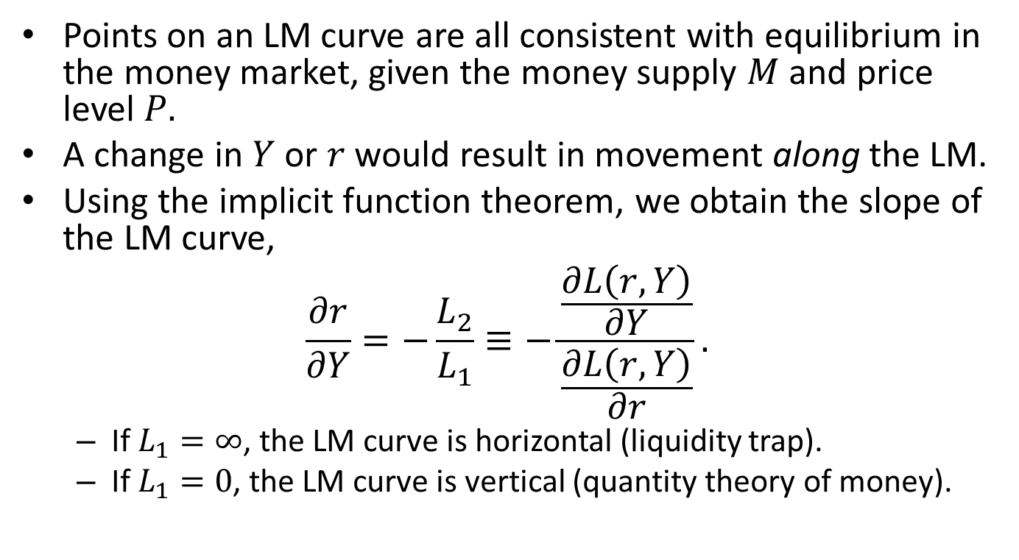
Moving Along The LM Curve
Points on an LM curve are all consistent with equilibrium in the money market, given the money supply $M$and price level $P.$
A change in $Y$ or $r$ would result in movement along the LM.
Using the implicit function theorem, we obtain the slope of the LM curve,
$$\frac{∂r}{∂Y}=−\frac{L_{2}}{L_{1}}≡−\frac{\frac{∂L\left(r,Y\right)}{∂Y}}{\frac{∂L\left(r,Y\right)}{∂r}}.$$
  If $L_{1}=∞$, the LM curve is horizontal (liquidity trap).
  If $L_{1}=0$, the LM curve is vertical (quantity theory of money).

Slide 39
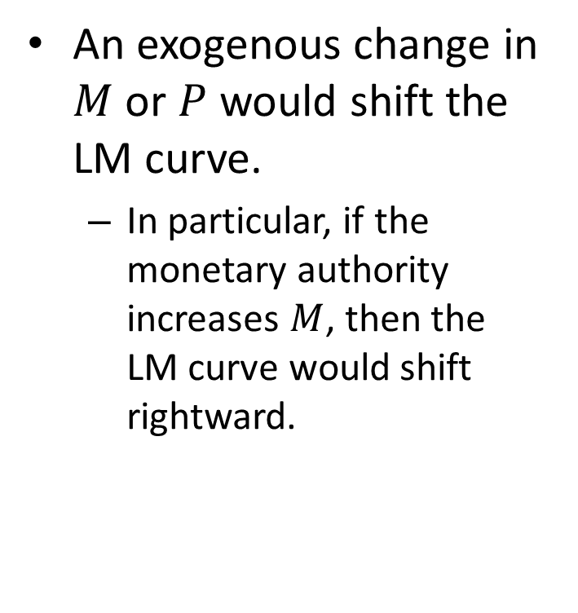
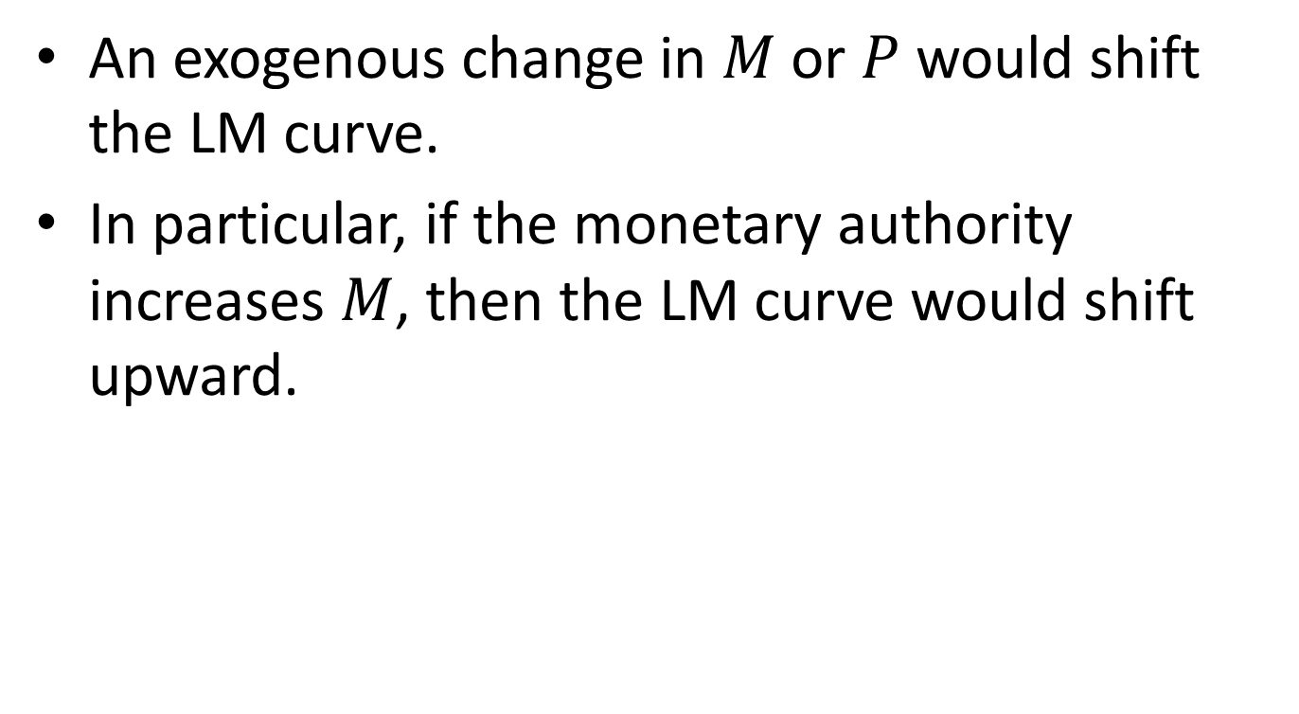
How Monetary Policy Shifts the LM Curve
An exogenous change in $M$ or $P$ would shift the LM curve.
  In particular, if the monetary authority increases $M$, then the LM curve would shift rightward.
$$r$$
LM’
Monetary expansion
LM’’
$$Y$$

Slide 40
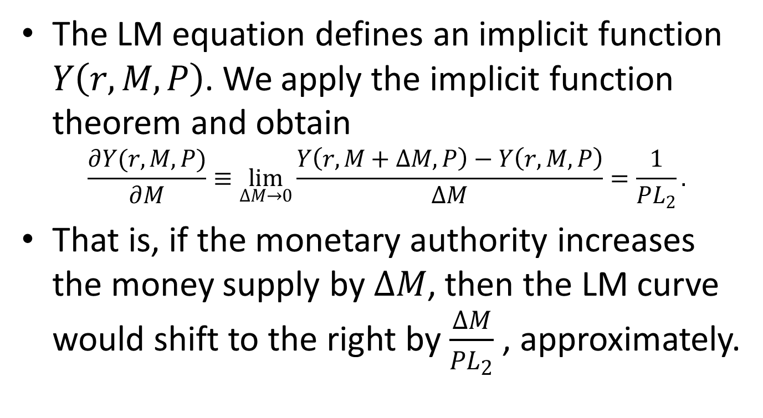
How Monetary Policy Shifts the LM Curve
The LM equation defines an implicit function $Y\left(r,M,P\right)$. We apply the implicit function theorem and obtain
$$\frac{∂Y(r,M,P)}{∂M}≡\lim_{ΔM→0}{\frac{Y\left(r,M+ΔM,P\right)−Y\left(r,M,P\right)}{ΔM}}=\frac{1}{PL_{2}}.$$
That is, if the monetary authority increases the money supply by $ΔM$, then the LM curve would shift to the right by $\frac{ΔM}{PL_{2}}$ , approximately.

Slide 41
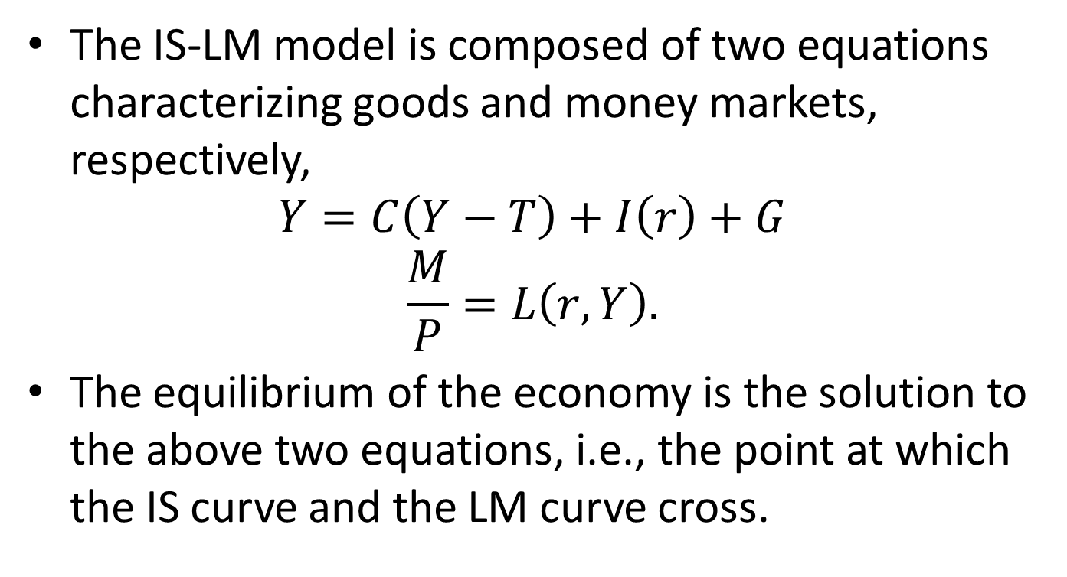
The IS-LM Model
The IS-LM model is composed of two equations characterizing goods and money markets, respectively,
$$Y=C\left(Y−T\right)+I\left(r\right)+G$$
$$\frac{M}{P}=L\left(r,Y\right).$$
The equilibrium of the economy is the solution to the above two equations, i.e., the point at which the IS curve and the LM curve cross.

Slide 42




The IS-LM Curves
Interest rate, $r$
LM
Equilibrium interest rate
$$r′$$
Equilibrium output
IS
$$Y′$$
$$\overline{Y}$$
Output, Y

Slide 43
Virtual Experiments
What if the government conducts fiscal stimulus?
  Increase government spending
  Tax cut
What if the central bank expands money supply?

Slide 44




The Effect of Expansionary Fiscal and Monetary Policies
Fiscal stimulus
$$r$$
LM
IS’’
IS’
$$Y$$
Monetary stimulus
$$r$$
LM’
LM’’
IS
$$Y$$

Slide 45
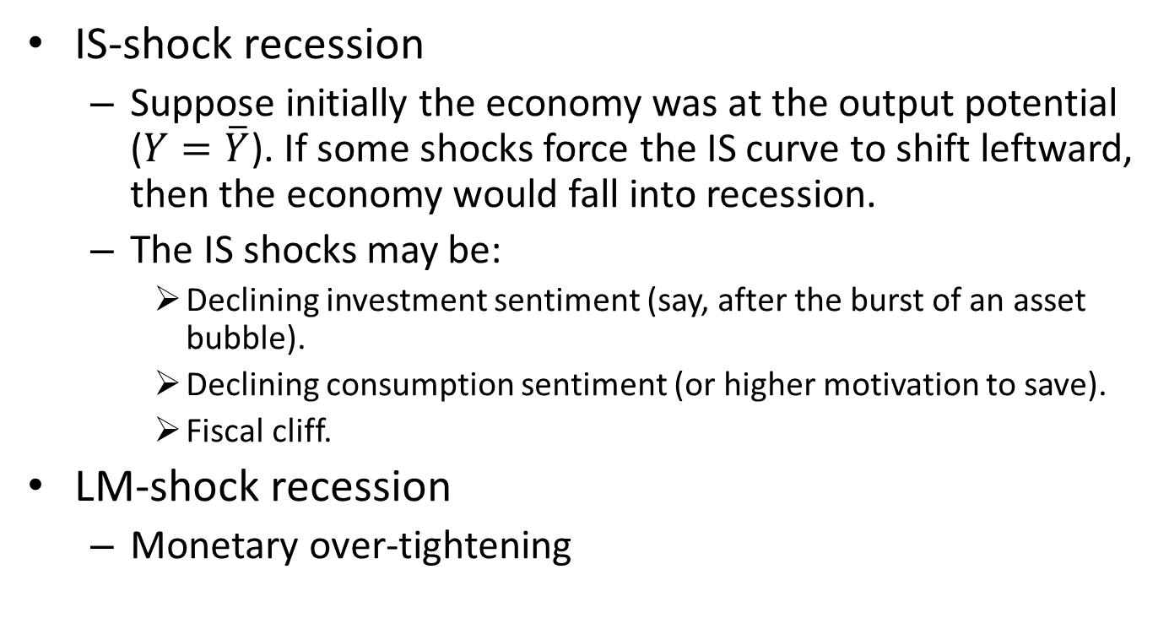
Explain Recessions
IS-shock recession
  Suppose initially the economy was at the output potential ($Y=\overline{Y}$). If some shocks force the IS curve to shift leftward, then the economy would fall into recession.
  The IS shocks may be:
    Declining investment sentiment (say, after the burst of an asset bubble).
    Declining consumption sentiment (or higher motivation to save).
    Fiscal cliff.
LM-shock recession
  Monetary over-tightening

Slide 46




The IS-Shock Recession
$$r$$
LM
$$\overline{Y}$$
IS’
IS’’
$$Y′′$$
$$Y^{′}=\overline{Y}$$
Y

Slide 47
Case Study: the Great Depression (the US case)

Slide 48
Unemployment Rate during the Great Depression

Slide 49
Interest Rate and Inflation

Slide 50
Explanation 1: IS-Shock
The fall of investment and consumption demand after the burst of a giant asset bubble.
  The stock market crash of 1929
  The end of residential investment boom
Second wave of shocks:
  Bank failures in the early 1930s.
  Fiscal tightening to rein in budget deficit.
  Protectionism (e.g., Smoot–Hawley act of 1930).
  Deflation and expectation of deflation.

Slide 51
The Debt-Deflation Theory
Assume that debtors (those who borrow money) have higher propensity to consume than creditors do.
Deflation increases real debt burden, shifting purchasing power from debtors to creditors.
Under our assumption, the reduction of spending by the debtors is more than the increase of spending by the creditors. The net effect is a reduction of spending, shifting the IS curve to the left.

Slide 52
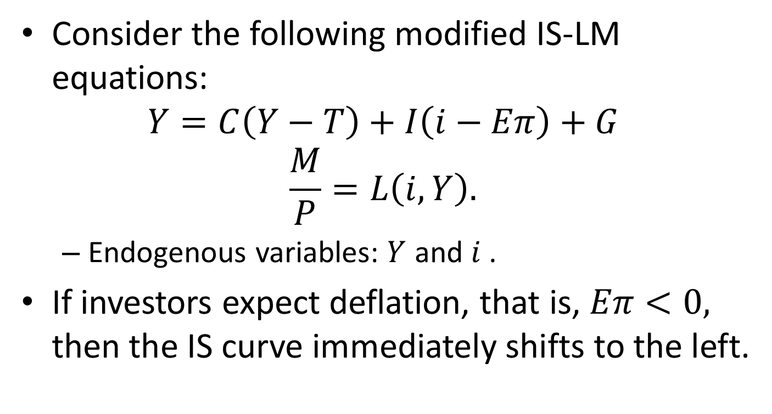
The Role of Expectation
Consider the following modified IS-LM equations:
$$Y=C\left(Y−T\right)+I\left(i−Eπ\right)+G$$
$$\frac{M}{P}=L\left(i,Y\right).$$
  Endogenous variables: $Y$ and $i$ .
If investors expect deflation, that is, $Eπ<0,$ then the IS curve immediately shifts to the left.

Slide 53
Explanation 2: LM-Shock
Friedman and Schwartz in “A Monetary History of the United States, 1867–1960”, argued that the contraction of money supply caused the Depression.
  The real interest rate increased during the Depression.

Slide 54
Policy Responses to Recessions
Policy makers may use fiscal, monetary, and both, to increase aggregate demand.
Fiscal stimulus
  Increase in government purchasing
  Tax reduction
Monetary stimulus
Combination of fiscal and monetary policies

Slide 55
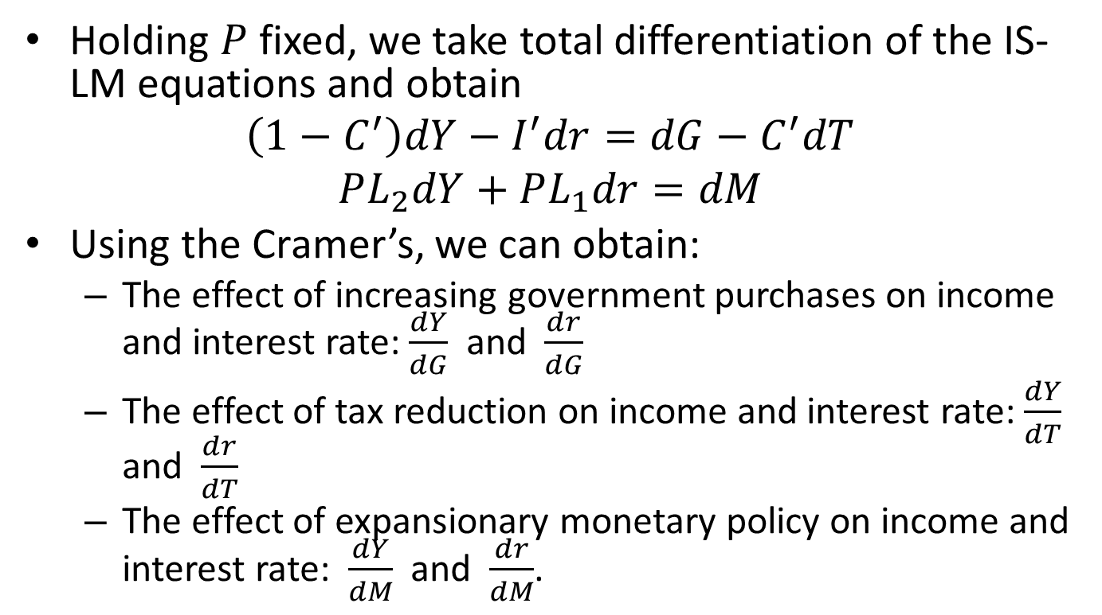
Policy Analysis
Holding $P$ fixed, we take total differentiation of the IS-LM equations and obtain
$$\left(1−C^{′}\right)dY−I^{′}dr=dG−C^{′}dT$$
$$PL_{2}dY+PL_{1}dr=dM$$
Using the Cramer’s, we can obtain:
  The effect of increasing government purchases on income and interest rate: $\frac{dY}{dG}$ and $\frac{dr}{dG}$
  The effect of tax reduction on income and interest rate: $\frac{dY}{dT}$ and $\frac{dr}{dT}$
  The effect of expansionary monetary policy on income and interest rate: $\frac{dY}{dM}$ and $\frac{dr}{dM}$.

Slide 56
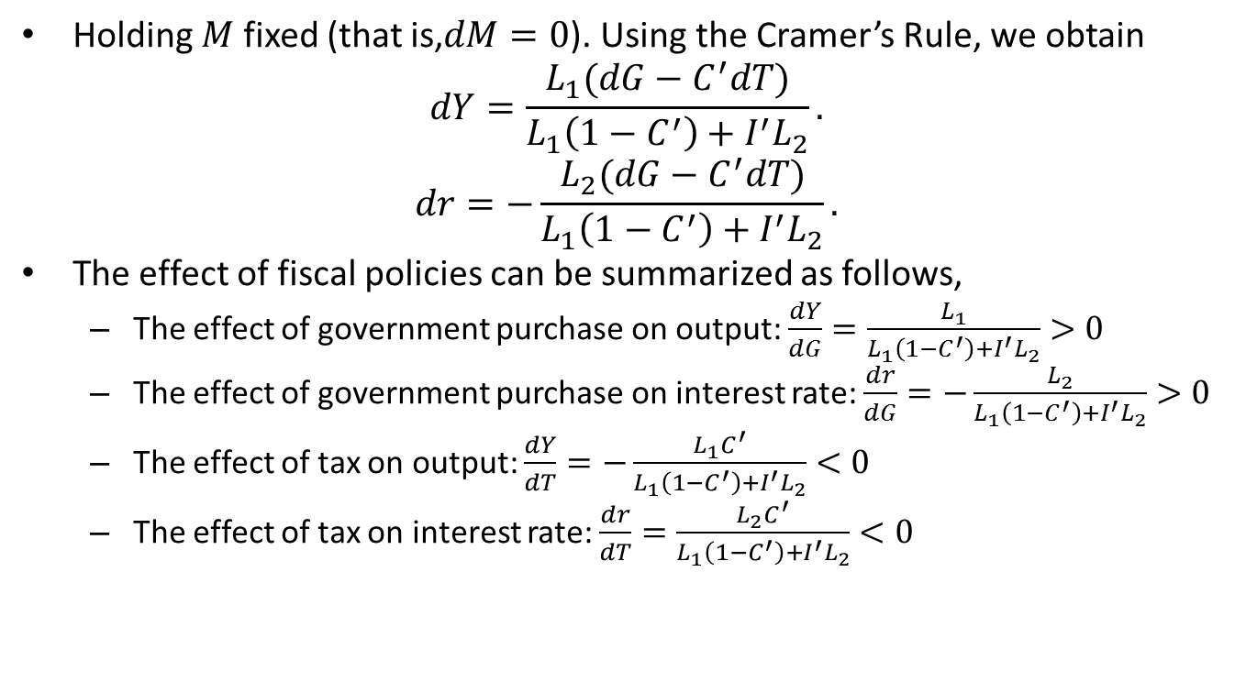
The Effect of Fiscal Policies
Holding $M$ fixed (that is,$dM=0$). Using the Cramer’s Rule, we obtain
$$dY=\frac{L_{1}(dG−C^{′}dT)}{L_{1}\left(1−C^{′}\right)+I^{′}L_{2}}.$$
$$dr=−\frac{L_{2}(dG−C^{′}dT)}{L_{1}\left(1−C^{′}\right)+I^{′}L_{2}}.$$
The effect of fiscal policies can be summarized as follows,
  The effect of government purchase on output: $\frac{dY}{dG}=\frac{L_{1}}{L_{1}\left(1−C^{′}\right)+I^{′}L_{2}}>0$
  The effect of government purchase on interest rate: $\frac{dr}{dG}=−\frac{L_{2}}{L_{1}\left(1−C^{′}\right)+I^{′}L_{2}}>0$
  The effect of tax on output: $\frac{dY}{dT}=−\frac{L_{1}C^{′}}{L_{1}\left(1−C^{′}\right)+I^{′}L_{2}}<0$
  The effect of tax on interest rate: $\frac{dr}{dT}=\frac{L_{2}C^{′}}{L_{1}\left(1−C^{′}\right)+I^{′}L_{2}}<0$

Slide 57
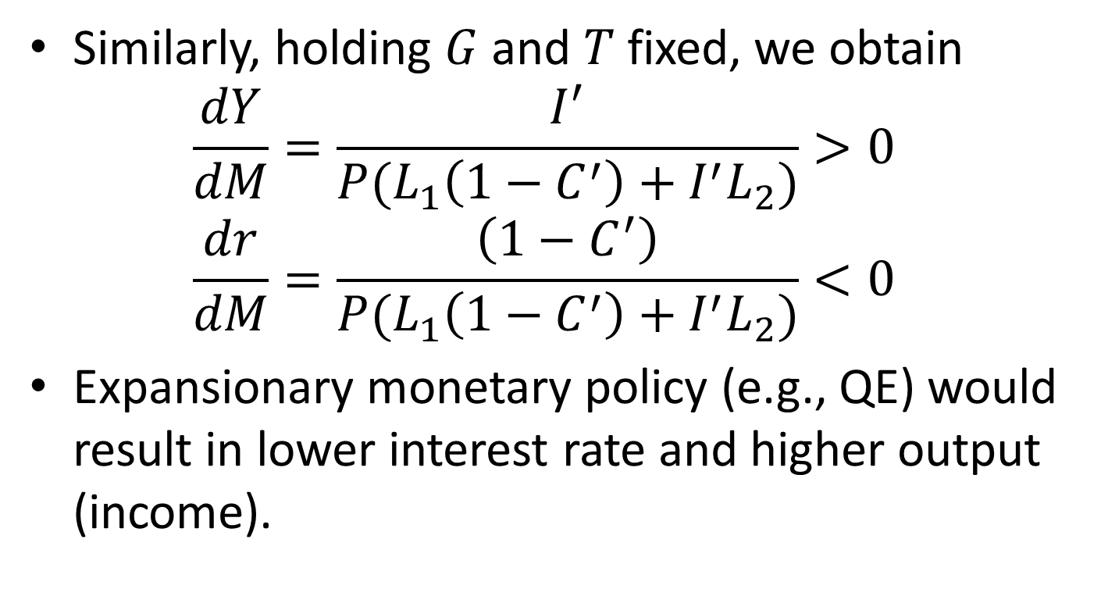
The Effect of Monetary Policies
Similarly, holding $G$ and $T$ fixed, we obtain
$$\frac{dY}{dM}=\frac{I^{′}}{P(L_{1}\left(1−C^{′}\right)+I^{′}L_{2})}>0$$
$$\frac{dr}{dM}=\frac{\left(1−C^{′}\right)}{P(L_{1}\left(1−C^{′}\right)+I^{′}L_{2})}<0$$
Expansionary monetary policy (e.g., QE) would result in lower interest rate and higher output (income).

Slide 58
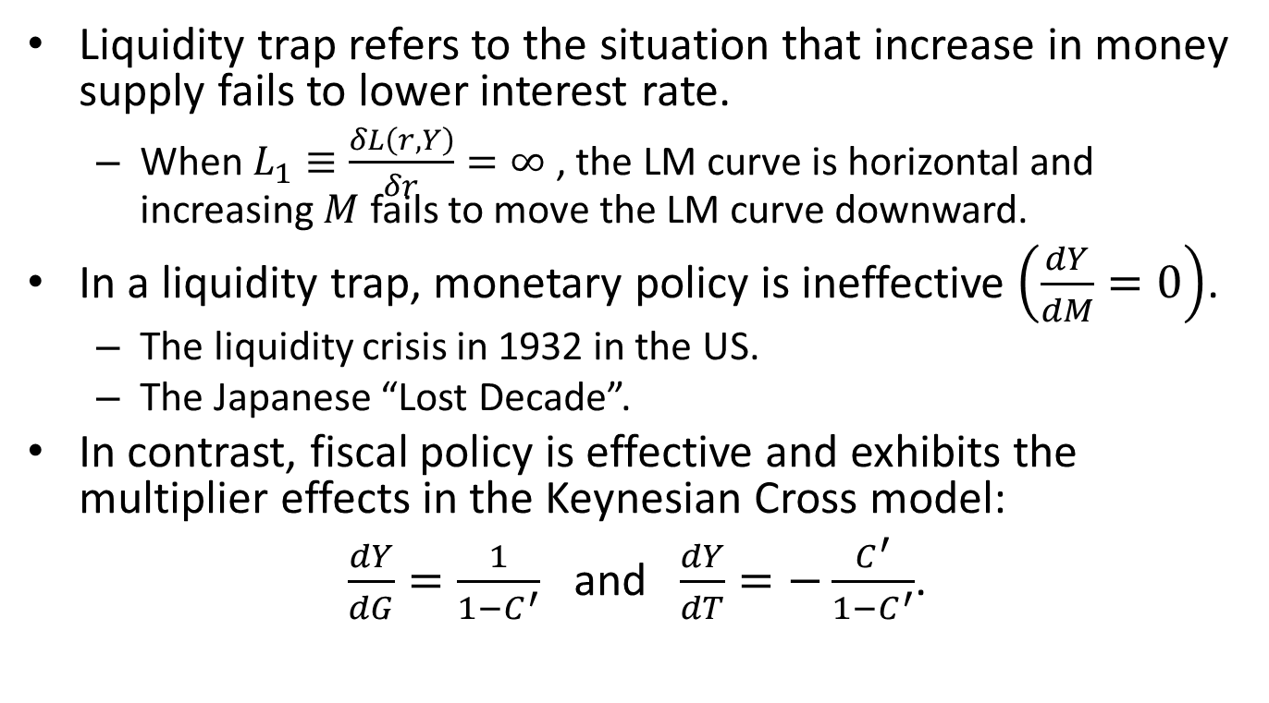
Liquidity Trap
Liquidity trap refers to the situation that increase in money supply fails to lower interest rate.
  When $L_{1}≡\frac{δL\left(r,Y\right)}{δr}=∞$ , the LM curve is horizontal and increasing $M$ fails to move the LM curve downward.
In a liquidity trap, monetary policy is ineffective $\left(\frac{dY}{dM}=0\right)$.
  The liquidity crisis in 1932 in the US.
  The Japanese “Lost Decade”.
In contrast, fiscal policy is effective and exhibits the multiplier effects in the Keynesian Cross model:
$\frac{dY}{dG}=\frac{1}{1−C^{′}}$ and $\frac{dY}{dT}=−\frac{C^{′}}{1−C^{′}}$.

Slide 59
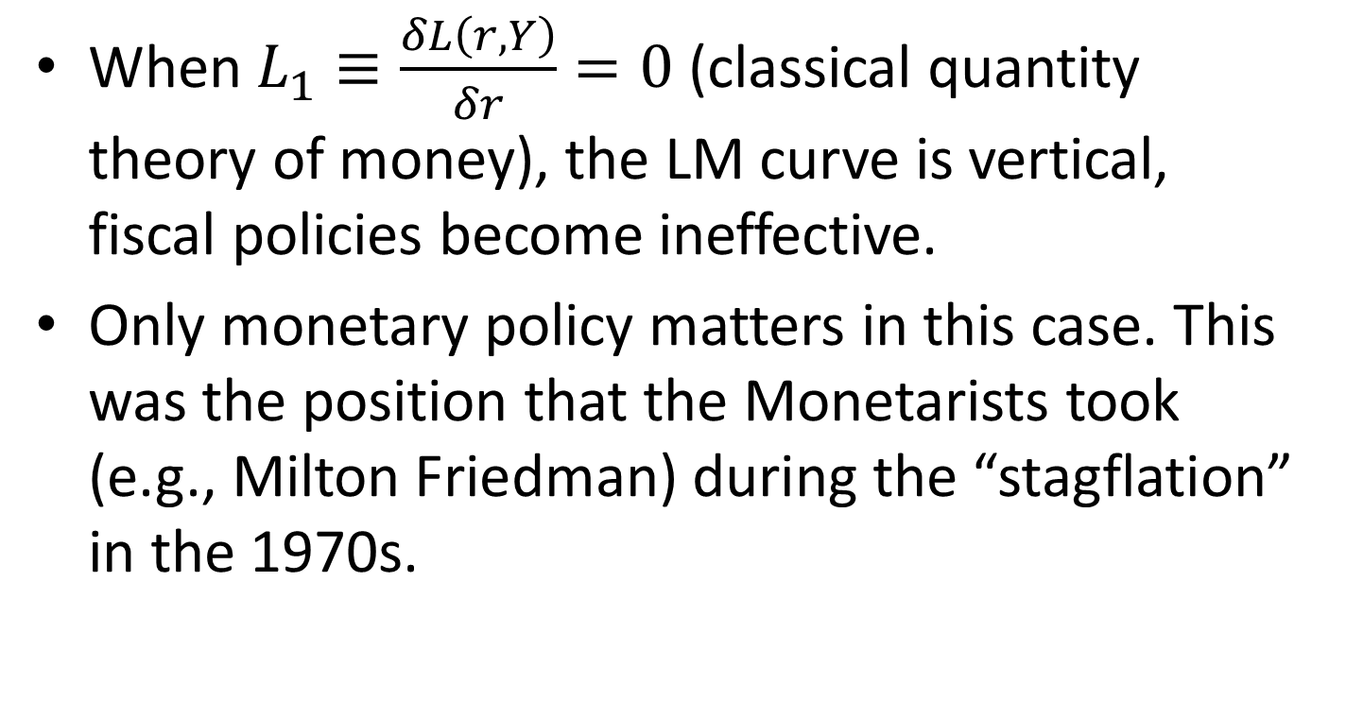
When Fiscal Policy Becomes Ineffective
When $L_{1}≡\frac{δL\left(r,Y\right)}{δr}=0$ (classical quantity theory of money), the LM curve is vertical, fiscal policies become ineffective.
Only monetary policy matters in this case. This was the position that the Monetarists took (e.g., Milton Friedman) during the “stagflation” in the 1970s.

Slide 60
Where Do Economists Stand
Quantity theory of money
r
IS’
Normal case
LM
Liquidity trap
IS
IS’’
Y

Slide 61
The Role of Interest Rate
Interest rate plays an important role in the IS-LM model.
In the normal case,
  Expansionary monetary policy lowers interest rate, which encourages investment.
  Fiscal stimulus drives up interest rate. This discourages investment and partly offsets the direct increase in output (income).
In a liquidity trap,
  Expansionary monetary policy fails to lower interest rate. Hence no effect on output.

Slide 62
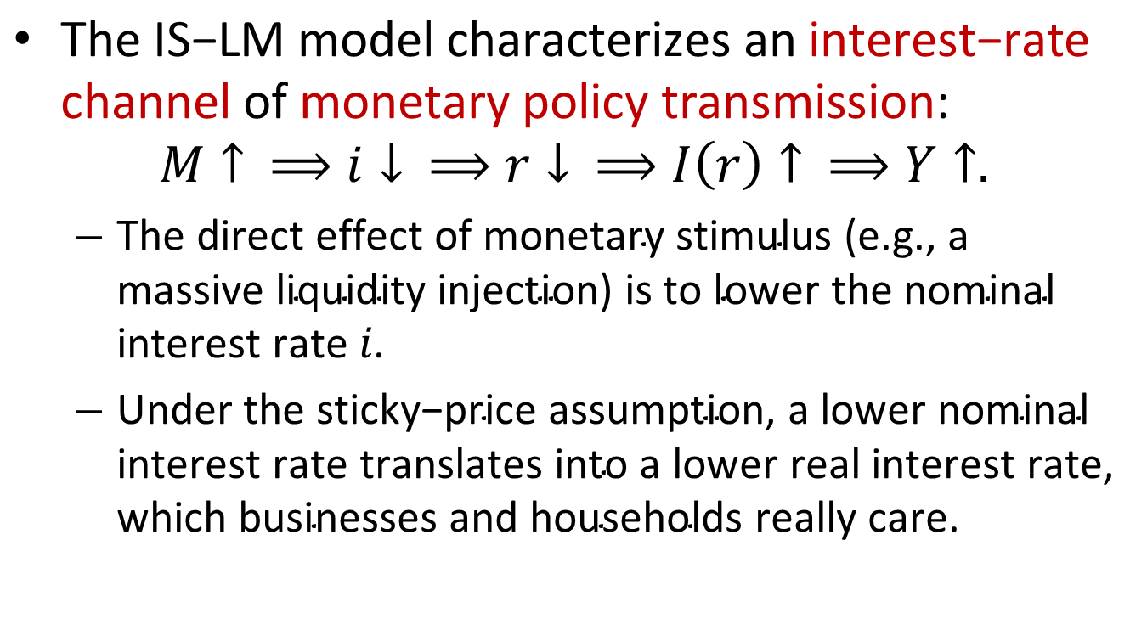
The Interest-Rate Channel of Monetary Policy Transmission
$\text{The} \text{IS}\text{−}\text{LM} \text{model} \text{characterizes} \text{an} \text{interest}\text{−}\text{rate} \text{channel} \text{of} \text{monetary} \text{policy} \text{transmission}\text{:}$
$$M↑ ⟹i↓ ⟹r↓ ⟹I\left(r\right)↑ ⟹Y↑.$$
  $\text{The} \text{direct} \text{effect} \text{of} \text{monetary} \text{stimulus}\text{ (}\text{e}\text{.}\text{g}\text{., }\text{a} \text{massive} \text{liquidity} \text{injection}\text{) }\text{is} \text{to} \text{lower} \text{the} \text{nominal} \text{interest} \text{rate} i\text{. }$
  $\text{U}\text{nder} \text{the} \text{sticky}\text{−}\text{price} \text{assumption}\text{, }\text{a} \text{lower} \text{nominal} \text{interest} \text{rate} \text{translates} \text{into} \text{a} \text{lower} \text{real} \text{interest} \text{rate}\text{, }\text{which} \text{businesses} \text{and} \text{households} \text{really} \text{care}\text{.}$

Slide 63
Interest Rate Policy
Central banks in the real world have a dominant influence on short-term interest rates without targeting any level of money supply.
The monetary authority manipulate one or more monetary instruments to steer short-term money-market interest rate (intermediate target variable) toward a desired level.
  USA: the federal funds rate.
  Euro zone: the overnight market rates.
  China: DR007, LPR

Slide 64
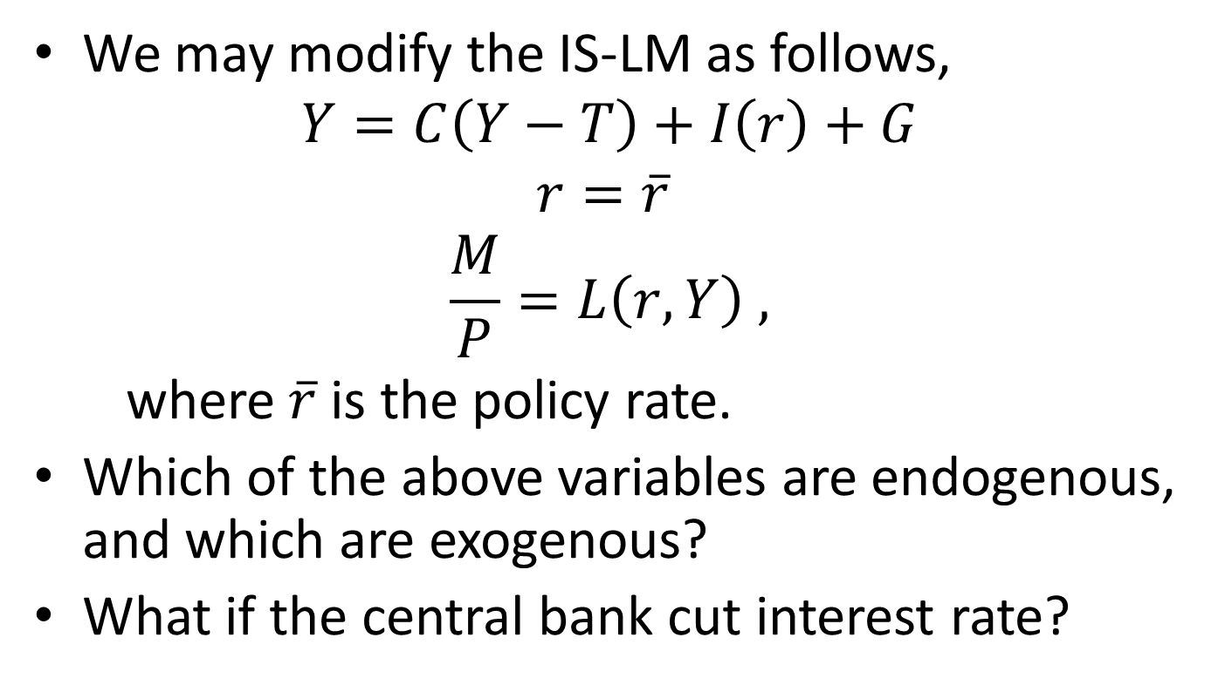
Modeling Interest Rate Policy
We may modify the IS-LM as follows,
$$Y=C\left(Y−T\right)+I\left(r\right)+G$$
$$r=\overline{r}$$
$$\frac{M}{P}=L\left(r,Y\right) ,$$
where $\overline{r}$ is the policy rate.
Which of the above variables are endogenous, and which are exogenous?
What if the central bank cut interest rate?

Slide 65
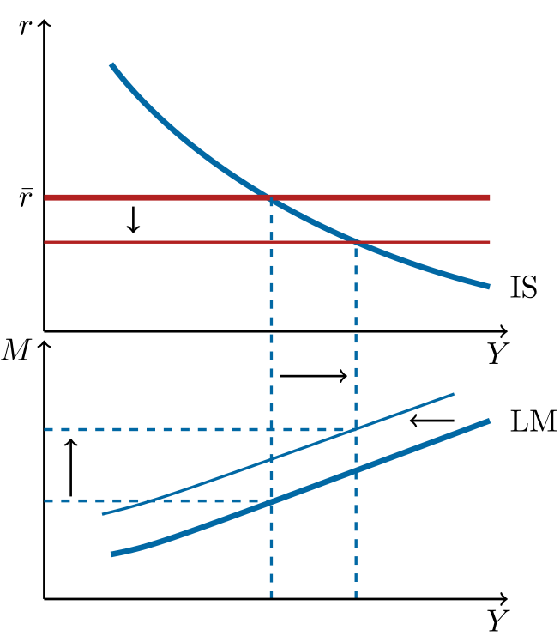
A Rate Cut

Slide 66
Content
Overview
The IS-LM Models
  The Keynesian Cross
  The Sticky-Price Assumption
  The IS-LM Model
  Open Economy
    Overview
    Small open economy with floating exchange rate
    Small open economy with fixed exchange rate
    Large open economy with floating exchange rate
The AD-AS Model
Keynes Theory
Concluding Remarks

Slide 67
Overview
We now consider open economies that trade with each other.
We shall study the effects of various shocks to exchange rate, money supply, interest rate, and output.
We assume that prices are sticky. Hence changes in real exchange rate is the same as nominal exchange rate.

Slide 68
Key Assumptions
The open economy, which allows trade and international finance.
Perfect capital mobility, which implies a common interest rate for the world.
Small economy, whose saving and investment does not affect the world interest rate.
Large economy, whose saving and investment does affect the world interest rate.

Slide 69
Fixed Exchange Rate
  In a typical fixed exchange rate regime (e.g., China from 1995 to 2005), the monetary authority stands ready to buy or sell the domestic currency at pre-determined price (exchange rate). There are several other forms of exchange rate pegging:
  Gold or silver standard (e.g., Bretton Woods)
  Monetary union (e.g., Euro area)
  “Dollarization” and currency boards (e.g., Hong Kong, Argentina in 1990s)
Advantages of fixed exchange rate
  Exchange rate stability
  The “import” of responsible monetary policy from the advanced countries.
Disadvantages of fixed exchange rate
  Non-independence of monetary policy
  To defend fixed rate against speculative attacks, the country has to accumulate a substantial amount of foreign exchange reserve.

Slide 70
China’s Foreign Reserve

Slide 71
Floating Exchange Rate
In a floating exchange rate regime, the exchange rate is allowed to fluctuate according to the foreign exchange market.
The monetary authority may or may not intervene the foreign exchange market.
Advantages of floating exchange rate
  Independent monetary policy (The monetary authority may pursue objectives other than the defending of a fixed exchange rate.)
Disadvantages of floating exchange rate
  Volatile exchange rate
Notes:
Dirty float, managed float or dirty float.

Slide 72
Content
Overview
The IS-LM Models
  The Keynesian Cross
  The Sticky-Price Assumption
  The IS-LM Model
  Open Economy
    Overview
    Small open economy with floating exchange rate
    Small open economy with fixed exchange rate
    Large open economy with floating exchange rate
The AD-AS Model
Keynes Theory
Post-Keynesian Theories

Slide 73
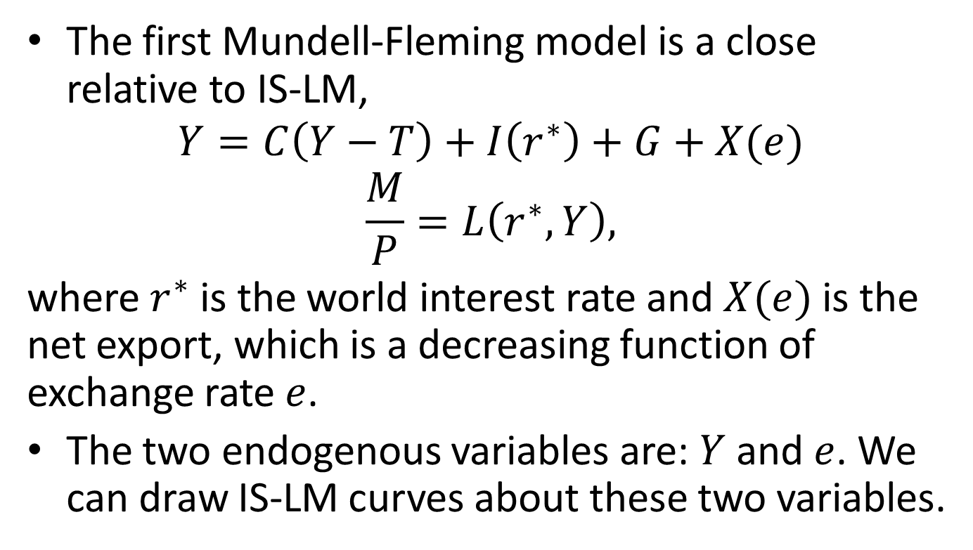
Small Open Economy with Floating Exchange Rate
The first Mundell-Fleming model is a close relative to IS-LM,
$$Y=C\left(Y−T\right)+I\left(r^{∗}\right)+G+X(e)$$
$$\frac{M}{P}=L\left(r^{∗},Y\right),$$
where $r^{∗}$ is the world interest rate and $X(e)$ is the net export, which is a decreasing function of exchange rate $e$.
The two endogenous variables are: $Y$ and $e$. We can draw IS-LM curves about these two variables.

Slide 74
IS-LM Curves of The Small Open Economy with Floating Exchange Rate
Exchange rate e
LM
Equilibrium exchange rate
Equilibrium output
IS
Output Y

Slide 75
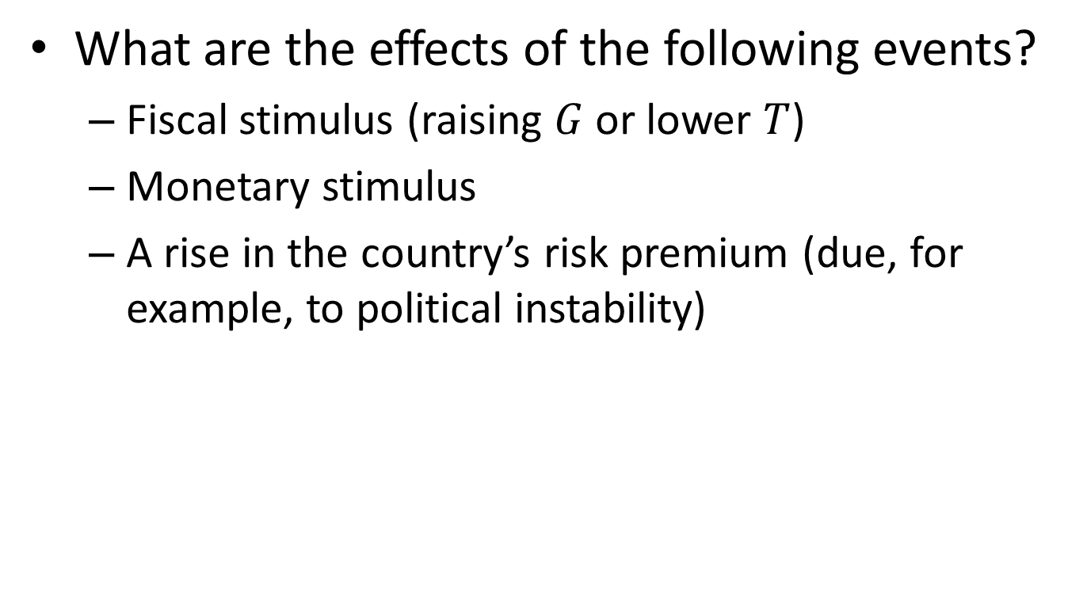
Virtual Experiments
What are the effects of the following events?
  Fiscal stimulus (raising $G$ or lower $T$)
  Monetary stimulus
  A rise in the country’s risk premium (due, for example, to political instability)

Slide 76
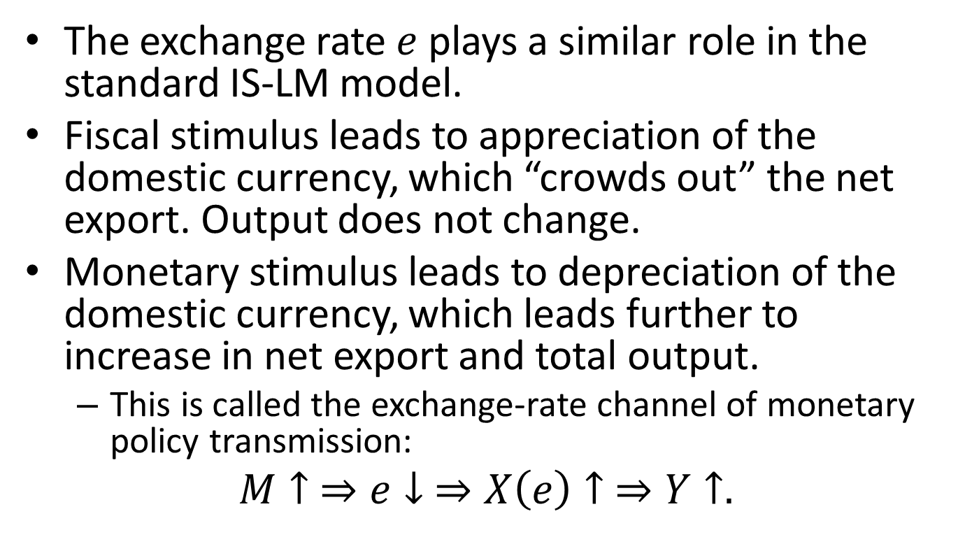
A Summary of Virtual Experiments
The exchange rate $e$ plays a similar role in the standard IS-LM model.
Fiscal stimulus leads to appreciation of the domestic currency, which “crowds out” the net export. Output does not change.
Monetary stimulus leads to depreciation of the domestic currency, which leads further to increase in net export and total output.
  This is called the exchange-rate channel of monetary policy transmission:
$M↑ ⇒e↓ ⇒X\left(e\right)↑ ⇒Y↑.$

Slide 77
Content
Overview
The IS-LM Models
  The Keynesian Cross
  The Sticky-Price Assumption
  The IS-LM Model
  Open Economy
    Overview
    Small open economy with floating exchange rate
    Small open economy with fixed exchange rate
    Large open economy with floating exchange rate
The AD-AS Model
Keynes Theory
Concluding Remarks

Slide 78
Small Open Economy with Fixed Exchange Rate
Under the fixed exchange regime, the monetary authority stands ready to buy or sell the domestic currency at pre-determined price (exchange rate).
When the monetary authority buys the domestic currency with a foreign currency, the monetary authority tightens the money supply.
When the monetary authority sells the domestic currency for a foreign currency, the monetary authority expands the money supply.
If the exchange rate is fixed, the money supply is endogenous.

Slide 79
The Challenge of Capital Flow
From 1980s to 1990s, the US and IMF pushed for capital account liberalization in developing countries. That is, to allow capital flow in the following forms:
  Direct investment
  Portfolio investment
  Loans
At the same time, due to the “fear of float”, many countries retained fixed or inflexible exchange rate.
The liberalized capital account poses a challenge for macroeconomic management:
  A country must choose: either fixing its exchange rate (sacrificing independence of monetary policy) or free float its exchange rate (to have independent monetary policy).

Slide 80
The Impossible Trinity
Free capital flows
Option 1
(e.g. The US)
Option 2
(e.g., Hong Kong)
Independent monetary policy
Fixed exchange rate
Option 3 (e.g., China in 1995-2005)
Notes:
Capital mobility was sacrosanct during the Gold Standard era, which prevailed until the WWI.
Economists (Keynes in particular) realized during the interwar period that capital mobility was incompatible with macroeconomic stability. This view was enshrined in the form of capital controls in Bretton Wood agreement of 1944.
By late 1980s, economists and policy makers again embraced capital mobility. EU made capital controls illegal in 1992. OECD forbade capital control. Soon financial crises broke out in Mexico and South Korea in 1994 and 1997, respectively. In the end, the US and European countries also had their own financial crisis.
In 2012, IMF reversed its long-held belief and approved capital control, although it still regards free capital mobility as an ideal.

Slide 81
The Role of Foreign Exchange Reserve
To conduct the intervention, the monetary authority needs a solid foreign currency reserve for the defense of the fixed exchange rate.
Under the fixed exchange rate regime,
net capital outflow = net private capital outflow + increase in foreign reserve.
The increase in foreign reserve corresponds to increase in domestic money supply.

Slide 82
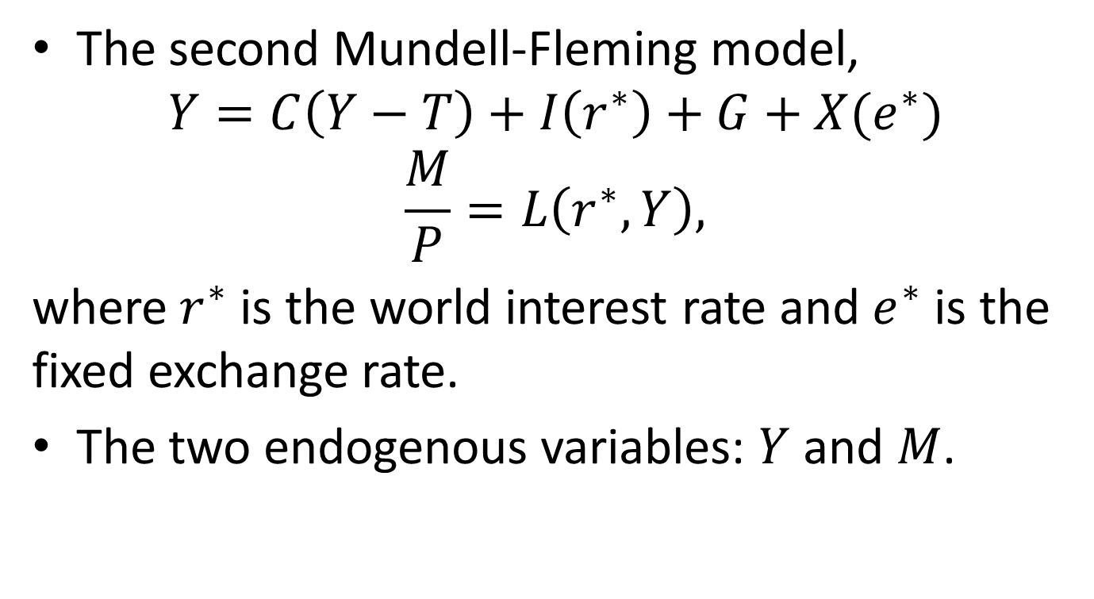
The IS-LM Model of The Small Open Economy with Fixed Exchange Rate
The second Mundell-Fleming model,
$$Y=C\left(Y−T\right)+I\left(r^{∗}\right)+G+X(e^{∗})$$
$$\frac{M}{P}=L\left(r^{∗},Y\right),$$
where $r^{∗}$ is the world interest rate and $e^{∗}$ is the fixed exchange rate.
The two endogenous variables: $Y$ and $M$.

Slide 83
Virtual Experiments
A negative shock to foreign demand.
Fiscal stimulus.
Global monetary tightening.

Slide 84


IS-LM Curves of The Small Open Economy with Fixed Exchange Rate
Money supply ($M$)
IS
LM
Equilibrium money supply
Equilibrium output
Output ($Y$)

Slide 85




Foreign-Demand-Shock Recession
Money supply ($M$)
IS’
IS
LM
$$Y′$$
$$\overline{Y}$$
Output ($Y$)

Slide 86
China’s Slowdown in 2008-2009
China’s GDP in 2007 was about 26% of the US GDP.
The “crawling peg” of RMB to USD: although the RMB exchange rate was no longer pegged to USD, it was still rigid and was allowed to appreciate very slowly.
As the financial crisis hit the US, the US demand for Chinese goods took a nosedive, resulting in China’s slowdown.

Slide 87
China’s Slowdown in 2008-2009
Quarter | RGDP (Y2Y growth,%) | Export to the US (Y2Y growth,%)
2008Q1 | 11.5 | 5.4
2008Q2 | 10.9 | 12.0
2008Q3 | 9.5 | 15.3
2008Q4 | 7.1 | 0.7
2009Q1 | 6.4 | -14.8
2009Q2 | 8.2 | -18.5
2009Q3 | 10.6 | -16.7
2009Q4 | 11.9 | 0.6

Slide 88
The Effect of Fiscal Stimulus
What would be the impact of a fiscal stimulus program?
The fiscal stimulus shifts the IS curve to the right, raising both output and money supply.
  The fiscal stimulus exerts appreciation pressure on the domestic currency. To defend the fixed exchange rate, the monetary authority sells the domestic currency, resulting in the expansion of the money supply.
China’s massive “Four-Trillion Stimulus” at the end of 2008 quickly puts a stop on the slowdown.

Slide 89
The Effect of Global Monetary Tightening
Suppose that the world real interest rate rises, due to policy changes in the US Fed. What would happen to small economies?
This would shift the IS curve to the left and the LM curve to the right, resulting in lower output and money supply.
  To understand why the money supply has to be tightened, note that the rise in the world interest rate puts depreciation pressure on the domestic.
  Defending the fixed exchange rate, the monetary authority has to buy the domestic currency, which is to withdraw money from the economy.

Slide 90
The Asian Financial Crisis
 | Fed Funds Rate (%) | Dollar Index | Exchange Rates (per Dollar)
 |  |  | Baht | Won | Rupiah
1993 | 3.02 | 89.9 | 25.3 | 805.8 | 2110
1994 | 4.20 | 88.4 | 25.2 | 806.9 | 2200
1995 | 5.84 | 83.4 | 24.9 | 772.7 | 2308
1996 | 5.30 | 87.2 | 25.4 | 805.0 | 2383
1997 | 5.46 | 93.9 | 31.1 | 953.2 | 4650
1998 | 5.35 | 98.5 | 41.3 | 1400.4 | 8025
1999 | 4.97 | 97.0 | 37.9 | 1189.8 | 7085
2000 | 6.24 | 101.8 | 40.2 | 1130.9 | 9595

Slide 91
The Asian Financial Crisis
 | RGDP Growth (local currency) |  |  | GDP Growth (in Dollar)
 | Thailand | S. Korea | Indonesia | Thailand | S. Korea | Indonesia
1994 | 8 | 9.2 | 7.5 | 13.8 | 13.3 | 17.9
1995 | 8.1 | 9.6 | 8.2 | 15.4 | 14.0 | 22.1
1996 | 5.7 | 7.6 | 7.8 | 8.1 | 12.8 | 7.5
1997 | -2.8 | 5.9 | 4.7 | -18.0 | -5.3 | -6.8
1998 | -7.6 | -5.5 | -13.1 | -24.3 | -57.0 | -32.9
1999 | 4.6 | 11.3 | 0.8 | 11.4 | 43.6 | 29.7
2000 | 4.5 | 8.9 | 4.9 | -0.2 | 19.1 | 15.7

Slide 92
Content
Overview
The IS-LM Models
  The Keynesian Cross
  The Sticky-Price Assumption
  The IS-LM Model
  Open Economy
    Overview
    Small open economy with floating exchange rate
    Small open economy with fixed exchange rate
    Large open economy with floating exchange rate
The AD-AS Model
Keynes Theory
Concluding Remarks

Slide 93
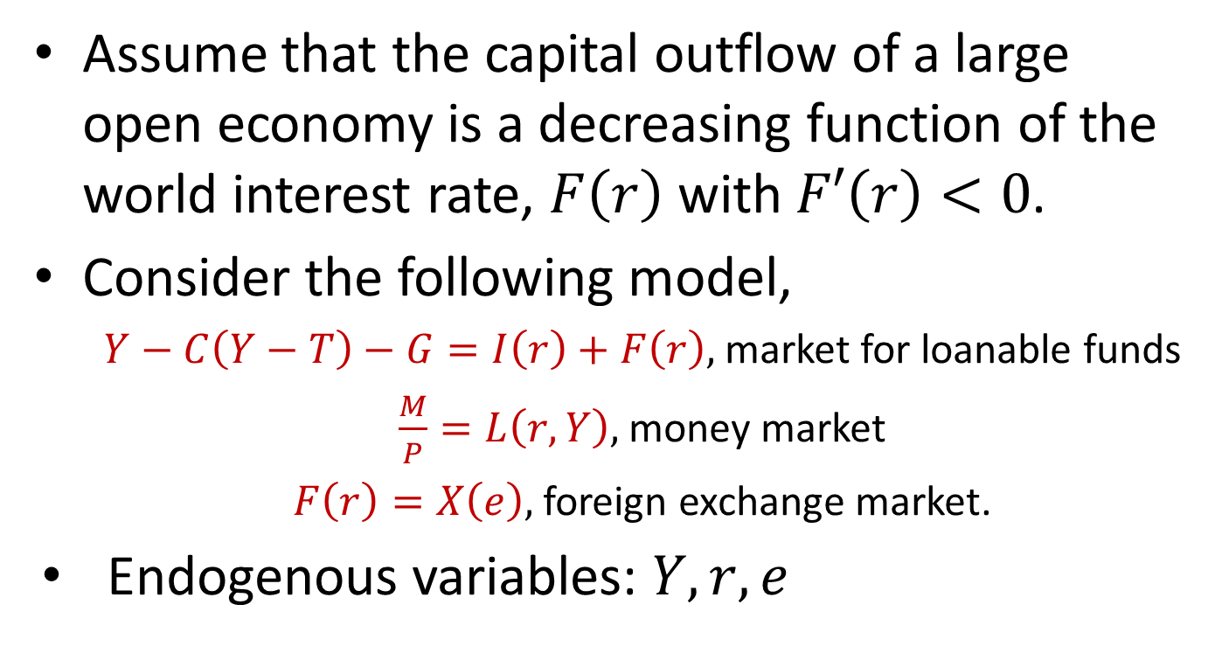
A Model of Large Open Economy with Flexible Exchange Rate
Assume that the capital outflow of a large open economy is a decreasing function of the world interest rate, $F\left(r\right)$ with $F′\left(r\right)<0$.
Consider the following model,
  $Y−C\left(Y−T\right)−G=I\left(r\right)+F\left(r\right),$ market for loanable funds
  $\frac{M}{P}=L\left(r,Y\right),$ money market
  $F\left(r\right)=X\left(e\right),$ foreign exchange market.
Endogenous variables: $Y, r, e$

Slide 94

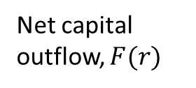






The IS-LM Curves of the Large Open Economy
Equilibrium interest rate
$$r$$
LM
$$r$$
IS
$$F(r)$$
$$Y$$
Net capital outflow, $F(r)$
Equilibrium output/income
$$e$$
Equilibrium exchange rate
$$X(e)$$
Net export, $X(e)$

Slide 95
Virtual Experiments
What would be the effects of the following changes?
  Fiscal stimulus
  Monetary stimulus
  A protectionist policy shock (e.g., an import tax)

Slide 96
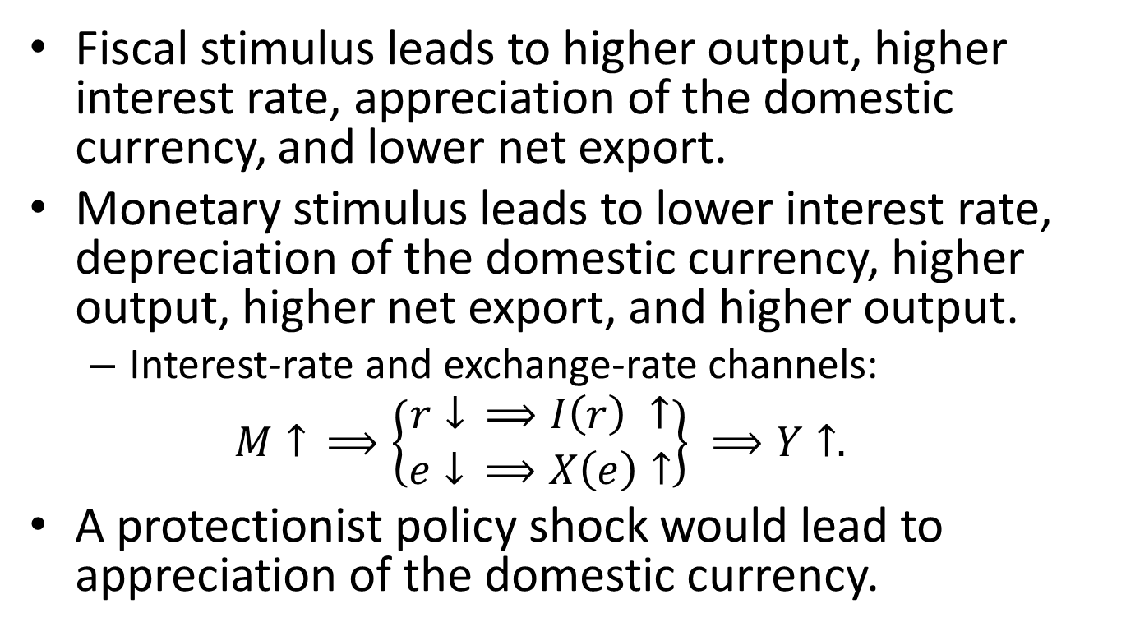
Summary of Virtual Experiments
Fiscal stimulus leads to higher output, higher interest rate, appreciation of the domestic currency, and lower net export.
Monetary stimulus leads to lower interest rate, depreciation of the domestic currency, higher output, higher net export, and higher output.
  Interest-rate and exchange-rate channels:
  $$M↑ ⟹\left\{\begin{matrix}r↓ ⟹I\left(r\right) ↑ \\ e↓ ⟹X\left(e\right)↑\end{matrix}\right\} ⟹Y↑.$$
A protectionist policy shock would lead to appreciation of the domestic currency.

Slide 97
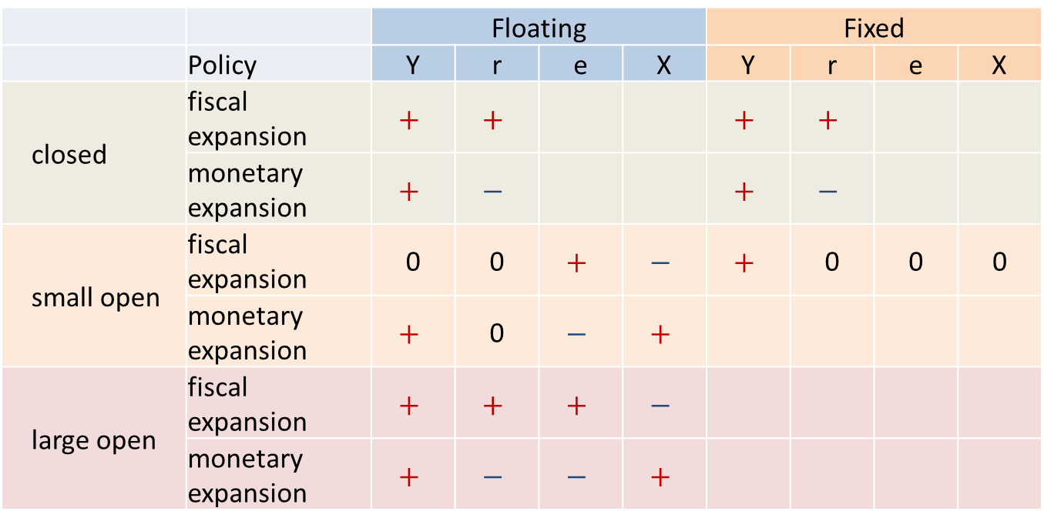
Summary of Policy Effects
 |  | Floating |  |  |  | Fixed
 | Policy | Y | r | e | X | Y | r | e | X
closed | fiscal expansion | $$+$$ | $$+$$ |  |  | $$+$$ | $$+$$
 | monetary expansion | $$+$$ | $$−$$ |  |  | $$+$$ | $$−$$
small open | fiscal expansion | 0 | 0 | $$+$$ | $$−$$ | $$+$$ | 0 | 0 | 0
 | monetary expansion | $$+$$ | 0 | $$−$$ | $$+$$
large open | fiscal expansion | $$+$$ | $$+$$ | $$+$$ | $$−$$
 | monetary expansion | $$+$$ | $$−$$ | $$−$$ | $$+$$

Slide 98
Content
Overview
The IS-LM Models
The AD-AS Model
  Aggregate Demand
  Aggregate Supply
  Phillips Curve
  Dynamic AD-AS Model
Keynes Theory
Concluding Remarks

Slide 99
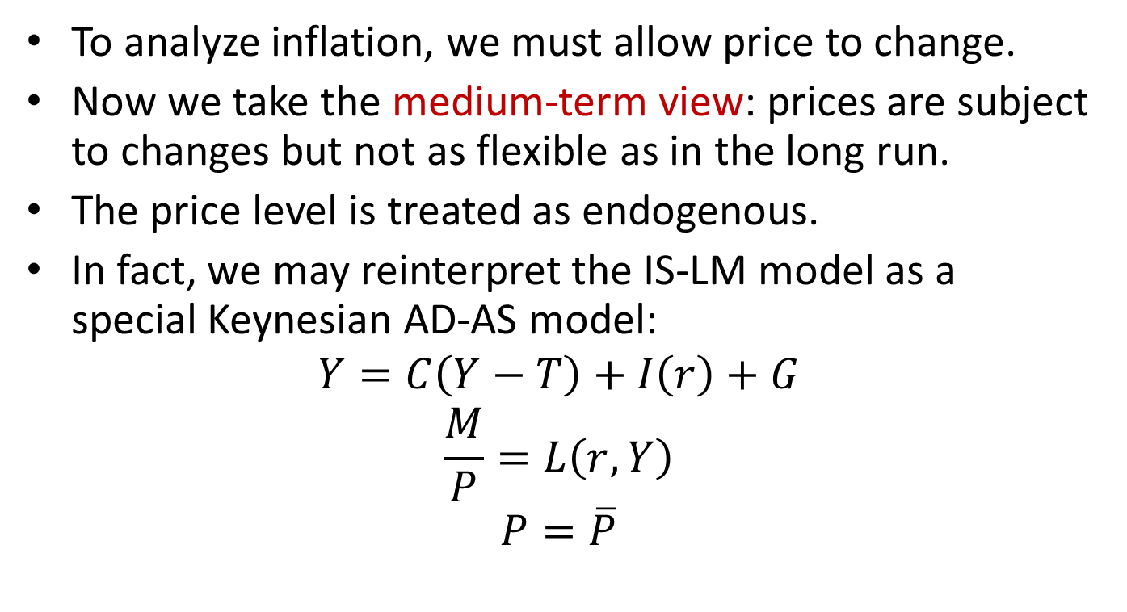
Endogenizing the Price
To analyze inflation, we must allow price to change.
Now we take the medium-term view: prices are subject to changes but not as flexible as in the long run.
The price level is treated as endogenous.
In fact, we may reinterpret the IS-LM model as a special Keynesian AD-AS model:
$$Y=C\left(Y−T\right)+I\left(r\right)+G$$
$$\frac{M}{P}=L\left(r,Y\right)$$
$$P=\overline{P}$$
Demand side
Supply side

Slide 100
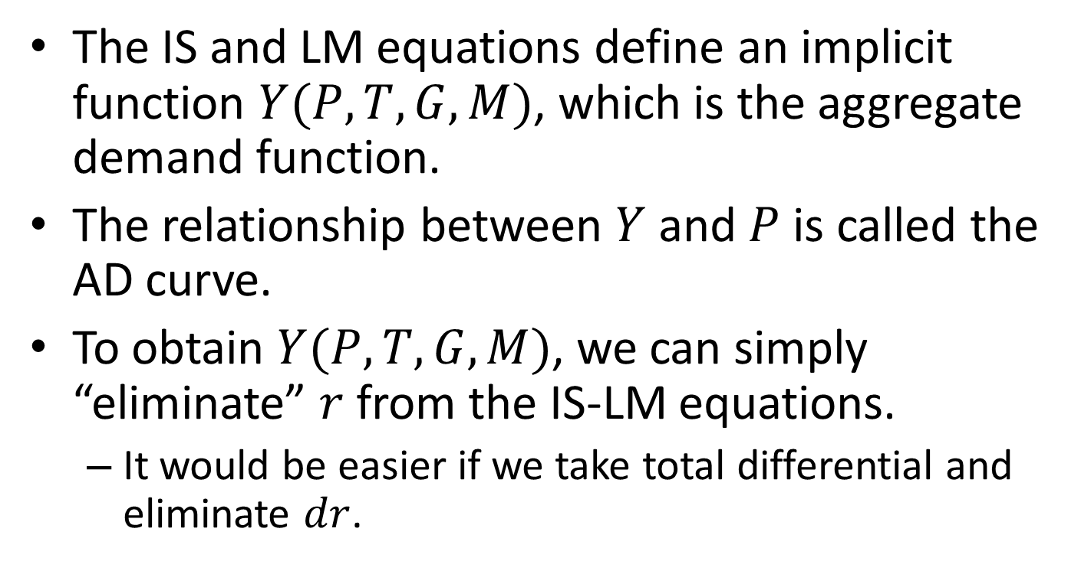
The Aggregate Demand
The IS and LM equations define an implicit function $Y(P,T,G,M)$, which is the aggregate demand function.
The relationship between $Y$ and $P$ is called the AD curve.
To obtain $Y(P,T,G,M)$, we can simply “eliminate” $r$ from the IS-LM equations.
  It would be easier if we take total differential and eliminate $dr$.

Slide 101
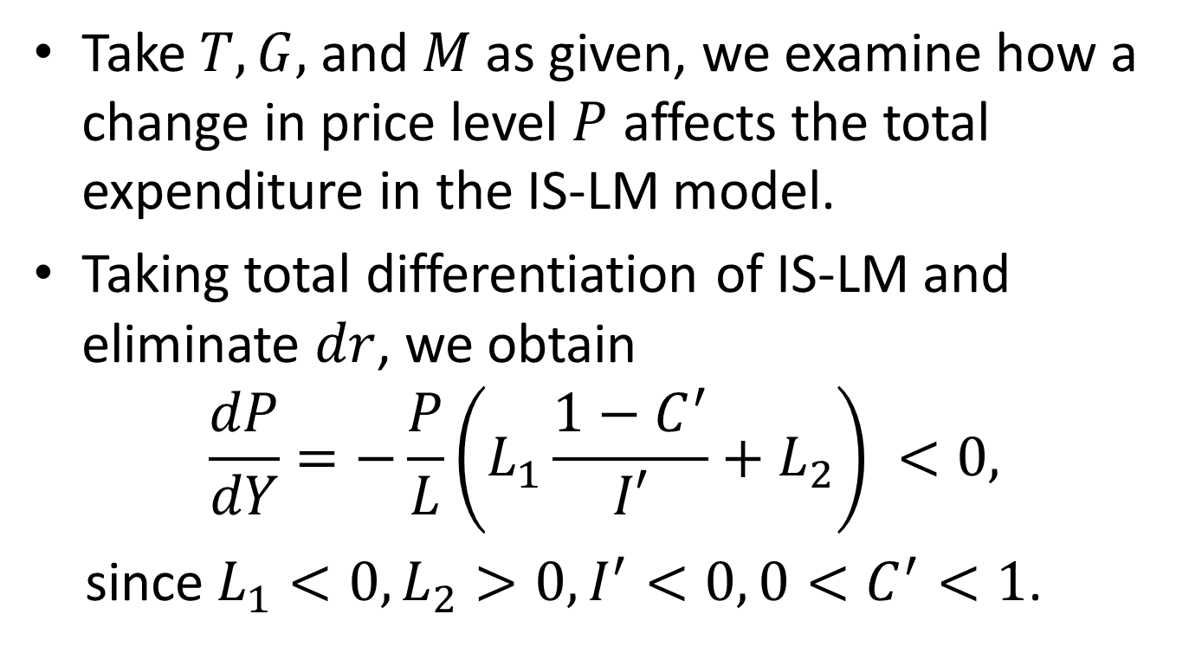
The Slope of the AD Curve
Take $T, G,$ and $M$ as given, we examine how a change in price level $P$ affects the total expenditure in the IS-LM model.
Taking total differentiation of IS-LM and eliminate $dr$, we obtain
$$\frac{dP}{dY}=−\frac{P}{L}\left(L_{1}\frac{1−C^{′}}{I′}+L_{2}\right) <0,$$
since$L_{1}<0,L_{2}>0, I^{′}<0,{0<C}^{′}<1$.

Slide 102




The Graphical Derivation
LM’
A decline in price increases the real balance of money supply, shifting the LM curve to the right. Hence lower equilibrium interest rate and higher income/output.
So the aggregate demand curve is downward-sloping.
$$r$$
LM’’
IS
$$Y$$
$$P$$
AD
$$Y$$

Slide 103
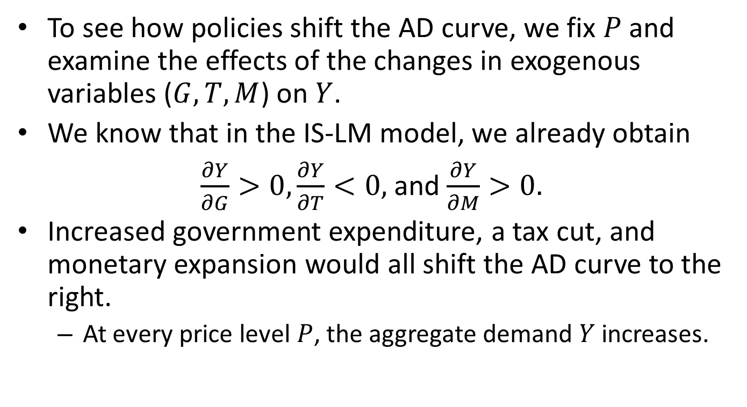
The Effect of Expansionary Fiscal and Monetary Policies
To see how policies shift the AD curve, we fix $P$ and examine the effects of the changes in exogenous variables ($G,T,M$) on $Y$.
We know that in the IS-LM model, we already obtain
$\frac{∂Y}{∂G}>0, \frac{∂Y}{∂T}<0,$ and $\frac{∂Y}{∂M}>0.$
Increased government expenditure, a tax cut, and monetary expansion would all shift the AD curve to the right.
  At every price level $P$, the aggregate demand $Y$ increases.

Slide 104





The Effect of Expansionary Fiscal and Monetary Policies
$$r$$
Monetary expansion
LM’
AD’
AD’’
LM’’
IS
$$Y$$
$$Y$$
Fiscal stimulus
LM
AD’
AD’’
IS’’
IS’
$$Y$$
$$Y$$

Slide 105
The Short-term Effect of Expansionary Policies
P
The effect of stimulus in the short-run
AS
AD’
AD’’
Y

Slide 106

The Long-term Effect of Expansionary Policies
P
The effect of monetary/fiscal stimulus in the long-run
AD’
AD’’
AS
$$\overline{Y}$$
Y
Notes:
In the long run, price is flexible and the economy produces the natural level, $\overline{Y}$.

Slide 107
From Short-Run To Long-Run
P
The long-run equilibrium
The short-run equilibrium
$$\overline{Y}$$
Y

Slide 108
Stabilization Policy
The government is both the monetary authority and the biggest spender. It is able to stabilize an economy that, under constant shocks, deviate from long-run natural levels of output and employment.
A shock to the economy may come from the demand side or the supply side.

Slide 109
Shocks to Aggregate Demand
Examples of positive shocks to AD include:
  An asset price bubble (stocks, property)
  A credit boom
  A surge in foreign demand
The corresponding negative shocks are: burst of bubbles, a decline in foreign demand.
When the economy overheats, tighten; when the economy goes into a recession, stimulate.

Slide 110
Shocks to Aggregate Supply
A supply shock changes the factor prices or the technology.
A supply shock is invariably associated with a change in price. Hence we often call it price shock.
Examples of adverse supply shocks:
  A severe drought
  A new environmental protection law
  An increase in labor unrest or union aggressiveness
  The formation of an international oil cartel
  Supply chain disruption (as happened in 2020-2021)

Slide 111
Stagflation
P
A price shock
Y
Output declines

Slide 112
Accommodate An Adverse Supply Shock
P
Long-run AS
Accommodation
A price shock
Short-run AS
Y
Output declines

Slide 113
Case Study: The Oil Shocks in 1970s and 1980s

Slide 114
Content
Overview
The IS-LM Models
The AD-AS Model
  Aggregate Demand
  Aggregate Supply
  Phillips Curve
  Dynamic AD-AS Model
Keynes Theory
Concluding Remarks

Slide 115
Aggregate Supply
Previously we assume that the aggregate supply curve is either vertical (the classical long-run case), or horizontal (the short-run sticky price case).
These are two extreme cases of a general theory of aggregate supply, a subject we study in this section.
  Basic theory
  Phillips curve
  Policy implications
Long-run AS
Intermediate case
Short-run AS

Slide 116
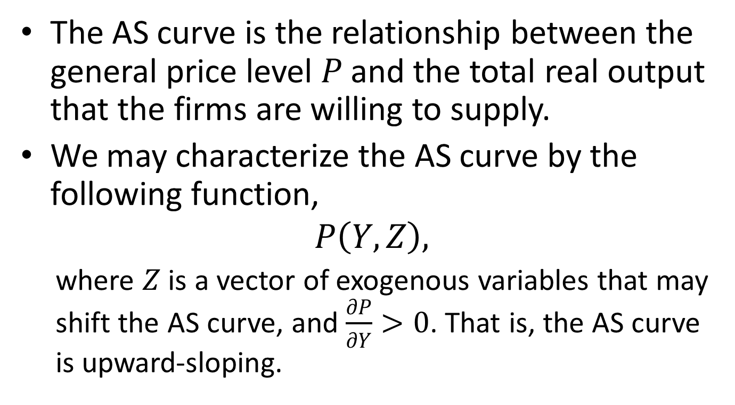
A General AS Curve
The AS curve is the relationship between the general price level $P$ and the total real output that the firms are willing to supply.
We may characterize the AS curve by the following function,
$$P\left(Y,Z\right),$$
  where $Z$ is a vector of exogenous variables that may shift the AS curve, and $\frac{∂P}{∂Y}>0$. That is, the AS curve is upward-sloping.

Slide 117
The Imperfect-Information Argument
We assume that each firm in the economy produces a single good and there are many goods in the market.
Furthermore, we assume that firms have an imperfect information on the overall price level. In other words, they may mistake an overall price rise as a rise in the relative price of the good they produce.
As the overall price level rises, many firms make more efforts to produce more. Hence the upward-sloping AS.

Slide 118
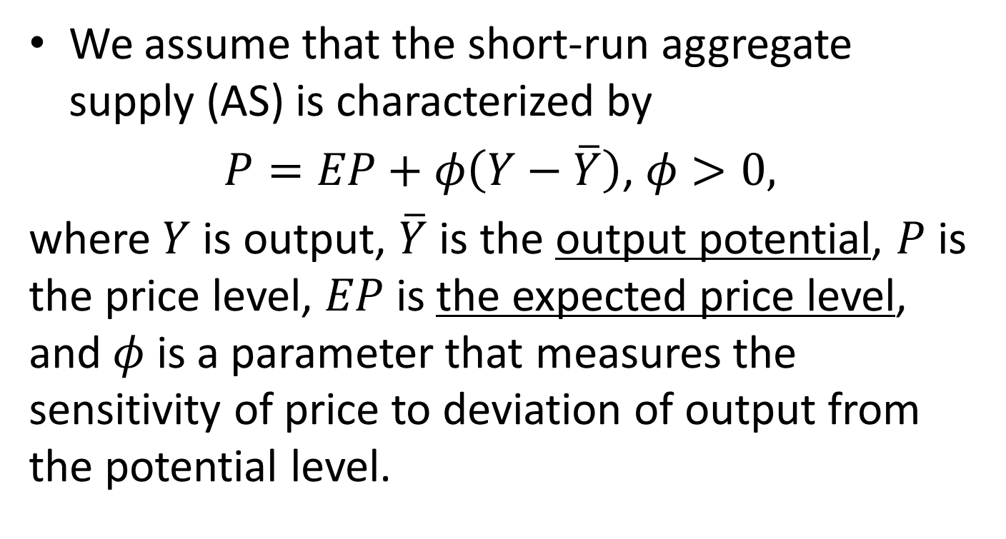
A Linear Aggregate Supply Equation
We assume that the short-run aggregate supply (AS) is characterized by
$P=EP+φ\left(Y−\overline{Y}\right)$, $φ>0,$
where $Y$ is output, $\overline{Y}$ is the output potential, $P$ is the price level, $EP$ is the expected price level, and $φ$ is a parameter that measures the sensitivity of price to deviation of output from the potential level.

Slide 119

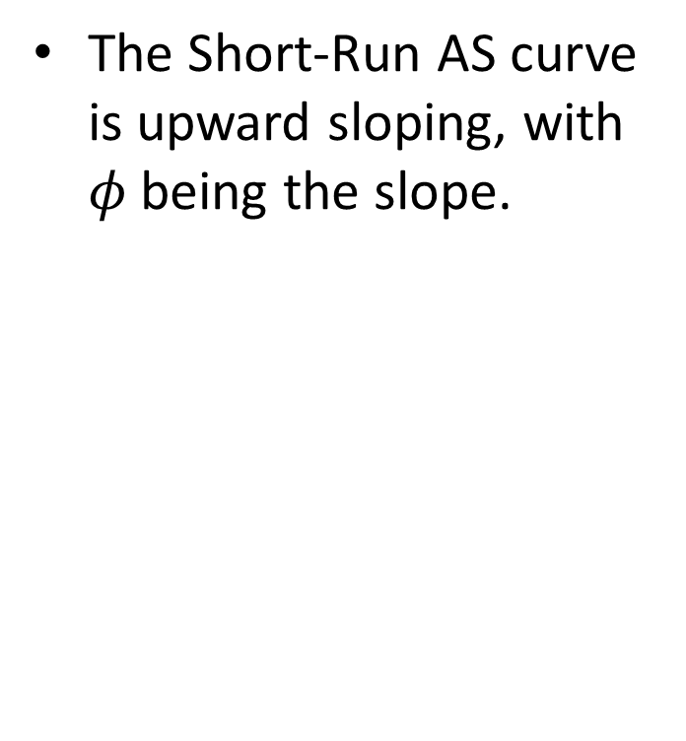



The Short-Run AS Curve
The Short-Run AS curve is upward sloping, with $φ$ being the slope.
Long-run AS curve
$$P$$
Short-run AS curve
$$φ$$
1
$$\overline{Y}$$
$$Y$$

Slide 120
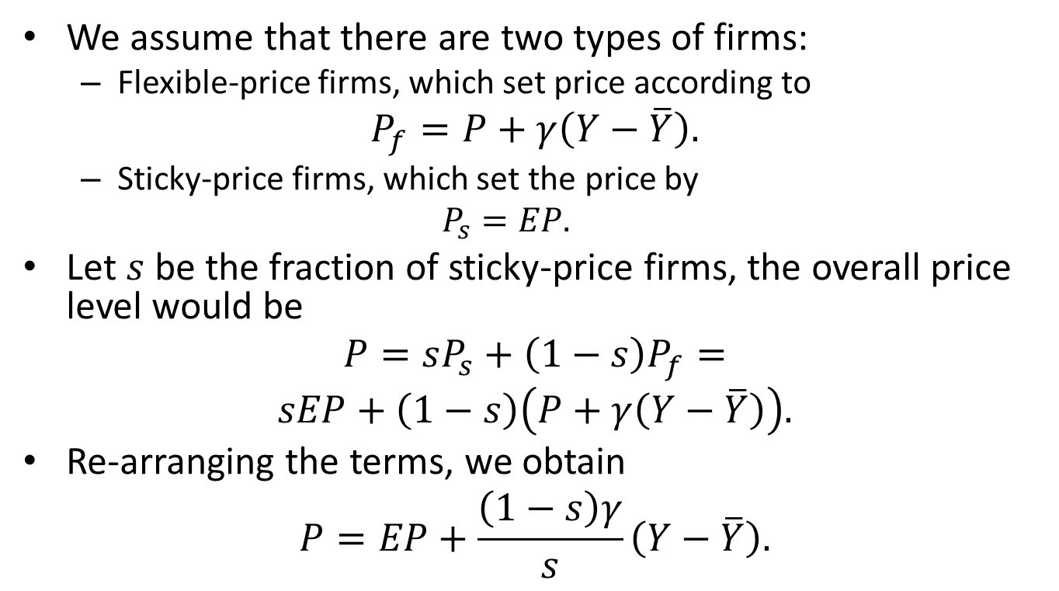
The Sticky-Price Argument
We assume that there are two types of firms:
  Flexible-price firms, which set price according to
$$P_{f}=P+γ\left(Y−\overline{Y}\right).$$
  Sticky-price firms, which set the price by
  $$P_{s}=EP.$$
Let $s$ be the fraction of sticky-price firms, the overall price level would be
$$P=sP_{s}+\left(1−s\right)P_{f}=$$
$$sEP+\left(1−s\right)\left(P+γ\left(Y−\overline{Y}\right)\right).$$
Re-arranging the terms, we obtain
$$P=EP+\frac{\left(1−s\right)γ}{s}\left(Y−\overline{Y}\right).$$

Slide 121

The Determinants of $φ$
The AS curve is steeper for those economies with volatile aggregate price level. (This is implied by the imperfect-information model.)
The AS curve is also steeper for those economies with higher average level of inflation. (This is implied by the sticky-price model.)

Slide 122





Demand-Shock Recession
$$P$$
$$AS$$
$$AD_{1}$$
$$AD_{2}$$
$$\overline{Y}$$

Slide 123
Demand-Shock Recession
If there is a negative shock to the aggregate demand, e.g., reduced investment sentiment, then the economy would enter a recession.
  Output declines, unemployment rises, and price declines (deflation).
Recall that deflation may further reduce aggregate demand.
  Transfer wealth from debtors to creditors, who generally have less MPC.
  The deflation expectation raises the real interest rate, further reducing investment.

Slide 124
Policy Response to Demand-Shock Recessions
In normal cases, both fiscal and monetary policies may be employed to increase aggregate demand.
However, if the recession is deep and there is widespread panic (e.g., liquidity trap), monetary policy alone may not work.
Even a tax cut may not work since people may choose to save the extra money.
Under such circumstances, government expenditure may directly raise income and, perhaps more importantly, restore confidence.

Slide 125
Content
Overview
The IS-LM Models
The AD-AS Model
  Aggregate Demand
  Aggregate Supply
  Phillips Curve
  Dynamic AD-AS Model
Keynes Theory
Concluding Remarks

Slide 126
Negative Correlation between Unemployment and Inflation
If the AS curve is upward-sloping and fixed, then shifts of the AD curve predict a negative relationship between unemployment and inflation.
  Suppose that the economy is in a recession and that the government conducts fiscal or monetary stimulus, shifting the AD curve to the right. As a result, the output increases, the unemployment rate declines, and the inflation rate picks up.
The Phillips curve describes the trade-off between unemployment and inflation.

Slide 127
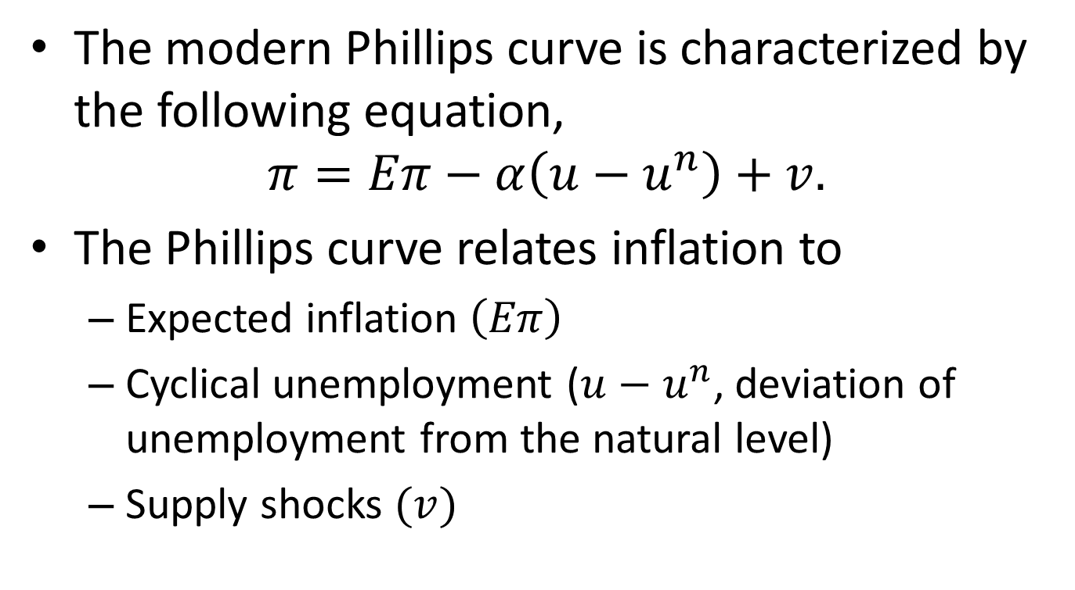
Phillips Curve
The modern Phillips curve is characterized by the following equation,
$$π=Eπ−α\left(u−u^{n}\right)+v.$$
The Phillips curve relates inflation to
  Expected inflation $\left(Eπ\right)$
  Cyclical unemployment ($u−u^{n}$, deviation of unemployment from the natural level)
  Supply shocks $(v)$

Slide 128

Derivation of The Phillips Curve
Let $p_{t}=log{(P}_{t}).$ Note that $π_{t}=p_{t}−p_{t−1}$. Rewrite the short-run AS equation,
$$p_{t}=Ep_{t}+φ\left(Y_{t}−\overline{Y}\right)+v_{t}$$
where we add the supply shock $v$.
Subtract $p_{t−1}$ from the equation,
$$π_{t}=Eπ_{t}+φ\left(Y_{t}−\overline{Y}\right)+v_{t}.$$
Using the Okun’s law, $\left(Y_{t}−\overline{Y}\right)=−γ(u_{t}−u^{n})$, we obtain
$π_{t}=Eπ_{t}−α(u_{t}−u^{n})+v_{t}$, with $α=φγ.$

Slide 129

How Inflation Changes
From the Phillips curve equation,
$$π_{t}=Eπ_{t}−α\left(u_{t}−u^{n}\right)+v_{t},$$
we can infer that there are three factors that may change inflation:
  The cyclical unemployment $\left(u_{t}−u^{n}\right)$, leading to “demand-pull inflation”.
  Supply shock ${(v}_{t})$, leading to “cost-push inflation”.
  Change in expectation
  Change in natural rate of unemployment ${(u}^{n})$

Slide 130

Adaptive Expectation of Inflation
A more concrete form of the Phillips curve is
$$π_{t}=π_{t−1}−α\left(u_{t}−u^{n}\right)+v_{t}.$$
where we make the assumption that
$$Eπ_{t}=π_{t−1}.$$
The above assumption is called the adaptive expectation of inflation.
The adaptive expectation implies that inflation is inert.

Slide 131
Inflation Inertia

Slide 132


The Trade-Off Between Inflation and Unemployment
The Phillips curve indicates a trade-off between inflation and unemployment.
The trade-off is not stable, however, because people adjust their expectation of inflation.
Inflation, $π$
Unemployment, $u$

Slide 133
“Sacrifice Ratio”
The trade-off between inflation and output (employment) can be summarized by the “sacrifice ratio”, which is defined by the percentage of a year’s real GDP growth that must be forgone to reduce inflation by 1 percentage point.
In the U.S., a typical estimate of the sacrifice ratio is about 5: for every percentage point that inflation is to fall, 5 percent of one year’s GDP must be sacrificed.
If the policy of monetary tightening is highly credible, the sacrifice ratio can be much smaller.

Slide 134
Rational Expectation
Rational expectation is a hypothesis that people form their expectations using all relevant information, and their expectations are correct in average.
Under the rational expectation, there may not be a trade-off between inflation and unemployment.
  Bad: it would be futile to combat unemployment with inflation.
  Good: it may be painless to combat inflation. In other words, inflation may be brought down without causing any increase in unemployment.
    It is important that policies are credible.

Slide 135




Trade-off under Rational Expectation
$$π$$
E$π′$
E$π$
$$u−u^{n}$$

Slide 136
Natural Rate of Unemployment
It is a hypothesis that there exists a natural rate of unemployment, which is called “natural-rate hypothesis”.
An alternative hypothesis is “hysteresis”, which states that the natural rate of unemployment may be time-varying and the level of unemployment rate depends not only the current state of economy, but also the historical path.
  A recession may permanently change an unemployed worker.
  A recession may change the balance of “insiders” and “outsiders” in the labor force.

Slide 137
Content
Overview
The IS-LM Models
The AD-AS Model
  Aggregate Demand
  Aggregate Supply
  Phillips Curve
  Dynamic AD-AS Model
Keynes Theory
Concluding Remarks

Slide 138

Static v.s. Dynamic
A static model specifies a set of simultaneous relations among variables, which is often assumed to hold in an equilibrium or steady state.
  For example, the Keynesian cross model, $Y_{t}=C\left(Y_{t}−T_{t}\right)+I_{t}+G_{t}$. The subscript $t$ can be omitted.
  Most models considered in this course are static.
A dynamic model specifies a set of time-dependent relations, which necessarily involves lags of endogenous variables.
  For example, if we assume adaptive expectation, the Phillips curve becomes $π_{t}=π_{t−1}−β\left(u_{t}−u^{n}\right)+v_{t}$, which is a dynamic model.

Slide 139

A Simple Example
Consider the linear AD-AS model,
$$Y_{t}=100+0.4P_{t}+u_{t},$$
$$Y_{t}=400−0.6P_{t}+v_{t},$$
where 𝑢 and 𝑣 denote shocks to the supply and the demand, respectively. Solving the model, we obtain $P_{t}=300+(v_{t}−u_{t})$.
In a static model, exogenous shocks have instantaneous impact on endogenous variables. In the example, a unit negative shock to 𝑢 would result in a unit instantaneous price increase.
Now we change the supply equation to
$$Y_{t}=100+0.4P_{t−1}+u_{t}.$$
The model becomes a dynamic model.
In a dynamic model, an exogenous shock leads to a series of changes to endogenous variables. See the next slide for the impact of a supply shock on the price level.

Slide 140
A Numerical Illustration

Slide 141
A More Useful Dynamic AD-AS Model
Model specifications
  The IS equation
  The “Phillips-curve” equation
  A monetary policy rule
Solving the model
Applications

Slide 142

The IS Equation
We specify the IS equation by
$$y_{t}=\overline{y}−α\left(r_{t}−ρ\right)+u_{t},$$
where $y_{t}=\log\left(Y_{t}\right)$, $\overline{y}=log\left(\overline{Y}\right)$, $r_{t}$ is real interest rate, $u_{t}$ is the demand-side shock, $α$is a constant measuring how demand respond to changes in $r_{t}$, and $ρ$ is a constant called “the natural rate of interest”.
We further specify $r_{t}$ as the ex ante real interest rate,
$$r_{t}=i_{t}−E_{t}π_{t+1},$$
where $i_{t}$ is the nominal interest rate and $E_{t}π_{t+1}$ is the expected next-period inflation at period $t$.

Slide 143

The “Phillips-Curve” Equation
We specify a Phillips-curve-like equation for the dynamics of inflation,
$$π_{t}=E_{t−1}π_{t}+φ\left(y_{t}−\overline{y}\right)+v_{t},$$
where$\left(y_{t}−\overline{y}\right)$ is called the output gap, $v_{t}$ is the supply-side shock, and $φ$ is a constant measuring how inflation responds to the output gap.
The above equation characterizes the trade-off between inflation and output (unemployment). Hence we call it the Phillips curve equation.

Slide 144

The Monetary Policy Rule
We assume that the monetary authority determines the nominal interest rate by the following rule
$$i_{t}=π_{t}+ρ+θ_{π}\left(π_{t}−π^{∗}\right)+θ_{y}\left(y_{t}−\overline{y}\right),$$
where $π^{∗}$ is inflation target, $θ_{π}$ and $θ_{y}$ are constants measuring how the monetary authority would respond to inflation and output gap, respectively.
The famous Taylor rule for the Fed is given by
$$federal fund rate=inflation+2$$
$$+0.5\left(inflation−2\right)+0.5\left(GDP gap\right)$$
The above monetary policy rule implies that the monetary authority has two objectives:
  To keep a moderate inflation
  To promote a “maximum” sustainable output and employment

Slide 145

Putting Together
To make the conditional expectation $E_{t−1}π_{t}$ operational, we assume adaptive expectation (i.e., $E_{t−1}π_{t}=π_{t−1}$). We have
$$y_{t}=\overline{y}−α\left(i_{t}−π_{t}−ρ\right)+u_{t},$$
$$π_{t}=π_{t−1}+φ\left(y_{t}−\overline{y}\right)+v_{t},$$
$$i_{t}=π_{t}+ρ+θ_{π}\left(π_{t}−π^{∗}\right)+θ_{y}\left(y_{t}−\overline{y}\right).$$
Endogenous variables: $y_{t}$, $π_{t}$, $i_{t}$
Predetermined variable: $π_{t−1}$
Exogenous variables: $\overline{y}$, $π^{∗}$, $u_{t}$, $v_{t}$

Slide 146

Steady State
We define the steady state as the state where inflation is constant and there are no shocks $u_{t}=v_{t}=0$.
It is easy to see that in the steady state, $y_{t}=\overline{y}$, $π_{t}=π^{∗}$, $i_{t}=π^{∗}+ρ$, and $r_{t}=ρ.$
In the steady state, real variables $(y_{t}, r_{t})$ do not depend on monetary policy, and monetary policy only influences the inflation ${(π}_{t})$ and nominal variables ${(i}_{t})$. (Recall the concepts: the classical dichotomy and monetary neutrality.)

Slide 147

Solution
There are three equations and three unknowns (endogenous variables). We may solve the system of equations and obtain
$$π_{t}=a_{1}{(π}_{t−1}+v_{t})+a_{2}π^{∗}+a_{3}u_{t},$$
$$y_{t}=\overline{y}+a_{4}\left(π^{∗}−π_{t−1}−v_{t}\right)+a_{5}u_{t},$$
where ${a_{1}=\left(1+\frac{φαθ_{π}}{1+αθ_{y}}\right)}^{−1}$, $a_{2}=\frac{φαθ_{π}}{1+αθ_{y}+φαθ_{π}}$, $a_{3}=\frac{φ}{1+αθ_{y}+φαθ_{π}},$ $a_{4}=\frac{αθ_{π}}{1+αθ_{y}+φαθ_{π}}$, and $a_{5}=\frac{1}{1+αθ_{y}+φαθ_{π}}$.
Similarly we may represent $i_{t}$ as linear functions of exogenous and predetermined variables.
These solutions are called the reduced-form model.

Slide 148


Calibration
Calibration is an approach for assigning values to the parameters in the model. Often these values are taken from empirical and experimental studies. We assume:
Furthermore, we assume $\overline{y}=100$ and $π^{∗}=2.$
Parameters | Value
$$α$$ | 1
$$ρ$$ | 2
$$φ$$ | 0.25
$$θ_{π}$$ | 0.5
$$θ_{y}$$ | 0.5

Slide 149
Simulation of A Demand Shock

Slide 150
A Demand Shock

Slide 151

The Economy After A Demand Shock
The demand shock causes output, inflation, and expected inflation to rise.
The central bank reacts by raising nominal interest rate more rapidly than the inflation, so that real interest rate also rises, partly offsetting the effect of the demand shock.
When the demand shock stops, due to the elevated expected inflation, the output would first drop below $\overline{Y}$, and then slowly recover.

Slide 152
A Supply Shock

Slide 153
The Economy After A Supply Shock: Stagflation
The supply shock causes the output to decline, the inflation to rise.
Although the supply shock lasts only one period, the inertia of expected inflation keeps the supply curve elevated, leading to prolonged periods of stagnation.
The central bank reacts by raising nominal interest rate more rapidly than inflation. Eventually the central bank would succeed in controlling inflation, but at the cost of a deeper recession.

Slide 154

A supply shock combined with a lenient monetary policy towards inflation
$(θ_{π}=−0.14)$

Slide 155
Explaining The Great Inflation in 1970s
A supply shock occurred (oil crisis).
The central bank, for fear of a deep recession, did not raise nominal interest rate aggressively.
The accommodative attitude of the central bank leads to lower real interest rate, pushing inflation even higher.

Slide 156
A Shift in Monetary Policy

Slide 157

The Economy After A Hawkish Policy Shift on Inflation
The central bank raises nominal (thus real) interest rate.
The output immediately drops below $\overline{Y}$, then slowly recovers.

Slide 158
Content
Overview
The IS-LM Models
The AD-AS Model
Keynes Theory
  Theory of Employment
  Theory of Investment
Concluding Remarks

Slide 159
The need to study Keynes’ theory
The IS-LM and AD-AS models are interpretations of Keynes’ theory by the mainstream Keynesian or New Keynesian economists.
The mathematical models, however, lose some key insights of Keynes.
  The importance of investment
  The importance of financial markets

Slide 160

Keynes Aggregate Demand
Keynes postulates an aggregate demand function to characterize the demand side of the economy as a whole,
$$D=f\left(N\right),$$
where $D$ is the proceeds (or revenue) which firms expect to receive from the employment of $N$ workers.
  Keynes uses $N$to measure the total output.
  $D$ corresponds to “price,” which we may call “aggregate demand price”
The aggregate demand function should be increasing in $N$.
  Higher employment corresponds to higher income, which further corresponds to more consumption (proceeds for firms).
Notes:
Note that, in microeconomics, the demand curve for a firm characterizes the changing quantity of a commodity that will be purchased at varying prices.

Slide 161

Keynes Aggregate Supply
Keynes postulates an aggregate supply function,
$$Z=φ\left(N\right),$$
where $Z$ is the aggregate supply price of the output from employing $N$ workers.
Keynes defines the AS price as follows,
“…the aggregate supply price of the output of a given amount of employment is the expectation of proceeds which will just make it worth the while of the entrepreneurs to give that employment.”

Slide 162

The Aggregation of AS
For a firm employing $N_{i}$ workers, the manager may expect a minimum amount of proceeds, $D_{i}$.
  If he expects a revenue lower than $D_{i}$, he will reduce employment.
In aggregation, there is a minimum amount of proceeds that the whole entrepreneur class requires to employ a varying amount of total employment.

Slide 163

The Shape of AS curve
The AS function should be increasing, too. To induce more employment, the AS price must increase.
  The aggregate supply price should be higher than the expected factor costs, including wage costs in particular.
  We may assume that
  $$Z=W⋅N+R,$$
  where $W$ is the average wage, $W⋅N$ is the total wage bill, and $R$ represents the sum of economic profits and other factor costs.
  $R$ may or may not increase as entrepreneurs consider more employment of labor. But it is unlikely that $R$ decreases as entrepreneurs consider increasing labor inputs.

Slide 164

The Relationship between AD and AS curves
The AS curve has a steeper slope than the AD curve;
The AS curve is below the AD curve when the employment level $N$ is low.
Therefore, there exists an equilibrium. The cross-section of AD and AS curves gives the equilibrium employment level and the effective demand.

Slide 165







The Keynes AD-AS Model
$Z$ or $D$
AS, $Z=φ(N)$
Effective
Demand
AD, $D=f(N)$
$$D′$$
$$N′$$
$$\overline{N}$$
$$N$$

Slide 166
Implications
The effective demand may not support full employment.
When AD declines, if AS fails to adjust, then employment may decline.
  Sticky-price, sticky wage in particular, may prevent AS from adjusting.

Slide 167
Content
Overview
The IS-LM Models
The AD-AS Model
Keynes Theory
  Theory of Employment
  Theory of Investment
Concluding Remarks

Slide 168

The Importance of Investment
We may omit the effect of foreign trade and government expenditure and decompose the effective demand $Y$ into two components,
$$Y=C\left(Y\right)+I,$$
  $C\left(Y\right)$ denotes an aggregate consumption function, which Keynes calls “propensity to consume.” We assume that the effective demand equals the aggregate income.
  $I$ denotes the demand derived from new investment.
If there is insufficient new investment, the effective demand has to decline and, with it, the volume of employment.
Notes:
the effective demand differs from the aggregate income by a user cost of capital.

Slide 169
Paradox of Poverty in the Midst of Plenty
Since the marginal propensity to consume is less than one and it generally declines as income increases, wealthy societies have wider gaps between the aggregate income and the consumption expenditure.
Investment means not only the possibility of future growth but also the necessity of maintaining the current living standards.
Once there is a decline of investment, unemployment will follow.

Slide 170
The Determinants of Investment
Prospective yield: future cash flows from an investment or capital asset.
Supply price, or replacement cost: the asset price that would just induce the production of an additional unit of such assets.
Interest rate
Notes:
Replacement cost: 重置成本

Slide 171

Marginal Efficiency of Capital
Keynes invents the marginal efficiency of capital to connect the future to the present. He defines the marginal efficiency of capital as
  “the rate of discount which would make the present value of the series of annuities given by the returns expected from the capital-asset during its life just equal to its supply price.”
In mathematics, we denote the series of expected annuities by $Q_{1}, Q_{2},…, Q_{n}$. The marginal efficiency of capital is a discount rate $r_{m}$ that solves the following equation,
$$Supply price=\frac{Q_{1}}{(1+r_{m})}+\frac{Q_{2}}{{\left(1+r_{m}\right)}^{2}}+⋯+\frac{Q_{n}}{{\left(1+r_{m}\right)}^{n}}.$$

Slide 172

The Demand Price of Capital
Entrepreneurs as a whole will add new investment until there is no longer any class of capital asset with a marginal efficiency of capital higher than the current interest rate.
To help understand this, Keynes introduces the demand price of a capital asset,
$$Demand price=\frac{Q_{1}}{(1+r)}+\frac{Q_{2}}{{\left(1+r\right)}^{2}}+⋯+\frac{Q_{n}}{{\left(1+r\right)}^{n}},$$
where $r$ is interest rate.
If the supply price of a capital asset is lower than the demand price or, equivalently, if $r_{m}>r$, then entrepreneurs will supply such capital assets, that is, add new investment.

Slide 173
Source of Instability
The supply price of capital is relatively stable.
But the expectation, especially the long-term expectation, of prospective yields can be volatile.
Keyes regards the fluctuation in the marginal efficiency of capital as the cause of business cycles.
  The optimistic evaluation of the marginal efficiency of capital leads to over-investment in the later phase of economic expansion.
  Sooner or later, the game has to stop since the feverish accumulation of capital would depress the marginal efficiency of capital. When this happens, optimism gives way to pessimism.

Slide 174
When Does a Recession End?
The recession continues as long as the marginal efficiency of capital is lower than the interest rate. The dismal state of the economy may change for the better when:
  the monetary authority slashes the interest rate to below the marginal efficiency of capital;
  the expectation of future yield improves as business confidence restores;
  the supply price of capital declines by an amount enough for the marginal efficiency of capital to exceed the rate of interest.

Slide 175
The Role of the Stock Market
For potential entrepreneurs, stocks are alternatives to investment in real assets.
  When stock market valuation is low, there is little incentive for entrepreneurs to make new investments since they can purchase capital assets in the stock market.
The stock market provides for entrepreneurs and investors with a conventional valuation on almost every type of capital asset.
  The conventional valuation is imperfect but indispensable.
    Uncertainty makes it difficult to form expectations about prospective yields.

Slide 176
The Weaknesses of the Stock Market
The stock market’s overall ability to value assets is dubious.
Short-term fluctuations in profits tend to have excessive influence on the market.
The conventional valuation of the stock market results from the mass psychology of a large number of ignorant individuals, which may suddenly change due to factors unrelated to the prospective yield.
Notes:
On 1, Keynes points to the fact that more and more shares are owned by retail investors or people who have no special knowledge of businesses.
On 2, Keynes gives two examples:
the share prices of American ice companies are seasonally higher in summer;
the recurrence of holidays may raise the market valuation of the British railway substantially.
On 3,

Slide 177
The Weaknesses of the Stock Market
Even professional investors and speculators are concerned not with making superior forecasts of future yields, but with foreseeing changes in the conventional valuation a little ahead of the others.
  Challenges for value investors
    Human nature desires quick results.
    The value investors must have greater resources for safety and should avoid leverage.
    When a committee is in charge of evaluating investment performance, the value investor will face the most criticism.
Notes:
“markets can remain irrational longer than you can remain solvent.”
“Worldly wisdom teaches us that,” Keynes says, “it is better for reputation to fail conventionally than to succeed unconventionally.”

Slide 178
Summary of Keynes’ View
The conventional valuation offered by the stock market has deep flaws.
The violent fluctuations in the mass psychology of investors and speculators drive the fluctuations in the conventional valuation of prospective yields, which further drives the fluctuations in new investment, which further drives the business cycles.
Keynes: When the capital development of a country becomes a by-product of the activities of a casino, the job is likely to be ill-done.

Slide 179
Content
Overview
The IS-LM Models
The AD-AS Model
Keynes Theory
Concluding Remarks

Slide 180
Concluding Remarks on Business Cycles
The full-employment equilibrium is as “transitory” as the under-employment equilibria.
Full of inner dynamism, our economy cannot stay quietly anywhere. As soon as it recovers from a recession and reaches the full-employment state, it will move on to overheat.
The inner dynamism manifests itself most evidently in finance.
Notes:
What doesn’t change is change itself.

Slide 181
Minsky’s Financial Instability Hypothesis
Minsky: A fundamental characteristic of our economy is that the financial system swings between robustness and fragility and these swings are an integral part of the process that generates business cycles.

Slide 182
Minsky’s Financial Cycle
Hedge
finance
Speculative finance
Ponzi
finance

Slide 183
Concluding Remarks on Business Cycles
The financial cycle does not simply repeat in the same style. Every cycle is different because financial markets are structurally changing over time.
  The government reaction to busts (and booms): regulation and deregulation.
  The market reactions: financial innovations, shadow banks.
Mark Twain: The history of economic fluctuations doesn't repeat itself, but it often rhymes.

