Slide 1
Introduction
Junhui Qian

Slide 2
Content
What macroeconomics is about
How the economy works
Macroeconomic modeling
History of macroeconomic thought

Slide 3
Macroeconomics
With microeconomics, macroeconomics (macro) is one of the two pillars of economics.
Macroeconomics studies the performance, structure, behavior, and policy-making of an economy as a whole.
Notes:
The fact that macroeconomics studies the economy as a whole has an important implication: it is more reasonable to take a behavioral approach.
Fallacy of composition.

Slide 4
Individual v.s. Whole
Microeconomics studies individuals’ behavior, while macroeconomics studies the economy as a whole.
  Macroeconomics is built on aggregate concepts such as aggregate supply/demand, general price level, etc.
  The aggregate concept is not necessarily the sum of the corresponding individual concept (e.g., the price level).
  Laws of microeconomics do not automatically carry to macroeconomics (e.g., the AD curve).
  It is often more reasonable to use the behavioral approach in macroeconomic modeling.
Notes:
George A. Akerlof once said, “If there is any subject in economics which should be behavioral, it is macroeconomics.”
原因有二：
Even when everyone in the economy behaves rationally, they as a whole may exhibit strong irrationality.
The economy as a whole has structural constraints that individuals do not have. For example, a rational individual may smooth his consumption to the extent that the variation of current income has a small effect on current consumption. In macroeconomics, however, the current total consumption must depend crucially on the current total income for the simple fact that consumption expenditure generates income to the sellers of consumption goods.

Slide 5
Objectives of Macroeconomics
To understand causes and consequences of “business cycles”.
To understand why some countries achieve long-term economic growth while others do not.
Macroeconomic policy making
  Fiscal policy
  Monetary policy
Macroeconomic forecasting

Slide 6
Why Macroeconomics Is Important
With a better understanding of why economy grows and why recessions occur, better policy making is possible.
A stably growing economy leads not only to a better living for millions of people, but also to a better society.
Paul Samuelson: “It is not too much to say that the widespread creation of dictatorships and the resulting World War II stemmed in no small measure from the world's failure to meet this basic economic problem [the Great Depression] adequately.”

Slide 7
Content
What macroeconomics is about
How the economy works
  Market economy
  Planned economy
  Mixed economy
Macroeconomic modeling
History of macroeconomic thought

Slide 8
Problems An Economy Must Solve
Production
  What goods and services should be produced, and in what quantity?
  How should resources, which are scarce and have alternative uses, be used in producing these goods and services?
Distribution
  For whom are they to be produced?

Slide 9
Some Stylized Forms of Economy
The economy of instinct (e.g., bees)
The tribal economy
The market economy
The planned economy (or command economy)

Slide 10
Market Economy
A market economy relies on the market to solve these problems.
  As demand for some goods and services increases, consumers bid up their prices, which induce suppliers to produce more.
  To produce more of the demanded goods and services, suppliers bid up prices of required inputs (labor, capital, land, energy, metals, etc.). The increased prices then lead to re-allocation of these resources for production.
  Workers receive their compensation for the supply of labor; Owners of capital get paid for the supply of capital; And owners of the firms claim the residual profit. All of them are consumers of goods and services in the economy.

Slide 11
Price: the “Invisible Hand”
In a market economy, price plays a crucial role.
  For the first problem an economy must solve, prices signal the supply and demand condition in the market of consumer goods and services.
  For the second problem, prices signal the relative scarcity of resources and the reward for being used.
  Invisibly and without any coercion, prices direct resources to be used in producing millions of goods and services demanded by millions of consumers with different tastes and preferences.

Slide 12
Limitations of Market Economy
The market alone would under-supply public goods and over-supply public bads (pollution).
Monopolies may lead to under-supply of goods and services with distortionary prices.
Without proper regulation of the financial industry, the market may experience violent boom-bust cycles.
Distribution of income and wealth in a pure market economy may be dangerously unequal.
  Recommended reading: Capital in the 21st Century, by T. Piketty

Slide 13
Moral Limits of Market
There are things money should not buy (e.g., human being, political rights).
Market value of labor can be unfair.
  Salary of “super-managers” v.s. nurses
  Professor of finance v.s. mathematics
Recommend reading: What Money Can’t Buy: The Moral Limits of Markets, by M.J. Sandel

Slide 14
Planned Economy
From 1953 to 1978, China experimented planned economy similar with the former Soviet Union.
The planned economy relies on the government to determine what and how much goods and services to be produced, how resources are used in production, and how to distribute final goods and services among peasants, workers and cadres in every ranks.
Without markets and prices, the economic planning turned out to be a disaster resulting in huge waste in the use of labor and capital, extreme scarcity of consumer goods, stagnation of living standards.

Slide 15
Mixed Economy
Since 1978, China started reforming and opening its economy.
The spirit of the reform was to let market play a more and more important role in the economy.
In 2001, China joined WTO (World Trade Organization), almost fully opening itself.
What we have now is a mixed economy, where both the market and the government play important roles in the economy.

Slide 16
The Roles of Government in Mixed Economy
Provide public goods (defense, public security, protection of environment, etc.)
Conduct public investment (infrastructure, education, basic research, etc.)
Make transfer payments (less developed areas; the retired, the unemployed, etc.)
Financial regulation (banks, securities, insurance)
Conduct monetary and fiscal policy
Directly manage state-owned enterprises
Notes:
An interesting piece:
https://conversableeconomist.blogspot.com/2021/06/the-social-nature-of-government-actions.html

Slide 17
Content
What macroeconomics is about
How the economy works
Macroeconomic modeling
History of macroeconomic thought

Slide 18
Macroeconomic Variables
We “know” the economy, in an objective way, through macroeconomic variables (e.g., GDP, (un)employment, inflation, interest rates, exchange rates, etc.), which are measurements of the economy from different perspectives.
We “understand” the economy using models that characterize causal relationships among macroeconomic variables.

Slide 19
Endogenous vs. Exogenous Variables
In economic models, we must have both endogenous variables and exogenous variables.
  Endogenous variable: also called “dependent variable”, a variable whose value is determined by the solution of a model.
  Exogenous variable: also called “independent variable”, a variable whose value is determined outside the model.
What is economic explanation? Associate variations in endogenous variables with variations in some exogenous variables.

Slide 20
The Graphic Illustration of a Macroeconomic Model
Money supply
Investment
Inflation
Exogenous variables
Endogenous variables
Notes:
The model may be proposed to explain why money supply and inflation are correlated.

Slide 21
Macroeconomic Modeling
Professional economists approach economic problems by scientific modeling.
  From data we summarize empirical facts (phenomenon) to be explained. These empirical facts are usually some statistics of some endogenous variables. For example, the average growth rate of real income.
  To explain, we conjecture a model (that is, a toy economy) that has
    Endogenous variables, exogenous variables
    A functional relationship
  A successful model explains the empirical facts about the endogenous variable using the exogenous variables, under some reasonable assumptions.
  However, a successful model in one setting will probably fail in another setting, where the assumptions of the model no longer hold.
  Then new models, with modified assumptions, are proposed to explain new phenomena in the new setting.
  This dynamic process goes on.
Notes:
In natural science, new models supersede old ones when the former are more general, meaning that new models can explain facts that old models can explain, as well as new facts that old models fail to explain.
In economics, new models add to the ever-richer set of models, each of which may give us insight in some particular settings.

Slide 22
The Art of Using Models
It takes science to propose and evaluate models. But it takes art to choose an appropriate model in a particular setting.
Keynes:
  Economics is a science of thinking in terms of models joined to the art of choosing models which are relevant to the contemporary world.
Notes:
"Good economists are scarce because the gift for using ‘vigilant observation’ to choose good models, although it does not require a highly specialized intellectual technique, appears to be a very rare one."

Slide 23
It Depends!
The default answer to an economic question should be: it depends.
  There’s no definite answer, since the setting where an economic question arises is almost always complex, so that there is uncertainty on whether a model’s assumptions actually hold.
  It’s important to have observations that are as accurate and complete as possible.
  It’s important to be humble.

Slide 24
Example: Analyzing the Fluctuation of Interest Rate
Consider the Chinese government bond market, where a term structure of interest rate is determined.
The government bond price (or equivalently, the risk-free interest rate) would be the endogenous variable in our model.
The empirical fact is that the interest rates (or bond prices) fluctuate over time.

Slide 25
Example: Analyzing the Fluctuation of Interest Rate

Slide 26
The Supply and Demand Model
An obvious choice is the model of supply and demand in the bond market.
  Endogenous variables: price and quantity of government bonds
  Exogenous variables may include
    Demand side: the monetary policy of the US Fed, domestic inflation expectation, etc.
    Supply side: bond issuance, which is related to government deficit.
  Exogenous variables shifting the supply and demand curves.
P
Supply curve
Demand curve
Y

Slide 27
The Application of Macro Models
To explain macroeconomic phenomena
To make forecasts on trends in the economy and the financial markets
To analyze policies, old or new
  Treatment-effect analysis
  Counter-factual analysis

Slide 28
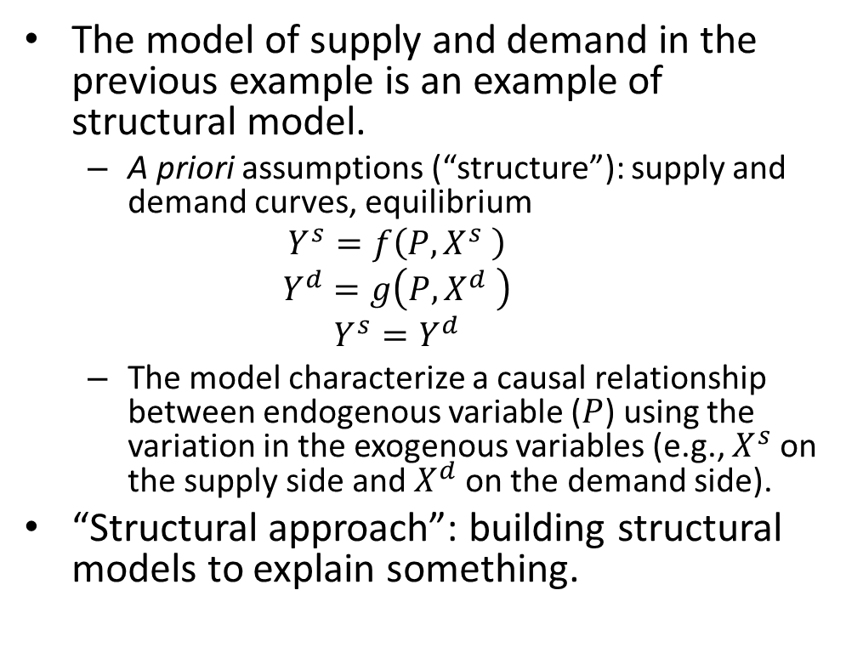
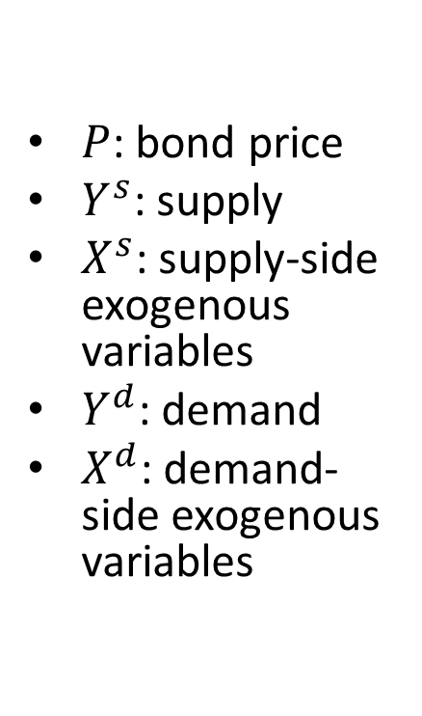
Structural Model
The model of supply and demand in the previous example is an example of structural model.
  A priori assumptions (“structure”): supply and demand curves, equilibrium
  $$Y^{s}=f\left(P,X^{s} \right)$$
  $$Y^{d}=g\left(P,X^{d} \right)$$
  $$Y^{s}=Y^{d}$$
  The model characterize a causal relationship between endogenous variable ($P$) using the variation in the exogenous variables (e.g., $X^{s}$on the supply side and $X^{d}$on the demand side).
“Structural approach”: building structural models to explain something.
$P$: bond price
$Y^{s}$: supply
$X^{s}$: supply-side exogenous variables
$Y^{d}$: demand
$X^{d}$: demand-side exogenous variables
Notes:
With structural models, we can talk about causality.

Slide 29
Reduced Model
If without a structural model, we may still make forecasts based on the correlations between endogenous and exogenous variables or predetermined variables. The set of correlations constitutes a reduced model.
Reduced models are often data-driven.
The reduced model is nothing but statistical associations, which does not lead to causal explanations.

Slide 30
Structural Model v.s. Reduced Model
The solution of a structural model is in the form of a reduced model. We call it reduced-form model.
Structural models are highly simplified, omitting factors that may be informative for short-term forecasting. Hence structural models are in general inappropriate for forecasting.
Reduced models (often data-driven) are more flexible and often yield more accurate predictions.
As time goes by, correlations in the reduced model may change, leading to erroneous predictions. This point is known as the “Lucas Critique”, which was raised by Robert Lucas, the winner of 1995 Nobel Prize in economics.

Slide 31
Content
What macroeconomics is about
How the economy works
Macroeconomic modeling
History of macroeconomic thought

Slide 32
History of Macroeconomic Thought
Classical
Keynes
Keynesian (Neoclassical synthesis)
Monetarism
New classical
New Keynesian
Other schools

Slide 33
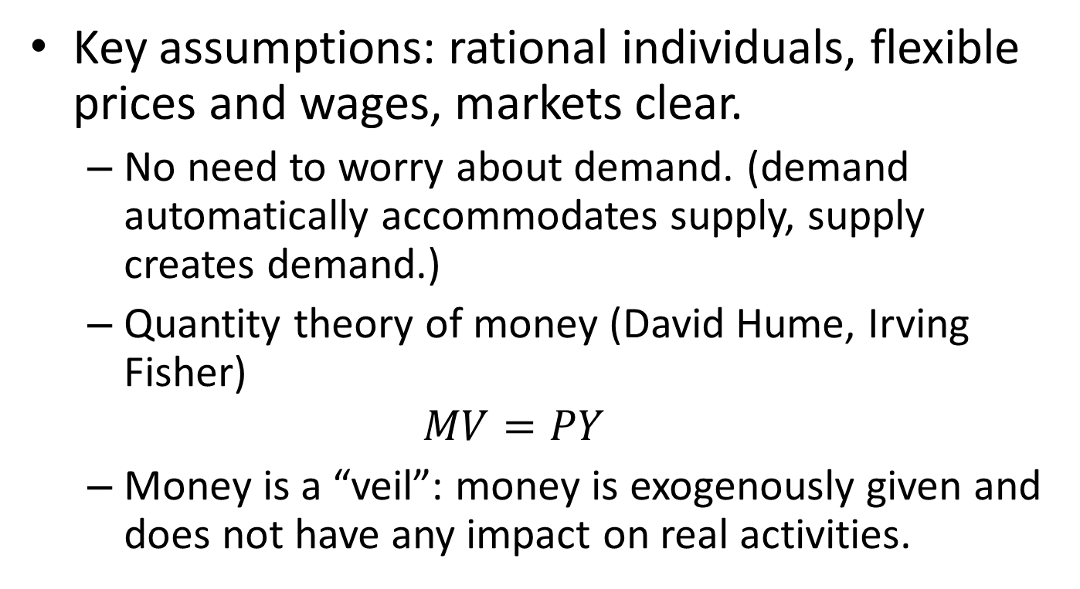
Classical Thought
Key assumptions: rational individuals, flexible prices and wages, markets clear.
  No need to worry about demand. (demand automatically accommodates supply, supply creates demand.)
  Quantity theory of money (David Hume, Irving Fisher)
  $$MV=PY$$
  Money is a “veil”: money is exogenously given and does not have any impact on real activities.

Slide 34
Keynesian Revolution
Macroeconomics began with the publication of John Maynard Keynes's General Theory of Employment, Interest and Money, in the depth of the Great Depression.
Keynes offers a theory that explains why the Great Depression can occur and what governments can do.
Keynesian theory does not assume imperfect markets and rationality of individuals.
  “Sticky price” (wage)
  “Animal spirits”
  “Beauty contest”
Notes:
John Maynard Keynes (1883-1946)

Slide 35
Neoclassical Synthesis
The neo-Keynesians, notably Paul Samuelson (1915–2009), combine Keynes's macroeconomics with neoclassical microeconomics (general equilibrium analysis).
Samuelson establishes a new pattern for economic teaching and research: economic theories expressed in formal, mathematical models.
Large-scale econometric models are developed for macroeconomic forecasts and policy evaluation (e.g., Jan Tinbergen (1903 –1994), Lawrence Klein (1920-2013)).
Notes:
Samuelson's book “Foundations of Economic Analysis”, which is derived from his PhD dissertation, is considered his magnum opus. The book proposes two general hypotheses as sufficient for economic explanations:
1. maximizing behavior of agents (including consumers as to utility and business firms as to profit) and
2. economic systems (including a market and an economy) in stable equilibrium.

Slide 36
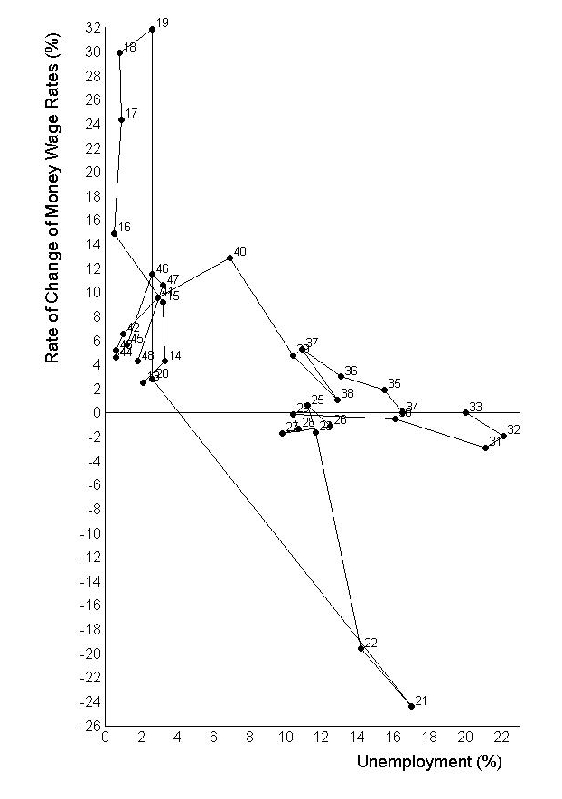
The Phillips Curve
One of these equations is called the Phillips curve, which postulate an inverse relationship between inflation and unemployment.
The Phillips curve gives support to policies that combat unemployment by creating inflation using fiscal and monetary policies.
Data of United Kingdom 1913–1948 from Phillips (1958)
Notes:
William Phillips (18 November 1914 – 4 March 1975), a very interesting person.

Slide 37
Monetarism
Monetarism is championed by Milton Friedman (1921-2006).
  Revive the quantity theory of money
  Propose rule-based monetary policy: stable growth of money supply
  Refutation of Phillips curve
  Permanent income hypothesis
Notes:
Friedman (and Phelps) argues that there is no long-run trade-off between inflation and unemployment, because people can form expectations of future inflation.
In contradiction to his contemporary Keynesians, Friedman argues that monetary policy matters and that fiscal policy may fail.

Slide 38
New Classical Macroeconomics
New classical economists, notably Robert Lucas, further challenged the Keynesians.
  Micro-foundation of macroeconomics (e.g., optimizing rational representative agent)
  Critique of large-scale econometric models
  Rational expectation of individuals
Real business cycle (RBC) theories (Edward C. Prescott and Finn E. Kydland)
  Methodology: dynamic Stochastic General Equilibrium, DSGE
  Policy: business cycles are efficient responses to exogenous shocks.

Slide 39
New Keynesianism
As a response to the criticism of the lack of “micro-foundation”, New Keynesians study whether and how market imperfections occur.
  Monopolistic competition
  Sticky price
  Asymmetric information
Key figures: Joseph E. Stiglitz, Guillermo Calvo, Michael Woodford, Gregory Mankiw, etc.

Slide 40
Other Schools
Knut Wicksell (1851-1926, forerunner of the Stockholm School)
Michał Kalecki (1899-1970)
Stockholm school (Gunnar Myrdal (1898-1987), Bertil Ohlin (1899-1979), etc.)
Austrian business cycle theory (Carl Menger, Ludwig von Mises (1881- 1973), Friedrich Hayek (1899-1992), etc.)
Post Keynesian economics (Hyman Minsky (1919- 1996), Modern Monetary Theory, etc.)
Notes:
Wicksell advocates to use the interest rate to maintain price stability. Michael Woodford calls his own framework 'neo-Wicksellian', and he titled his textbook on monetary policy in homage to Wicksell's work.
Kalecki, Polish, developed many similar ideas with Keynes before Keynes. He worked for the economic planning in Poland. But soon he lost influence.
摘自《中国“明斯基时刻”会到来吗？》
对冲融资（hedge finance）, 投机融资（speculative finance）, 和庞氏融资（Ponzi finance）。
在“对冲融资”中，借款人能用（所投资资产的）现金流还本付息；在“投机融资”中，借款人能用现金流付息，但是需要借新债还旧债，不断对债务作“展期”（roll over）；在“庞氏融资”中，借款人的现金流既不能还本也不能付息，需要（所投资）资产价格不断上涨，才有希望偿债或展期。
在经济周期底部，因为不久前经历过经济或金融危机，人们还十分谨慎，于是“对冲融资”居多。随着经济不断复苏，恐惧渐渐消退，人们开始变得乐观，于是“投机融资”越来越多。融资活动的繁荣进一步推动经济繁荣，资产价格（房地产，股市）不断上涨，人们渐渐相信资产价格会永远上涨。基于此信念，“庞氏融资”越来越多。
到某个时刻，往往伴随资产价格突然下跌，“庞氏融资”首先崩盘。他们的清盘（变卖资产）导致资产价格进一步下跌，打击投资者信心，进而投融资活动跳水，“投机融资”跟着崩盘。甚至那些较为谨慎的对冲融资者，也因为经济萧条而难以为继。
这个时刻，就叫做“明斯基时刻”。“明斯基时刻”最近的例子，是2007-2008的全球金融危机。次级贷及其衍生品的繁荣建立在“房价永远上涨”的假设基础上，房价在2006年见顶后缓慢回落，逐渐引爆了巨大的次级贷泡沫。

Slide 41
What Do We Believe?
We should not religiously believe in any school of thought.
A model is in a sense always wrong, since it is a theoretical abstraction. It is valuable as long as it sheds light on some question in some particular setting.
It’s dangerous to be captivated by a single big idea (e.g., free market, or omnipotent government) and try to use it in every problem.
Notes:
The philosopher Isaiah Berlin distinguished between two styles of thinking, which he identified with the hedgehog and the fox. The hedgehog is captivated by a single big idea, which he applies unremittingly. The fox, by contrast, lacks a grand vision and holds many different views about the world—some of them even contradictory.

Slide 42
Concluding Remarks
Macroeconomics is the study of the economy as a whole.
Our economy can be characterized as a mixed economy, where both market and government play important roles.
To explain, evaluate, or/and predict, professional economists rely on models.
It takes science to propose and evaluate models. But it takes art to choose an appropriate model in a particular setting.

