Slide 1
消费股投资
钱军辉

Slide 2
内容
引论
案例分析
喜诗糖果
可口可乐
百润股份
达美乐
安踏体育
小结
Notes:
喜诗糖果作为引子，讲品牌消费品的生意逻辑，以及什么是好生意。
可口可乐，讲二级市场的买入决策，考虑成长性和估值。
百润股份，估值体系的变化，以及困境逆转.
达美乐，轻资产
安踏体育，直销

Slide 3
消费股
主营产品或服务用于个人和家庭消费
衣食住行玩
必需品和可选品
主营业务营收和利润紧跟消费趋势
消费基础设施（购物广场、网购平台）

Slide 4
消费股投资
产品和服务容易享受高毛利。
周期性较弱，业绩可预测性强。
市场大，成长性容易理解。
新产品、新市场（如智能手机、功能饮料、电动车）
品牌提升，集中度升高
地理扩张
消费升级
个人投资者容易调研。

Slide 5
内容
引论
案例分析
喜诗糖果
可口可乐
百润股份
达美乐
安踏体育
小结

Slide 6
喜诗糖果（See’s Candy）: 改变巴菲特的投资
1921年创办，生产和销售品牌糖果，包括巧克力。
1972年，Berkshire Hathaway (BRK) 购买喜诗糖果。
要价3000万美元，2500万美元成交。
800万美元净资产
3000万美元销售额
税前利润<500万美元
Notes:
See the history of See’s:
https://www.sees.com/timeline/
An excellent analysis:
https://25iq.com/2016/11/25/a-dozen-things-warren-buffett-and-charlie-munger-learned-from-sees-candies/
Buffett and Munger were dissuaded by the paltry level of the See’s book value.
Munger: “See’s Candies was acquired at a premium over book (value) and it worked. Hochschild, Kohn, the department store chain (in Baltimore), was bought at a discount from book and liquidating value. It didn’t work. Those two things together helped shift our thinking to the idea of paying higher prices for better businesses.”
How do Munger and Buffett assess quality? This passage from the 1992 Berkshire Chairman’s letter set out the key test: “Leaving the question of price aside, the best business to own is one that, over an extended period, can employ large amounts of incremental capital at very high rates of return. The worst business to own is one that must, or will, do the opposite – that is, consistently employ ever-greater amounts of capital at very low rates of return.”

Slide 7
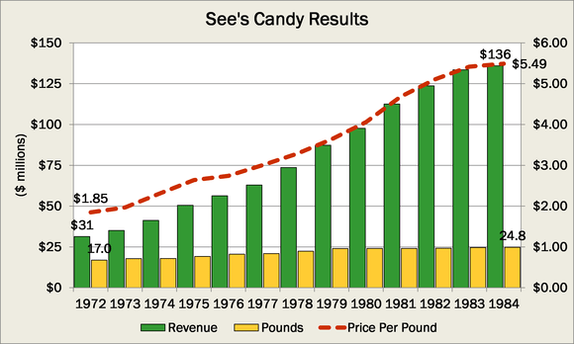
品牌 $⇒$ 涨价能力
喜诗糖果是当时美国糖果第一品牌。
很早就在电视做广告
右图：全国直播的玫瑰碗巡游（Rose Bowl Parade）
在圣诞节、情人节送糖果，必须是See’s Candy，才有面子。
潜在涨价能力
Notes:
二代，Laurance See, was nine years old when his father founded See's Candies. After graduating from Stanford University, Laurance soon became See's General Manager. In 1949, following three years of military service overseas, he returned to succeed his father as President. Laurance ensured that See's jumped on the television bandwagon early; opportunities to be televised, such as the Rose Bowl Parade, brought See's into living rooms nationwide. See's first-ever float in the Rose Bowl Parade was a giant 15-foot Easter Bunny pulling a cart with revolving Easter egg wheels, and was televised on New Year's Day.
Buffett believes: “The single most important decision in evaluating a business is pricing power. If you’ve got the power to raise prices without losing business to a competitor, you’ve got a very good business. And if you have to have a prayer session before raising the price by 10 percent, then you’ve got a terrible business.” Buffett and Munger found an asset in the form of See’s that has retained tremendous pricing power over the years. That means See’s has a moat.
Buffett: “Buy commodities, sell brands has long been a formula for business success. It has produced enormous and sustained profits for Coca-Cola since 1886 and Wrigley since 1891. On a smaller scale, we have enjoyed good fortune with this approach at See’s Candy since we purchased it 40 years ago.” “When we bought See’s Candies, we didn’t know the power of a good brand. Over time we just discovered that we could raise prices 10% a year and no one cared. Learning that changed Berkshire. It was really important.”

Slide 8
议价能力
卖品牌买大宗（Sell brand, buy commodity）
下游品牌垄断
上游是竞争市场
产品涨价，原材料价格相对稳定 $⇒$
利润增速 > 销售额增速 > 销售量增速
Notes:
从1972到2007，糖果销售从1600万磅到3100万磅（年化平均增长1.9%），利润从420万美元到8200万美元（年化平均增长8.5%）。

Slide 9
造血能力
资本开支很少，喜诗糖果给BRK 带来源源不断的现金。-- 自由现金流
BRK然后把喜诗糖果的利润再投资到回报率更高的公司中。
芒格:
There are two kinds of businesses: The first earns 12%, and you can take it out at the end of the year. The second earns 12%, but all the excess cash must be reinvested — there’s never any cash.
It reminds me of the guy who looks at all of his equipment and says, “There’s all of my profit.” We hate that kind of business.

Slide 10
对巴菲特的影响
第一次用“高价”买高质量公司，并大获成功。
买喜诗糖果后，认识到品牌的力量。
因为控股并参与管理（如开店、调价），巴菲特&芒格深入企业管理，对企业理解更深。
Buffett:
When we bought See’s Candies, we didn’t know the power of a good brand.
We have made a lot more money out of See’s than shows from the earnings of See’s, just by the fact that it’s educated me.
If we hadn’t bought See’s, we wouldn’t have bought Coke.

Slide 11
内容
引论
案例分析
喜诗糖果
可口可乐
百润股份
达美乐
安踏体育
小结

Slide 12
可口可乐
1886年，John S. Pemberton 做出配方：
Coca $→$ 可卡因（ cocaine ）
Kola nuts $→$咖啡因（ caffeine ）
1888年，Asa G. Cander成为大股东，向全国市场扩张。
1892年，可口可乐公司成立。
1919年上市，1920年开始分红。
1928年，开始在中国生产。
1988年，巴菲特买进可口可乐。
Notes:
With an initial investment of about $1 billion, Buffett’s Berkshire Hathaway acquired approximately 7% of the company, becoming the largest shareholder.

Slide 13
可口可乐的生意
卖品牌买大宗
原材料：糖、咖啡因、水、玻璃、铝
毛利60%左右，净利>20%
轻资产
ROIC 15%左右
Notes:
Coke’s genius, its secret formula in many ways, was staying out of the business of making stuff. The company consistently proved adept at tapping into technological systems that were built, financed, and managed by others.
Coke was the ultimate outsourcer.
Coke’s main business was not selling Coke; it was providing concentrate and syrup to bottlers and soda fountains. Such a business (unlike bottling) required little capital.

Slide 14
可口可乐股价（1985-2025）

Slide 15
80年代的可口可乐
可口可乐面临困境。
多元化投资不利。
市占率从1948年的60%下降到1984年的21.8%。
1985年，可口可乐尝试新口味失败。
80年代中期开始回归聚焦主业，并强调海外市场。
1987年，可口可乐回归道琼斯指数。
Notes:
60年代到80年代，可口可乐曾经走过弯路，向上游拓展，多样化投资。

Slide 16
巴菲特的投资决策
1985年，可口可乐推出“New Coke”, 遭遇大众抵制。
同年，巴菲特最喜欢的饮料在从Pepsi变成Cherry Coke.
估值
15倍P/E或P/FCF
成长性
国际市场人均消费量远低于美国
股东回报
持续分红
1987年宣布三年内回购10.6%的流通股份。
为什么不买Pepsi?
From Chapter 18, Buffett: The Making of An American Capitalist.
Notes:
1988年，每股FCF约为$3，股价在$35 and$45.25之间。
1. The stock was undervalued
Berkshire bought 23 million shares of Coca-Cola in 1988 and 1989, when the market was still recovering from the Black Monday crash of 1987. Buffett paid an average price of $43.81 per share ($2.73 on a split-adjusted basis) -- or 15 times Coca-Cola's earnings per share (EPS) in 1988.
That price-to-earnings (P/E) ratio didn't make it a deep value stock, but Buffett believed it was undervalued relative to its growth potential. After all, Coca-Cola was already an evergreen brand that had dominated the beverage market for decades before Berkshire bought its first shares.
2. It's a "forever" stock
In Berkshire's 1988 shareholder letter, Buffett said he planned to hold Coca-Cola and its other latest investments "for a long time." He also explained that "when we own portions of outstanding businesses with outstanding managements, our favorite holding period is forever.“
The company has grappled with declining soda consumption over the past decade, but it's largely offset that pressure by buying and developing new brands of juices, teas, sports drinks, bottled water, coffee, and even alcoholic beverages. It's also consistently refreshed its carbonated drinks with new flavors, smaller serving sizes, and healthier sugar-free versions.
That's why Coca-Cola's annual revenue rose from $8.3 billion in 1988 to $38.7 billion in 2021, representing a steady compound annual growth rate (CAGR) of 5%, even as sales of its namesake product stagnated.
3. It's a Dividend King
Coca-Cola has raised its dividend annually for 60 straight years, making it a Dividend King. It's tough to join that elite club -- which only consists of the S&P 500 companies that have raised their payouts annually for at least 50 straight years -- because paying consistent dividends for decades requires a company to generate stable profits through countless crises and recessions.
Coca-Cola currently pays a healthy forward dividend yield of 2.8%. Therefore, Berkshire's 400 million shares of the company now net a whopping $704 million in dividend payments each year.
4. Coca-Cola buys back its own stock
Back in 2004, Buffett told investors that buybacks are "probably the best use of cash" when a company's stock is undervalued. Berkshire didn't launch its own buyback plan until 2011, but it frequently invests in companies that aggressively repurchase their own shares.
In 1987, Coca-Cola announced that it would repurchase up to 10.6% of its shares over the following three years, even though its stock had already risen every year since 1980. That bold decision likely convinced Buffett that the stock was cheap and still had room to run.
Coca-Cola has reduced its share count by 30% since the beginning of 1987. After pausing its buybacks during the pandemic, it plans to repurchase about $500 million in shares this year.
为什么不买Pepsi?
He did not have the same degree of certainty about pizza, chicken, and tacos.
“A more interesting case was PaineWebber’s Emanuel Goldman, who liked Coca-Cola but preferred the more diversified PepsiCo.33 Goldman showed the Wall Street disease of paying too close attention to the trees. Pepsi, he noted, could expect a boost from higher Frito Lay prices, better results with Mountain Dew, home delivery of Pizza Hut, a forty-nine-cent meal at Taco Bell, and healthier fare at Kentucky Fried Chicken. Buffett also looked at Pepsi (which would also turn out well).34 But he did not have the same degree of certainty about pizza, chicken, and tacos.
He could reduce Coke’s virtues to a sentence: If you gave me $100 billion and said take away the soft drink leadership of Coca-Cola in the world, I’d give it back to you and say it can’t be done”

Slide 17
巴菲特的买入过程
1988年夏天，5.93亿美元（每股约2.6美元）。
1989年，4.31亿美元（每股约2.94美元）。
1994年，2.75亿美元（每股约10.42美元）。
到1994年底，可口可乐仓位约占Berkshire普通股投资额的34%。

Slide 18
可口可乐股价（1975-1994）
Notes:
股价上涨原因：业绩上升，估值上升。

Slide 19
类似的股票
怪物饮料（Monster Beverage, MNST）
东鹏饮料（605499）

Slide 20
内容
引论
案例分析
喜诗糖果
可口可乐
百润股份
达美乐
安踏体育
小结

Slide 21
百润股份
创于1997年7月，2011年3月上市，初始主营业务为香精香料。
子公司巴克斯酒业经营预调鸡尾酒，2009年以100元价格被剥离，卖给大股东为首的自然人。
2014年9月宣布以56.63亿元价格收购巴克斯酒业100%股权。
主营业务成为预调鸡尾酒+香精香料。

Slide 22
从Commodity 到 Brand

Slide 23
2014-2015
渠道：进入超市。
营销：明星代言、品牌赞助、电视剧植入广告大获成功。
自2015年1月10日《何以笙箫默》开播起，16天内，其天猫旗舰店的限量版包装日均销量同比增长4倍，达到每日4500瓶，常规包装销量同比增长8倍，每日12000瓶。
2013年Rio市占率20%，落后于百加得的冰锐。2014年上升到40%，2015年上升到65%。

Slide 24
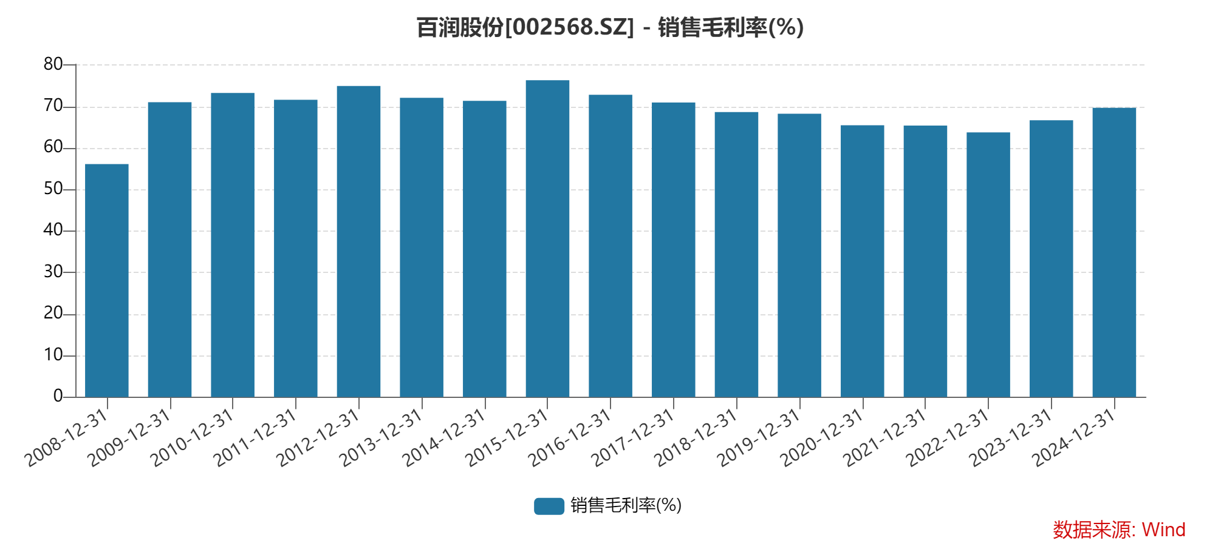
预期$≫$事实

Slide 25
昙花一现
Notes:
https://zhuanlan.zhihu.com/p/196299117
https://new.qq.com/rain/a/20210331A00I0H00

Slide 26
归母净利润

Slide 27
自由现金流

Slide 28
度过寒冬
2015年底，全行业陷入寒冬。
2016年
百润从全国铺货转回重点发达地区，同时拓展电商和餐饮渠道。
牺牲短期业绩，减少出货量，帮助经销商消化库存。
维持较高销售开支，支撑品牌。
2017年RIO市场占有率达70%。
2020年RIO市场占有率达到86.8%。
Notes:
2016年，据欧睿数据显示，行业销量规模下降了33%，而公司整体销量同比下降了61%，公司产品出货量远低于终端产品销量。
2016年公司销售费用仅同比下降20%，表明公司仍保持较高强度的推广。

Slide 29
品牌的支撑

Slide 30
2019-2021，两年15倍

Slide 31
融资扩产
烈酒项目
2020年11月增发股票募集基金9.9亿元，主要用于烈酒项目，增发价为62.68元。
2021年又发行可转债募资11.28亿元。
烈酒能否成为未来增长引擎？
2023年8月，宣布启动最高金额为20.25亿元的定增计划，用于预调鸡尾酒业务。
现有产能不足吗？
Notes:
根据2021年发行可转债时披露的数据，2018年到2021年上半年，公司预调鸡尾酒（含气泡水）产能利用率分别为18.99%、26.73%、28.55%、35.8%。其中2020年产能为6600万箱，产量仅为1884万箱。到了2022年，产量增长至3082.81万箱，即使以2020年产能来算，公司产能利用率也仅为47%。

Slide 32
存货：Make or Break

Slide 33
内容
引论
案例分析
喜诗糖果
可口可乐
百润股份
达美乐
安踏体育
小结

Slide 34
达美乐（Domino’s Pizza）
1960年Thomas and James Monaghan 用900美元在Ypsilanti, Michigan买下一家比萨小店，外卖到大学宿舍。
1965年取名Domino’s Pizza.
1967年第一家加盟店。
1983年第一家国际店。
1998年，Bain Capital领衔的投资基金从Monaghan家族买下93%的股权。
2004年在纽交所上市，代码DPZ.
竞争者包括必胜客（Pizza Hut）、棒约翰（Papa John’s）等。
达美乐是比萨外卖市场龙头，在全球90个市场有 19800家店（2023.1），其中99%为加盟店。
Notes:
1960, brothers Thomas and James Monaghan borrowed $900 and purchased a small pizza store in Ypsilanti, Michigan.
The IPO of shares in the nation's largest pizza-delivery company closed on the New York Stock Exchange at $13.50, or 3.6% below its offering price of $14 apiece.”

Slide 35
DPZ 月K线
IPO至今，年化复合增长率约20%.
2008年低点至今，年化复合增长率>30%.
Notes:
IPO价格为14元，前复权价格为6.455，

Slide 36
分析维度
是否好生意？
毛利和净利
现金流如何
投资回报率
成长性如何？
估值是否便宜？
回报股东？
有哪些风险？
风险
生意
成长性
股东回报
估值

Slide 37
生意
经营模式
美国国内：加盟店和自营店
国际特许经营商：Master franchisee （例如在大中华地区，达势股份1405.hk）
收入来源
加盟费和特许使用费（franchise royalties and fees, 约20%营收，75%利润）
供应链服务
自营店销售
内在增长动力
加盟店利润 $⇒$ 创业加盟需求 $⇒$ 供应链服务需求
Notes:
资本管理
高杠杆（royalty-based ABS融资）
回购、分红

Slide 38
加盟店竞争优势
主营外卖和自提
房租、管理、人员成本低。
菜单简单
降低运营复杂性
加快点单和食物准备
规模优势
原料供应（quality & consistency）
科技创新（信息化管理系统，网上点单系统）
产品创新
营销
Notes:
Our
supply chain segment offers profit-sharing arrangements to U.S. and Canadian franchisees who purchase all of their
food for their stores from our centers. These profit-sharing arrangements generally offer participating franchisees
and Company-owned stores with 50% (or a higher percentage in the case of Company-owned stores and certain
franchisees who operate a larger number of stores) of the pre-tax profit from our supply chain center operations. We
believe these arrangements strengthen our ties to and provide aligned benefits with franchisees.
In recent years, we have focused specifically on increasing
our presence in our existing markets to provide better service to our customers, including condensing our delivery
areas to provide better delivery service and adding locations that are closer to our carryout customers. We call this
approach our fortressing strategy.
Each Domino’s store located in the U.S. is obligated to contribute 6% of its sales
to DNAF, which uses such fees for national advertising in addition to contributions for local market-level
advertising.
our GPS
delivery tracking technology, which allows customers to monitor the progress of their food, from the preparation
stages to the time it is in the oven to the time it arrives at their doors.

Slide 39
业绩重要指标
全球销售增长（Global Retail Sales Growth）
特许权使用费（royalty）和广告费都和加盟店销售挂钩。
同店销售（Same Store Sales Growth）
开店增长（Store Growth Activity）
销售
增长
Notes:
全球销售增长剔除汇率影响。

Slide 40
全球销售增长

Slide 41
年末门店数量

Slide 42
同店销售增长

Slide 43
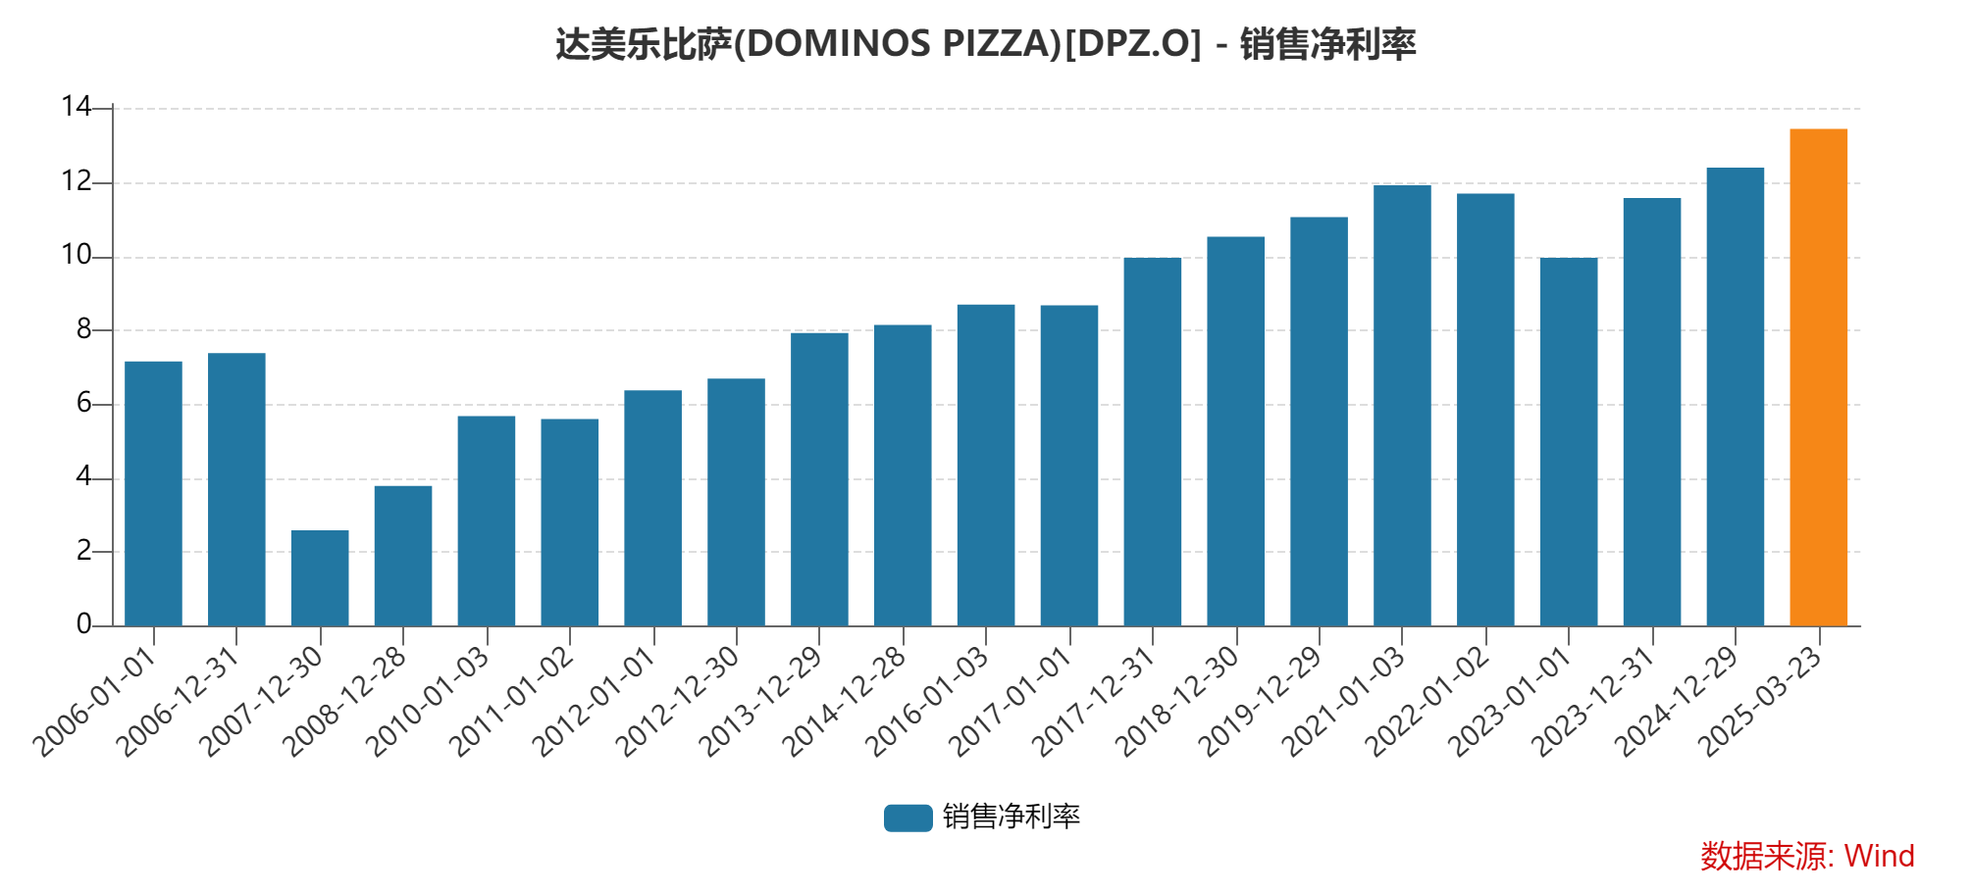
毛利和净利
2024年，毛利率为39.3%。
国内供应链11.1%
国内自有门店16.7%
专营权及费用？

Slide 44
现金流含量

Slide 45
ROIC

Slide 46
估值（TTM PE, 2013-2025）

Slide 47
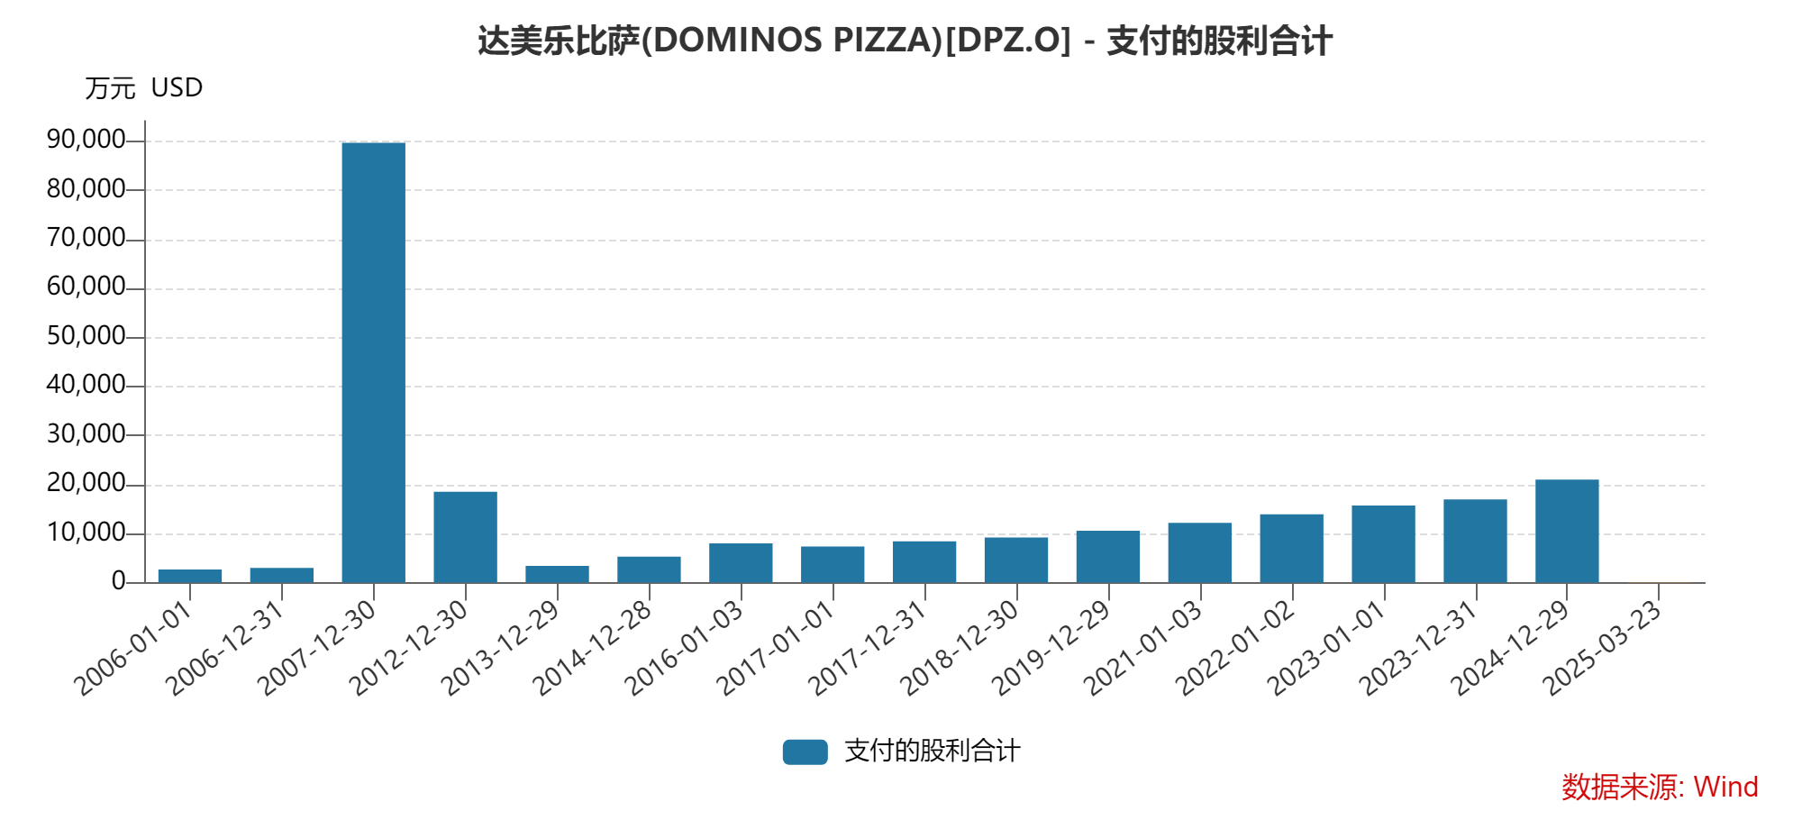
回报股东
股息
回购

Slide 48
风险：高杠杆模式的隐忧
在2022年末，公司有大约50亿美元借款。主要形式为以royalty fee为基础的资产证券化债券。
几乎每年都要借新还旧（Recapitalization）。
如果高利率环境持续，利息成本会攀升。

Slide 49
分析框架的运用
是否好生意？
毛利和净利
现金流如何
投资回报率
成长性如何？
估值是否便宜？
回报股东？
有哪些风险？
风险
生意
成长性
股东回报
估值

Slide 50
内容
引论
案例分析
喜诗糖果
可口可乐
百润股份
达美乐
安踏体育
小结
Notes:
喜诗糖果作为引子，讲品牌消费品的生意逻辑，以及什么是好生意。
可口可乐，讲二级市场的买入决策，考虑成长性和估值。
百润股份，估值体系的变化，以及困境逆转.
达美乐，轻资产
安踏体育，直销

Slide 51
安踏体育

Slide 52
资产负债表（安踏，2024年报）

Slide 53
利润和现金流（安踏，2024年报）

Slide 54
生意
生意：多品牌体育用品
毛利率62%，净利率21%。
自由现金流/净利润约85%.
ROIC 39%.
风险
生意
成长性
股东回报
估值

Slide 55
成长性
行业增长
行业内竞争
海外扩张
成长动力
新开店
新产品
新品牌
风险
生意
成长性
股东回报
估值
Notes:
行业门槛越来越高，新来竞争者少
比同行更懂消费者（产品定位）
全渠道：传统商场，购物中心，沿街店铺，奥特莱斯，电商

Slide 56
估值
静态市盈率15.6倍
如果剔除2024年的非经营性损益，静态市盈率22倍，不算低估。
分部估值
安踏品牌
Fila
其他
Amer Sports (52.7%)
风险
生意
成长性
股东回报
估值

Slide 57
股东回报
股息率约2.6%（2015.5.26）
外部融资
2020.2：发行10亿欧元零息可转债，2025.5到期，转股价96.76港币。
2023.4：配售1.19亿新股，价格为99.18港币。
2024.12：发行15亿欧元零息可转债，2029.12到期，转股价港币104.02（已调整至102.62）。
回购股票
2024.9至今，回购2500万股。
风险
生意
成长性
股东回报
估值

Slide 58
所以结论是什么？

Slide 59
小结
消费股容易理解、容易调研、业绩稳定，值得个人投资者关注。
通过本课的学习，理解“卖品牌买大宗”的生意，理解什么是“合理估值买好公司”，学习如何判断好公司。
在正常市场中，好公司估值偏高。要关注遇到困境的好公司。

