Slide 1
The Future of Chinese Economy
Junhui Qian
2018

Slide 2
Content
Growth potential
Growth engine
Hurdles
Q&A

Slide 3
GDP per capita

Slide 4
Growth Potential
China’s GDP per capita is less than 1/6 of the US’s GDP per capita.
If China’s living standard is to converge to that of the US, then there is still a great potential for further growth.

Slide 5
The Key Question:
Will convergence take place for China?
Or, will China become a high-income country?
Notes:
Convergence is rare, in the recent world history.
One can optimistically point to the fact that China is already an industrialized nation. In history, all industrialized nations have achieved high-income-country status.

Slide 6
Growth Engine
Supply side
“Technological progress”
Capital accumulation
Demand side
Investment
Consumption upgrade

Slide 7
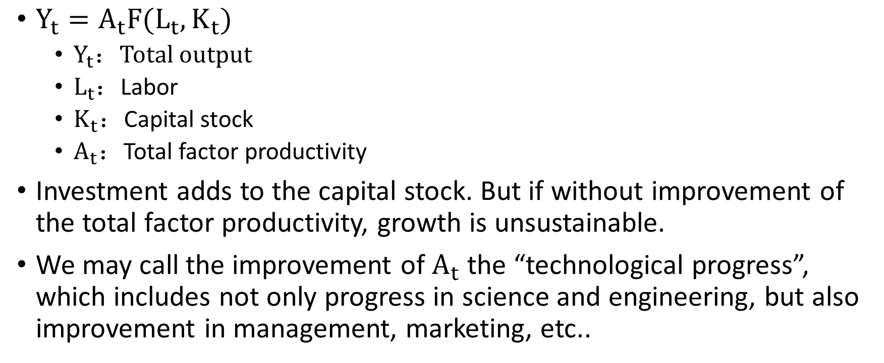
Understanding Long-term Growth
$Y_{t}=A_{t}F(L_{t},K_{t})$
$Y_{t}：$Total output
$L_{t}$：Labor
$K_{t}$：Capital stock
$A_{t}$：Total factor productivity
Investment adds to the capital stock. But if without improvement of the total factor productivity, growth is unsustainable.
We may call the improvement of $A_{t}$ the “technological progress”, which includes not only progress in science and engineering, but also improvement in management, marketing, etc..

Slide 8
Investment as a Growth Engine

Slide 9
The Ultimate Source of Growth
Reform and open-up
A dynamic and robust market economy
Catch-up
Innovation

Slide 10
What Makes China Special
Huge size
Extraordinary reward for investment and innovation
Pro-business culture
Strong entrepreneurship
Business-friendly policy

Slide 11
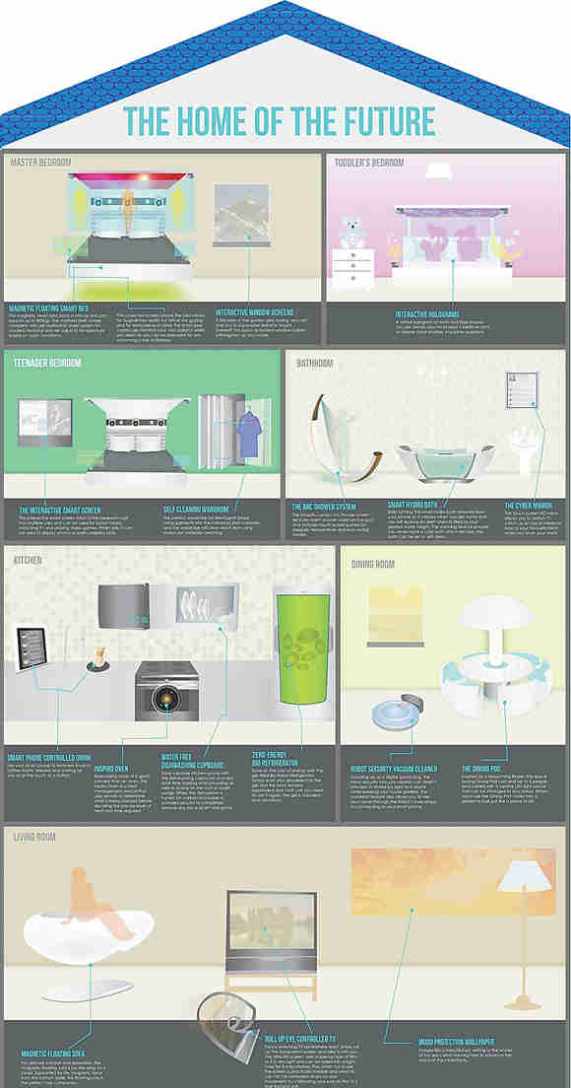
Consumption Upgrade
What holds Chinese consumption back:
Lack of safety net
Urban-rural division
Consumption inertia
While conspicuous consumption leads, inner-quality lags behind.

Slide 12
Hurdles against Growth
Regional disparity
Debt burden on the local government
Restrictions on migration
Restrictions on land use
Political uncertainty

Slide 13
Question?

