Slide 1
Fiscal System
Junhui Qian
2015 October

Slide 2
Content
Basics
The Transition of Fiscal System
  The Fiscal System Before the Reform
  Fiscal Responsibility System (1980-1993)
  Fiscal Reform of 1994
  Reforms after 1994
  Future Fiscal Reform
Recent Trends

Slide 3
Basics of Fiscal System
The fiscal system collects tax, provide public goods and make transfer payments to the citizens.
A modern fiscal system has the following characteristics:
  Principled taxation (equity, certainty, convenience, economy in collection, etc.)
  Modern budgeting process (in which the public have a say)
  Rule/law-based sharing of revenue and responsibility among different levels of government

Slide 4
What are public goods?
 | Excludable | Non-excludable
Rival | Private goods (e.g., clothes, food) | Common goods (e.g., public parks)
Non-Rival | Semi-public goods (e.g., satellite signal) | Public goods (e.g., national defense, public security)

Slide 5
Content
Basics
The Transition of Fiscal System
  The Fiscal System Before the Reform
  Fiscal Responsibility System (1980-1993)
  Fiscal Reform of 1994
  Reforms after 1994
  Future Fiscal Reform
Recent Trends

Slide 6
The Fiscal System Before the Reform
Essentially all expenditures were determined at the center.
Responsibilities for day-to-day public administration and social services, such as education (except universities), public safety, health care, social security, housing, and other local/urban services, were all delegated to local governments.
Financing for these services was provided by the central government through the revenue-sharing system, under which all revenues belonged to the central government.
Revenues came largely from industrial profits and were collected in a highly uneven pattern from different regions and localities.

Slide 7
The Decline of the Budget
As reform started, the formal revenue system quickly began to erode.
Central revenues were especially hard-hit because local governments in rich regions often shielded local enterprises from taxation to avoid sharing revenues with central the government.
Furthermore, there was no tax administration in place for rural enterprises.
Piece-meal reforms:
  1984: Income tax on SOE’s was introduced to replace profit remittances.
  1986: A contract system was introduced
  1988: Fiscal responsibility system (a contract system with local governments )

Slide 8
Fiscal Responsibility System
The contracts stipulated a lump-sum remittance to the center from each province, to increase annually by an agreed rate, with any additional revenues accruing to the province. In return, provinces accepted responsibility for meeting their expenditure requirements from retained revenues.
Fiscal contracts put local governments on a self-financing basis.
The responsibility system did not stop the decline of the budget. The central government share of revenue declined further due to the generous terms of the contracts (also thanks to the inflation).
Accompanying this decline of the budget, “extra-budgetary revenues” grew during the 1980s and 1990s.
By the early 1990s, the central government was in a “desperate” situation, spurring a drastic reform with two objectives:
  stemming the decline of revenues
  Increasing the share of central government revenue

Slide 9
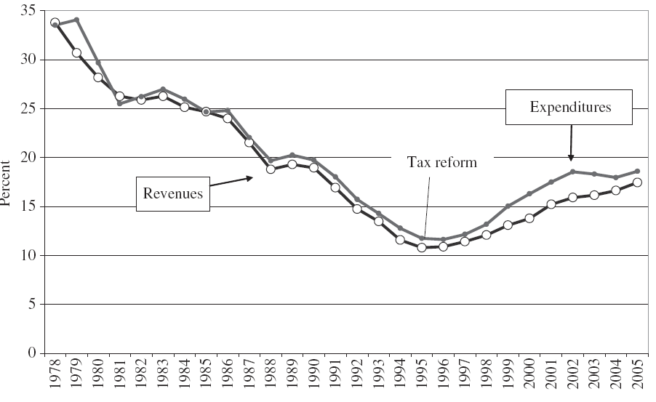
Budgetary Share of GDP

Slide 10
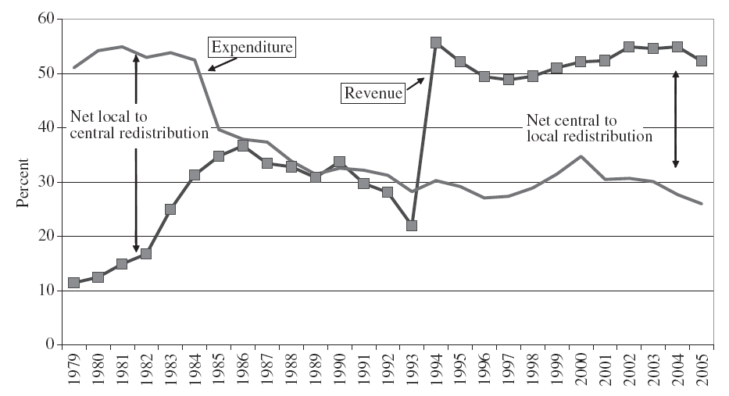
Central government share of budgetary revenue and expenditure

Slide 11
The 1994 Reform
The major fiscal reform of 1994 re-centralized the fiscal system.
The reform package had three components:
  Tax modernization
  Tax sharing
  Tax administration

Slide 12
Tax Modernization
Objectives: simplify tax structure, eliminate distortion, and increase transparency.
The complex multi-tiered system of turnover taxes borrowed from the Soviet Union was replaced with a value-added tax (VAT), which now applies to all manufacturing, repair, and assembly activities, primarily at a single rate of 17 percent.
By taxing only the portion of value added in any enterprise, the VAT also eliminated tax cascading and much of the incentive for vertical integration.
On eleven products an excise tax (the consumption tax, CT) is applied at differing rates in addition to the VAT, generally at a rate of 5%.

Slide 13
Tax-Sharing System
Under the TSS, taxes are assigned to central government, local government, or shared.
By assigning the biggest tax, the VAT, as a shared tax and claiming 75 percent of its receipts, the central government reclaimed a majority portion of total revenues.

Slide 14
Revenue assignments between the central and provincial governments (I)
Taxes exclusively assigned to the central government include:
  Excise taxes
  Taxes collected from the Ministry of Railroads and from the headquarters of banks and insurance companies
  Income taxes, sales taxes, and royalties from offshore oil activities of foreign companies and joint ventures
  All customs duty, VAT, and excise taxes on imports
  Enterprise income tax collected from banks and other financial institutions

Slide 15
Revenue assignments between the central and provincial governments (II)
Taxes shared between the central and local governments include:
  Value-added tax (75 percent central and 25 percent provincial)
  Natural resource taxes (coal, gas, oil, and other minerals if the enterprises are fully Chinese owned)
  Salt tax
  Industrial and commercial tax, and income tax levied on foreign and joint venture enterprises
  Security and exchange tax (50 percent central and 50 percent provincial) – added in late 1990s
  Income tax of all enterprises – added in 2002
  Personal income taxes – added in 2002

Slide 16
Revenue assignments between the central and provincial governments (III)
Taxes exclusively assigned to local governments include:
  Business (gross receipts) tax falling on sectors not covered by VAT (transportation and communications, construction, finance and insurance, post and telecommunications, culture and sports, entertainment, hotels and restaurants, and other)
  Rural market (stall rental) trading tax
  The urban maintenance and construction tax (a surcharge on the tax liability of enterprises for business tax, CT, and VAT)
  The urban land-use tax
  Vehicle and vessel utilization tax
  Value-added tax on land
  Education surtax
  Entertainment and slaughter taxes
  Property tax
  Surtax on collective enterprises
  Resources tax

Slide 17
Tax Administration
The 1994 reform established a national tax administration in China for the first time.
By removing central taxes and the VAT from local administration, the reform largely eliminated opportunities for local governments to divert central revenues into local coffers through manipulation of tax assessments.

Slide 18
Overview of the 1994 Reform
While reducing fiscal incentives for promoting local industry, the TSS also shifted incentives more toward commerce and trade by expanding the business tax on services and assigning it to local governments where it has become an important revenue source that rivals the VAT.
Distortions remain.
  The sharing of VAT and EIT on a derivation basis (where taxes are collected, such as the headquarters of enterprises) hinders the growth of national enterprises and slow down the consolidation process.
  Tax competition
More fundamentally, the reform recentralized revenues but left expenditure assignments unchanged, it created a huge fiscal gap for local governments.

Slide 19
The Fiscal Imbalance

Slide 20
Reforms after 1994
The clean-up of extra-budgetary revenue.
  In 1992, EBR represented 110.67% of in-budget revenue. In 2000, the ratio of EBR to IBR was reduced to 28%. By 2003, all fees and incomes from the previous EBR had been incorporated into budgeting.
Gradual improvement of tax sharing
  Most importantly, transfer payment is improved to equalize the provision of public goods across regions.
Expansion of VAT to service industry

Slide 21
What is transfer payment?
Transfer payment is a redistribution of income by the government. Examples include welfare, social security, subsidies for certain businesses, transfers from the central government to local governments.
Transfer payment is often referred to as the second distribution of income, after the first distribution in the market (i.e., wage, interest, dividend).

Slide 22
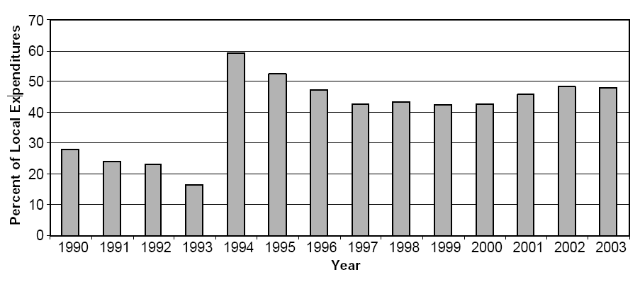
Transfers as a share of local expenditures

Slide 23
Transfer payment as a share of the gap between local revenue and local expenditure

Slide 24
The Improving Structure of Transfer Payments

Slide 25
Future Fiscal Reforms
The modernization of budgetary process
The rebalancing of revenue and responsibility among different levels of the government.
  Key questions are: what kind of public goods should be provided by the local governments and how to finance them?
Production-type VAT to consumption-type VAT

Slide 26
Content
Basics
The Transition of Fiscal System
  The Fiscal System Before the Reform
  Fiscal Responsibility System (1980-1993)
  Fiscal Reform of 1994
  Reforms after 1994
  Future Fiscal Reform
Recent Trends

Slide 27
Central Government Revenue and Balance

Slide 28
Tax and Nontax Revenue

Slide 29
Transfer Payment to Local Government

