Slide 1
Population and Employment
Junhui Qian, 2018

Slide 2
Content
Population
Employment
Issues
  Return to education
  Population aging
  Urban-rural disparity

Slide 3
Population Overview
As of 2016, Chinese has 1.38 billion people
Gender: 51.21% male and 48.79% female
Residence: 57.35% urban and 42.65 rural
Age: 22.9% under 15, 15% older or equal to 65
Education level among age 6+: 5.7% below primary, 12.9% beyond high school.
In average, a typical family has 3.11 persons.
  In Shanghai, the average family size is 2.47, the lowest among all provinces.
  Tibet has the highest average family size, 4.03.

Slide 4
The Dependency Ratio

Slide 5
Educational Achievement

Slide 6
Content
Population
Employment
Issues
  Return to education
  Population aging
  Urban-rural disparity

Slide 7
Employment Overview
As of 2016, 807 million are in labor force and 776 million are employed.
The primary (agriculture) sector employs 215 million, the secondary (manufacturing and construction) employs 224 million, and the tertiary (service) employs 338 million.
414 million are employed in the urban area, 362 million are employed in the rural area.
  Urban: 61.7 million are employed in SOEs, 4.5 million in collectives.
  Rural: 59.1 million are employed in private enterprises.

Slide 8
Labor Force Participation and Unemployment Rate

Slide 9
Structural Change (by sectors)

Slide 10
Structural Change (urbanization)

Slide 11
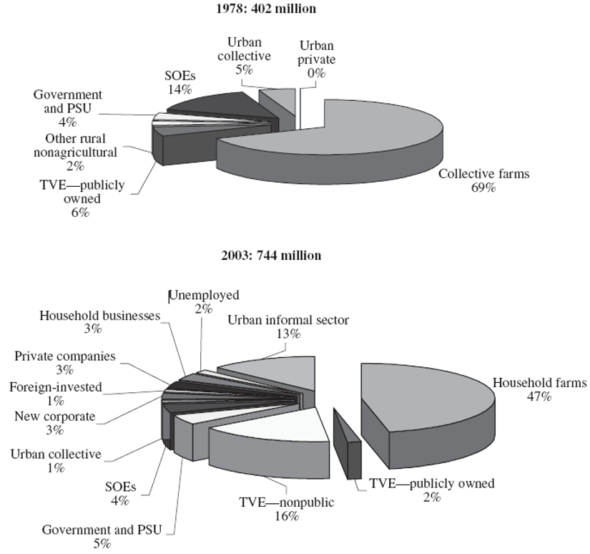
Employment by Ownership

Slide 12
Average Wage

Slide 13
Growth of Average Wage

Slide 14
Content
Population
Employment
Issues
  Return to education
  Population aging
  Urban-rural disparity

Slide 15
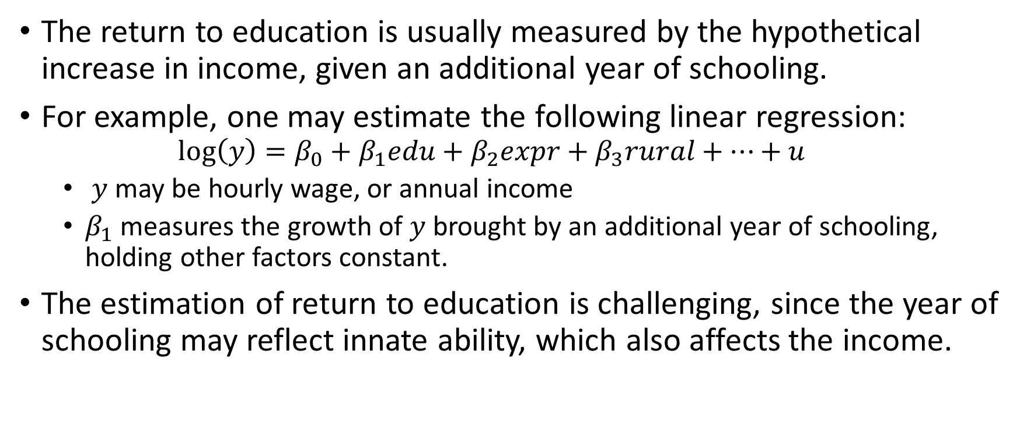
Return to Education
The return to education is usually measured by the hypothetical increase in income, given an additional year of schooling.
For example, one may estimate the following linear regression:
  $$log\left(y\right)=β_{0}+β_{1}edu+β_{2}expr+β_{3}rural+⋯+u$$
  $y$ may be hourly wage, or annual income
  $β_{1}$ measures the growth of $y$ brought by an additional year of schooling, holding other factors constant.
The estimation of return to education is challenging, since the year of schooling may reflect innate ability, which also affects the income.

Slide 16
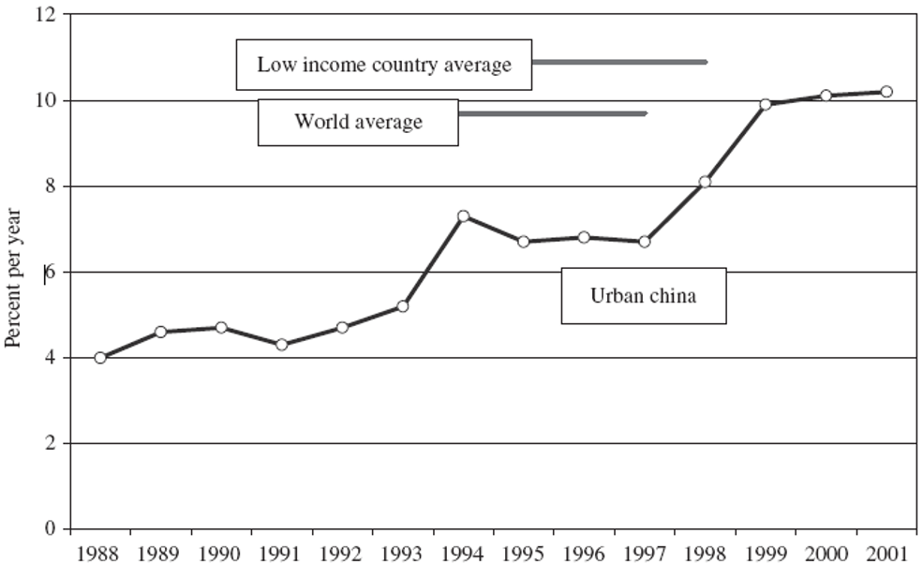
Percentage of wage increase given an additional year of schooling

Slide 17
Population Aging

Slide 18
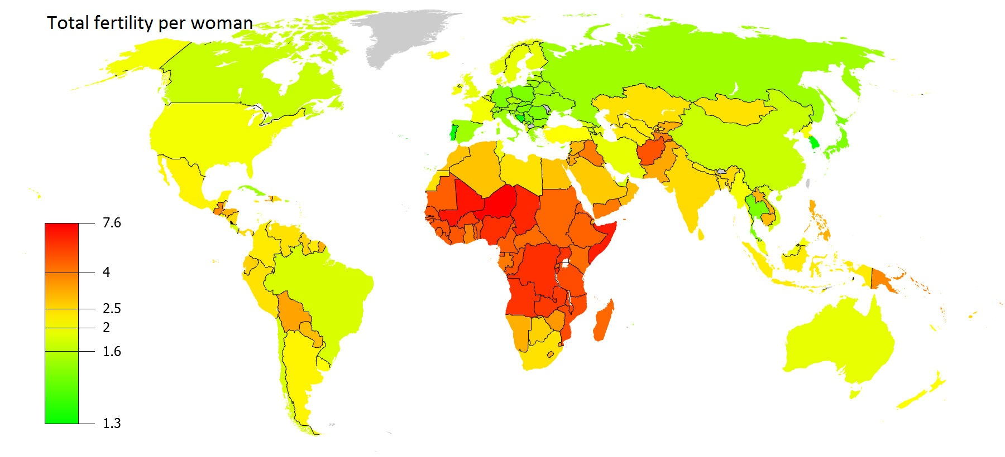
Reluctance to give birth
Notes:
Even after the complete abolishment of birth planning, the birth rate may not recover to a level that would keep population stable.

Slide 19
On Population Aging
For China, when would the pain of population aging be felt?
What would be the effect of population aging?

Slide 20
The Household Registration System (Hukou, 户口)
The Hukou system has origins in ancient China.
By 1954, rural and urban residents had been registered, and rigorous regulations on the conversion of hukou status had already been implemented.
After the great famine, greater limits were imposed on migration to big cities (Beijing and Shanghai, in particular).
In 1977, these limits were strengthened.
During the reform era, restrictions on migration from rural area to small cities have been relaxed, but migration to big cities are still strictly regulated.
During the reform, migration becomes common, but conversion of Hukou status remains difficult.

Slide 21
Hukou as a discrimination
In rural area, the provision of public goods (education, health, etc.) is poor.
Migrant workers face inequality in cities
  Less job opportunity
  Less employment benefits
  Children’s education
The Hukou discrimination may result in a poverty trap for rural population.
Notes:
Since the early 1990s, the migrants themselves have opened unlicensed private migrant schools that provide education to a large number of rural migrant children. Even these low-standard school were later closed down in Beijing and Shanghai, in effect driving many migrant children back in their hometown.

Slide 22
Hukou and Urbanization
Hukou as a barrier against urbanization, which is the ultimate solution to poverty.
  If without scale of production, a farmer would be no different from unemployed.
  The scale of production in the rural area implies mass migration to the cities.
Hukou is not the only barrier against urbanization.
  The outdated land ownership, rigid policies on land transfer and usage.

