Slide 1
International Trade and Investment
Junhui Qian, 2018

Slide 2
Content
Overview of international trade and investment
Issues
  Value-added v.s. gross value
  Chinese export as a supply shock
  Chinese import as a demand shock

Slide 3
Merchandise Trade
(millions of US$) | 2005 | 2010 | 2015 | 2016
Exports | 761,953 | 1,577,754 | 2,273,468 | 2,097,632
Imports | 659,953 | 1,396,247 | 1,679,566 | 1,587,925
Balance | 102,000 | 181,507 | 593,902 | 509,707

Slide 4
Service Trade
(millions of US$) | 2005 | 2010 | 2015 | 2016
Exports | 78,469 | (e) 178,339 | 217,556 | 208,488
Imports | 83,971 | (e) 193,401 | 435,847 | 453,014
Balance | -5,502 | (e) -15,063 | -218,292 | -244,526

Slide 5
The Most Open Large Developing Economy
Notes:
General Agreement on Tariffs and Trade, 1996

Slide 6
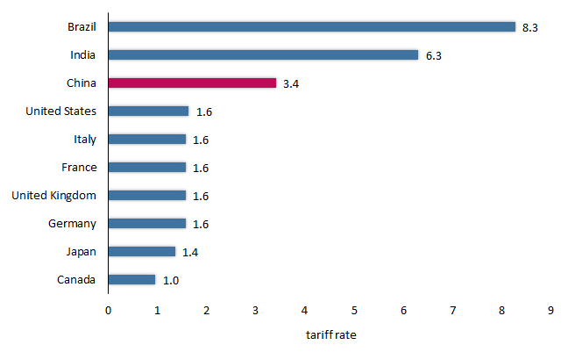
Weighted average applied tariff of 10 big countries in 2015 (%)
Notes:
Note: Data for India is for 2013, the most recent available year.
Source: World Development Indicators.
https://piie.com/blogs/china-economic-watch/china-most-protectionist-country-no-not-long-shot

Slide 7
Already the Top Trading Nation

Slide 8
One of the Most Welcoming Destinations for FDI

Slide 9
ODI from China Picks Up Rapidly

Slide 10
Content
Overview of international trade and investment
Issues
  Value-added v.s. gross value
  Chinese export as a supply shock
  Chinese import as a demand shock

Slide 11
Value-Added Export v.s. Gross Export
International trade data record gross value of goods as they cross borders.
  For example, iPhone is treated entirely as a Chinese export.
The emergence of global supply chain makes the international trade data an inaccurate characterization of the international trade.
  Implications for policy making
  Implications for policy analysis

Slide 12
Case Study: iPhone
iPhone was introduced to the market in 2007, selling an estimated 3.7 million, 13.7 million, and 25.7 million in 2007, 2008, and 2009, respectively.
It was designed in the US and assembled in China. When iPhones were shipped from China to the US, they were recorded as Chinese export to the US.
In 2009 alone, iPhone contributed USD 1.9 billion to the US-China trade deficit.

Slide 13
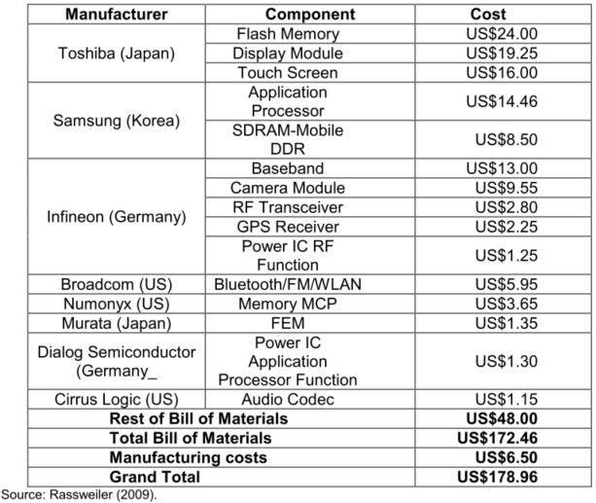
Apple iPhone 3G’s Major Components and Cost Drivers
Notes:
Table from: Yuqing Xing and Neal Detert, 2010, How the iPhone Widens the United States Trade Deficit with the People’s Republic of China, ADBI Working Paper Series

Slide 14
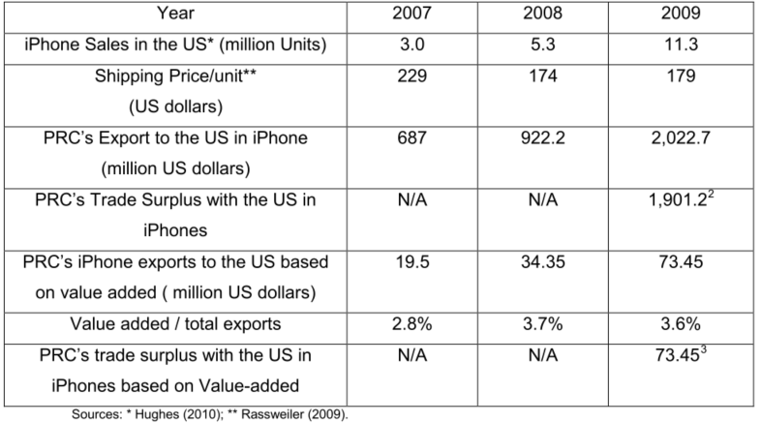
iPhone Trade and the US Trade Deficit with China

Slide 15
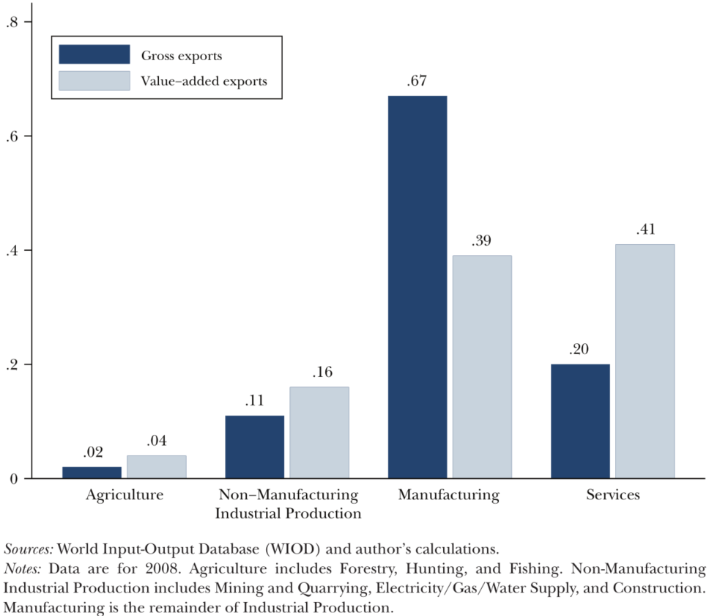
Sector Shares in Total World Value-Added and Gross Exports

Slide 16
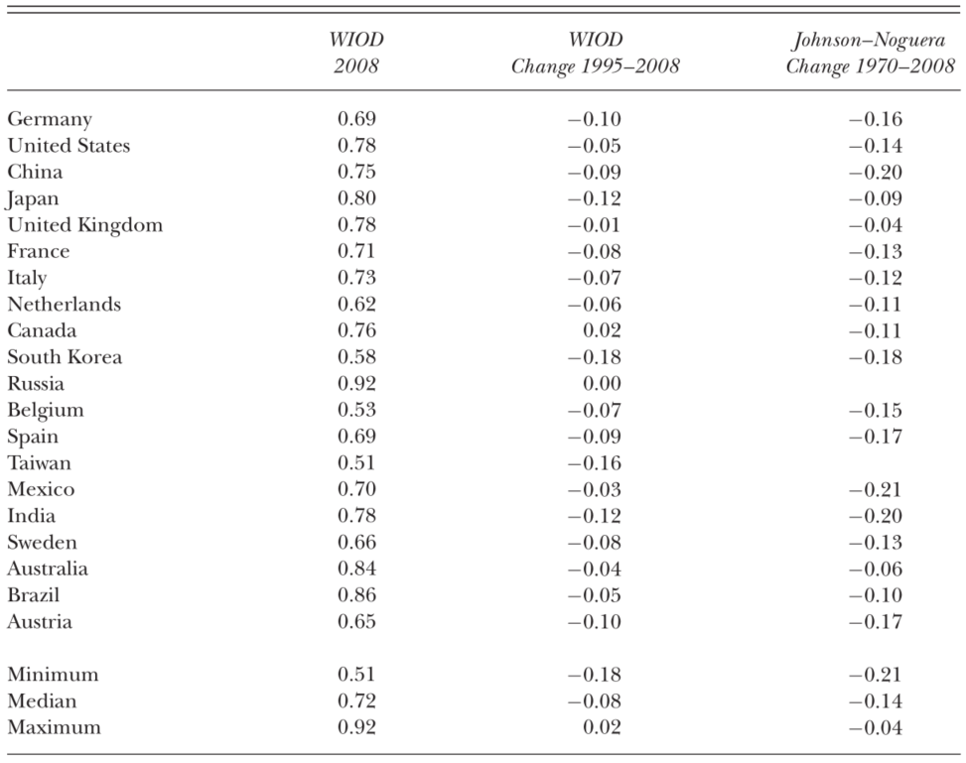
The Ratio of Value-Added to Gross Exports for the Top 20 Exporting Countries
Notes:
The table is from Johnson (2014)
Sources: World Input-Output Database (WIOD) and author’s calculations, Johnson and Noguera (2014).
Notes: The column “WIOD 2008” is the ratio of value-added exports to gross exports for each country in
2008 from the World Input-Output Database. The column “WIOD change 1995–2008” is the change
in this ratio from 1995 to 2008. The column “Johnson–Noguera change 1970–2008” is the change in
the ratio of value-added exports to gross exports for each country from 1970 to 2008, from Johnson and
Noguera (2014). Blank entries in that column reflect missing data. Exporting countries are ordered top
to bottom by total gross exports in 2008.

Slide 17
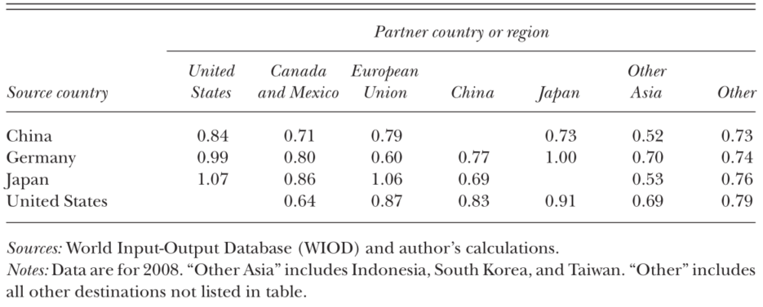
Ratio of Bilateral Value-Added to Gross Exports for Top 4 Exporting Countries
Notes:
The table is from Johnson (2014)

Slide 18
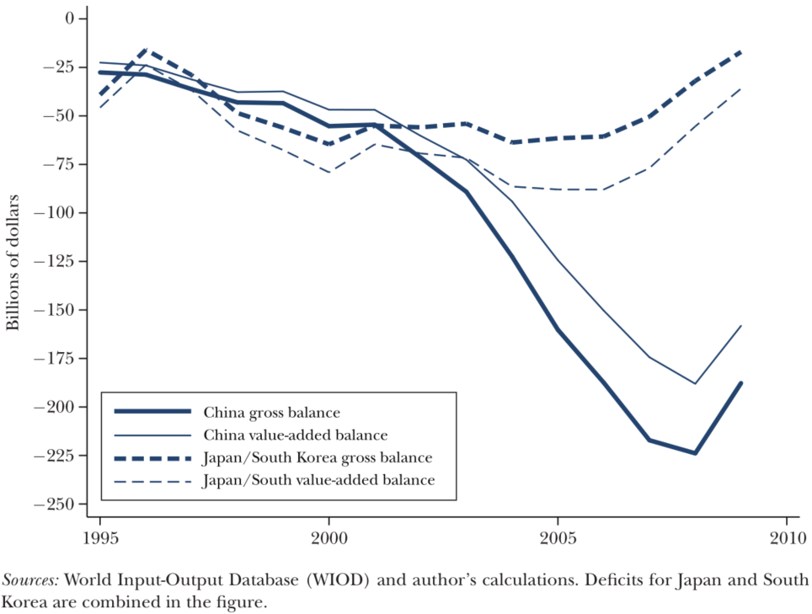
United States Trade Deficits with China, Japan, and South Korea

Slide 19
Discussions
How would a trade war between the US and China affect Japan and Korea?
What can be done to narrow the Sino-US bilateral trade deficit?

Slide 20
Content
Overview of international trade and investment
Issues
  Value-added v.s. gross value
  Chinese export as a supply shock
  Chinese import as a demand shock

Slide 21
Chinese Export as a Global Supply Shock
Low inflation
Low profit margin in manufacturing
Slow wage growth in the manufacturing sector
  Developed countries
  Developing countries
A secular fall in the long-term interest rate
  The global saving glut (Benanke, 2005)

Slide 22
Chinese Import as a Global Demand Shock
Industrial commodities
Consumption goods
Tourism
Education

