Slide 1
Monetary Policy
Junhui Qian, 2018

Slide 2
Content
Basics
Monetary policy instruments
  Reserve requirement
  Central bank loans
  Rediscounting
  Interest rate policy
  Exchange rate policy
  Open market operations
  Credit policy and window guidance
Recent trends
Macroprudential regulation

Slide 3
Functions of A Modern Central B ank
Banking for the government
Control availability of money and credit
Operate payment and settlement system
Lender of last resort
Surveillance and regulation of commercial banks

Slide 4
Objectives of Monetary Policy
For most countries:
  Low and stable inflation
  Low employment (high economic growth)
For some countries:
  Stable foreign exchange rates

Slide 5
Intermediate Objectives of Monetary Policy
Interest rates
Money supply
  Base money: currency in circulation + reserve
  Money multiplier: Money supply (M2 or M1) / Base money
Total credit and loans

Slide 6
Usual Instruments of Monetary Policy
Interbank overnight lending rate (e.g., US federal funds rate)
Reserve requirement
Central bank loans (Lending to financial institutions) and rediscounting
Open market operations
  Trading treasury bonds
  Issuance of central bank bills/papers
  Repo and reverse repo

Slide 7
Central Banking Before The Reform
Credit and cash plans were part of the central economic planning.
The planner controlled how much credit and cash should be issued and who should receive them.
With virtually no financial market, the planner easily controlled money supply.

Slide 8
The Birth of The Chinese Central Bank
Before the reform, PBC was a bureau under the Ministry of Finance in charge of monetary matters for economic planning.
The Agricultural Bank of China (ABC) was formed in Jan 1979 and was in charge of banking for the rural sector.
Bank of China was spun off in March 1979 and specialized in foreign currency management.
On Sep 17 of 1983, the State Council decided to transform PBC into a central bank in charge of monetary policy. Mechanism for reserve requirements and lending to commercial (special) banks was established.
The Industrial and Commercial Bank of China was formed in Jan 1984 and took away the industrial and commercial banking business of PBC.
By 1984, PBC became a de facto sole-purpose central bank.
In 1995, the Law of People’s Bank of China was passed, PBC became the central bank of China formally.

Slide 9
General Trends of Chinese Central Banking
More and more independent, from the Ministry of Finance, from the local governments, and in the future, from the State Council.
  In 1995, overdraft by MF was forbidden.
  In 1998, nine big branches replaced the old 31 provincial branches.
Rely less and less on command, and more and more on indirect control through market-based instruments.

Slide 10
The Case for Targeting Money Growth (M2)
Necessity:
  Financial system in transition
  Soft budget constraints of the state sector and the local governments
Feasibility:
  Bank dominance in the financial system

Slide 11
Content
Basics
Monetary policy instruments
  Reserve requirement
  Central bank loans
  Rediscounting
  Interest rate policy
  Exchange rate policy
  Open market operations
  Credit policy and window guidance
Macroprudential regulation
Recent trends

Slide 12
Reserve Requirement
Reserve requirement was established in 1984.
Two accounts: deposit reserve and settlement reserve
  The deposit reserve ratio (DRR) was 20% for enterprise deposits, 40% for savings deposits, 25% for rural deposits.
  In 1985, the DRR was unified as 10%.
  The DRR was raised to 12% in 1987 and 13% in 1988 to combat inflation.
  In 1989, the settlement reserve was required to keep 5%-7% of all deposits.
In 1998, two accounts were unified.
  The DRR was lowered from 13% to 8%.
  Banks may keep excess reserve in PBC.
  Deposit reserves are interest-bearing.

Slide 13
Required Reserve Ratio (1985-2018)

Slide 14
Central Bank Loans
The central bank loan (再贷款) is the central bank’s lending to commercial banks and other financial institutions.
CBL was a major source of base money expansion.
Since 1994, position for purchasing foreign exchange became the major source of base money expansion.
Since 1998, central bank loans was used in adjusting lending structure in the economy or injecting liquidity to financial institutions in distress.

Slide 15
Rediscounting
Rediscounting (再贴现) refers to the practice of discounting commercial papers by the central bank, which is to inject liquidity into the banking sector.
Rediscounting often happens when banks are in distress.
Rediscounting was one of the major instruments in the 1990s, and was used both in adjusting structural composition of liquidity provision and in signaling policy orientation.
The role of rediscounting has declined since 2000.

Slide 16
Interest Rate Policy
Before 1995, almost all interest rates were determined by PBC.
Since 1995, PBC has been persistently liberalizing interest rates.
In June 1996, interbank lending rate was liberalized.
In June 1997, interbank bond market was opened. Repo rate and interest rate on bonds were liberalized.
In Sep 1998, interest rates on the issuance of policy bonds and treasury bonds were liberalized.
In Sep 1999, treasury bonds started to be auctioned in the interbank bond market.
In Jan 2007, SHIBOR (ShangHai InterBank Offer Rates) was started.

Slide 17
Liberalization of Interest Rates on Deposits and Loans
The ordering the interest rate liberalization: first foreign, then domestic; first money market, then loans, then deposits; first long-term big-denomination, then short-term small denomination.
By Nov 2013, only the domestic deposit rate has a upper-limit. Other interest rates, including those on loans, are all determined by the market.
In Oct 2015, the upper-limit on the domestic deposit rate is also removed.
The central bank maintains the control over the benchmark interest rate, which is important for the setting of various loan interest rate (e.g., the mortgage interest rate).

Slide 18
Benchmark Interest Rates

Slide 19
Exchange Rate Policy
In 1994, RMB official exchange rate was merged with the market rate.
The interbank foreign exchange market was established. The exchange rate was formally determined by the market. But PBC intervened heavily.
From 1995 to 2005, the RMB/USD was de facto pegged at 8.3, with a daily fluctuation capped in [-0.3%, 0.3%].
From July 2005, RMB no longer pegs USD. RMB started to appreciate gradually. From 2005 to early 2014, RMB appreciated around 37%.
In August 2010, China established the RMB offshore market (CNH market).

Slide 20
The Reform of the RMB Exchange Rate (since 2005)
Milestones | Date | Main changes
“7.21” Reform | 2005.7.21 | Introduce the managed floating mechanism, with a [-0.3%, 0.3%] fluctuation band around the central parity rate.
 | 2006.1.4 | Introduce market makers and a new mechanism for the setting of the central parity rate.
 | 2007.5.21 | Widen the fluctuation band to [-0.5%, 0.5%].
 | 2008.10.6 | Restrict volatility with the onset of the global financial crisis.
 | 2010.10.22 | End of crisis mode.
“4.21” Reform | 2012.4.21 | Widen the fluctuation band to [-1%, 1%]; Deregulate banks’ foreign exchange dealings.
“3.17” Reform | 2014.3.17 | Widen the fluctuation band to [-2%, 2%].
“8.11” Reform | 2015.8.11 | Let the central parity rate reflect market demand and supply (previous closing rate).
 | 2016.2.15 | Introduce the mechanism of “closing rate plus exchange-rate movements of a basket of currencies” for setting the central parity.
 | 2017.5.26 | Introduce a “counter-cyclical factor” into the central parity pricing mechanism.

Slide 21
RMB/USD Exchange Rate (Annual)

Slide 22
Sterilized Intervention
To prevent RMB from appreciating (before 2005), or from appreciating too fast (2005-2014), the central bank has to intervene the foreign exchange market by purchasing the USD with created RMB. This operation increases the high-powered base money.
To sterilize the effect of the expanding money base (on inflation), the central bank conducted the following operations:
  Issuing the central bank bills (CBB, 央票)
  Increasing the required reserve ratio for commercial banks
Notes:
CBB reduces base money; Increasing RRR makes money multiplier smaller.

Slide 23
Foreign Reserve and the Issuance of Central Bank Bills

Slide 24
Foreign Reserve and Required Reserve Ratio

Slide 25
Open Market Operations
OMO in China include trading of treasury bonds, issuance of central bank bills, conducting repo and reverse repo.
Bonds trading and repo operations are both limited by the quantity of bonds in the open market.
In the late 1990s, purchasing treasury bonds was the major source of base money expansion.
From 2003, PBC started to issue central bank bills. CBB became the major instrument for sterilization of money expansion due to the purchase of foreign exchange reserve.
In 2007, the Ministry of Finance increased the supply of treasury bonds. PBC increased the usage of repo and reverse repo in the adjustment of short-term liquidity in the market.

Slide 26
Credit Policy and Window Guidance
Credit policy is still being used in adjusting supply of loans to different sectors, industries, geographic areas.
Window guidance is the central bank’s advice for commercial banks. It is up to banks to accept it or not.
Before 1998, monetary policy was based more on command. It was called “direct management”.
After 1998, monetary policy was achieved more by changing liquidity conditions in the market and by window guidance. This was called “indirect management”.

Slide 27
Content
Basics
Monetary policy instruments
  Reserve requirement
  Central bank loans
  Rediscounting
  Interest rate policy
  Exchange rate policy
  Open market operations
  Credit policy and window guidance
Macroprudential regulation
Recent trends

Slide 28
Macroprudential Regulation
Macroprudential regulation is the financial regulation that aims to mitigate systemic risk to the financial system and the economy as a whole.
In many countries including China, the responsibility of macroprudential regulation falls largely on the central bank.

Slide 29
The Policy Instruments for Macroprudential Regulation
Capital requirement (banking regulation)
The required reserve ratio
Window guidance
Liquidity provision

Slide 30
Event Study: 2013 Liquidity Panic
In June 2013, PBoC tightened the liquidity in the interbank money market, in an effort to control the runaway leverage buildup and liquidity mismatch in many medium and small-sized banks.
As a result, the short-term borrowing cost in the money market shot up.
  There were rumors on bank failures.
  The stock market crashed during the panic.
The liquidity panic ended only after the PBoC stepped in and started to provide liquidity.

Slide 31
2013 Liquidity Panic

Slide 32
The Lessons of the 2013 Liquidity Panic
Cutting liquidity, as a punishment, is costly.
The central bank, as the lender of the last resort, should have regulatory power over commercial banks.
The coordination and corporation between regulatory bodies are important for effective financial regulation.

Slide 33
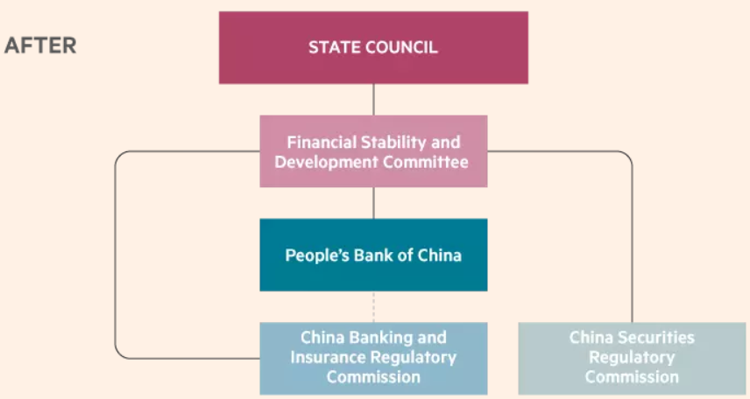
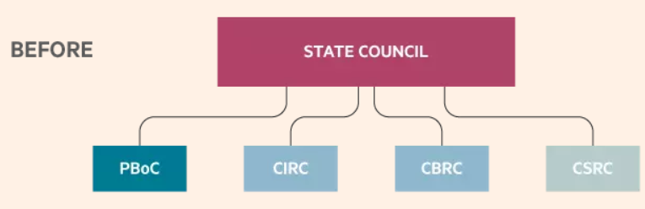
The Recent Regulatory Reform

Slide 34
Content
Basics
Monetary policy instruments
  Reserve requirement
  Central bank loans
  Rediscounting
  Interest rate policy
  Exchange rate policy
  Open market operations
  Credit policy and window guidance
Macroprudential regulation
Recent trends

Slide 35
Recent Trends
Base money expansion relies on lending facilities, rather than purchasing foreign currency (USD).
Quantity target gives way to interest rate target.
More liberalized interest rate and exchange rate policies.
More synchronized cycles of interest rate with the world.
Convergence of the Sino-US interest rates

Slide 36
More Balanced Trade

Slide 37
The Central Bank Lending Facilities
SLF (Standing Lending Facility,常备借贷便利, from 2013)
MLF (Medium-term Lending Facility, 中期借贷便利操作, from 2014)
PSL (Pledged Supplementary Lending, 补充抵押贷款, from 2014)
The interest rates of the above operations are supposed to guide the market interest rate.
Notes:
MLF: 2015年各季度分别开展MLF操作10145亿元、5145亿元、3600亿元和3058亿元，期末MLF余额为6658亿元。上半年，操作期限均为3个月，利率为3．5%。下半年，将期限延长为6个月，利率为3．35%，为引导金融机构降低贷款利率和社会融资成本，11月又将其利率下调至3．25%。
PSL: 2014年7月，央行向国开行注入为期3年1万亿的PSL，利率4.5%，用于支持棚户区改造、保障房安居工程、三农和小微企业发展。2015年6月，央行再次对特定银行进行了PSL操作，以提供基础货币，同时调降本次PSL利率至3.1%.

Slide 38
The Phasing-out of the M2 Target

Slide 39
Market Interest Rate

Slide 40
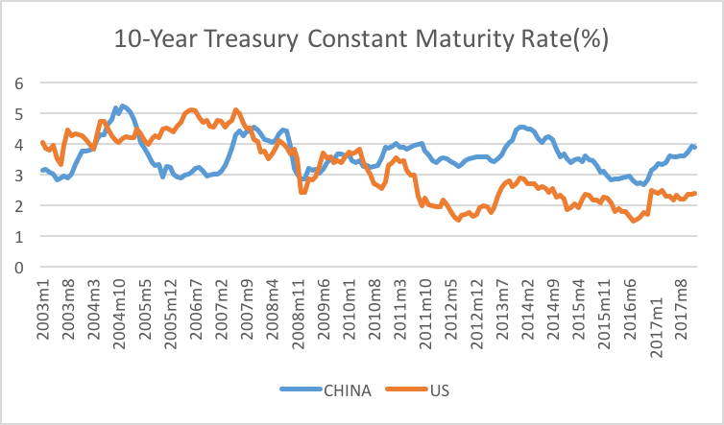
Synchronization of the Chinese and the US Interest Rate

Slide 41
Convergence

