Slide 1
Financial System (part 3)
Junhui Qian
2018

Slide 2
Content
Private Equity Investment
Bond Market

Slide 3
Private Equity Investment
The private equity (PE) refers to investments made by individual investors and private equity firms directly into a business.
Types of private equity firms include
  Private equity funds
  Venture capital funds (VC)
  Angel investors
The private equity investments are typically illiquid. The exit strategies include
  IPO
  Trade sale (acquisition)
  Open market sale (secondary sale)
  Secondary buyout
  Liquidation
The private equity funds are typically organized as limited partnerships, whose investors may include institutional investors, endowments, or individuals.
Notes:
Trade sale: in which the private equity investor sells all of its shares held in a company to a trade buyer, i.e. a third party often operating in the same industry as the company itself.
'Secondary Buyout‘:
In a secondary buyout, a financial sponsor or private equity firm sells its investment in a company to another financial sponsor or private equity firm, thereby ending its involvement with the company. Historically, secondary buyouts have been perceived as "panic" sales and, thus, sometimes hard to consummate. Secondary buyouts are not the same as secondary market purchases, or "secondaries," which typically involve the acquisition of entire portfolios of assets.

Slide 4
The Top 10 Private Equity Firms
The Blackstone Group
Kohlberg Kravis Roberts
The Carlyle Group
TPG Capital
Warburg Pincus
Advent International Corporation
Apollo Global Management
EnCap Investments
Neuberger Berman
CVC Capital Partners

Slide 5
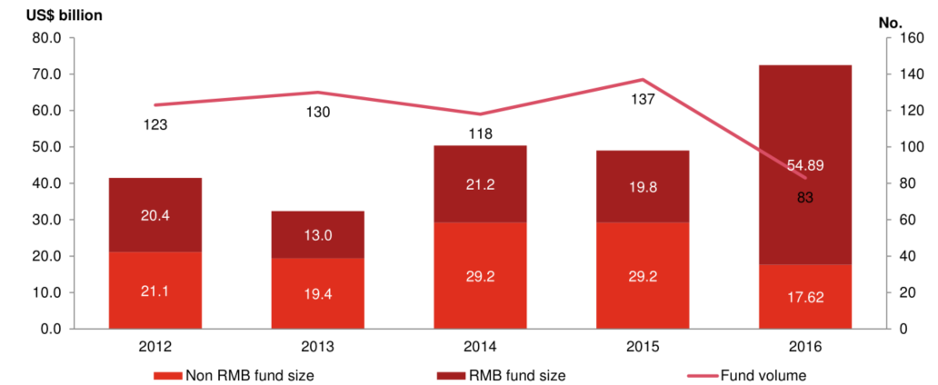
PE/VC Funding for Investment in China

Slide 6
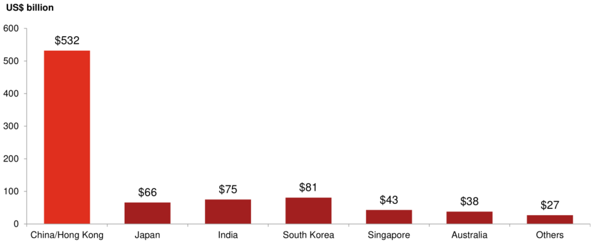
Total Funding Raised by Asian Countries (2006-2016)

Slide 7
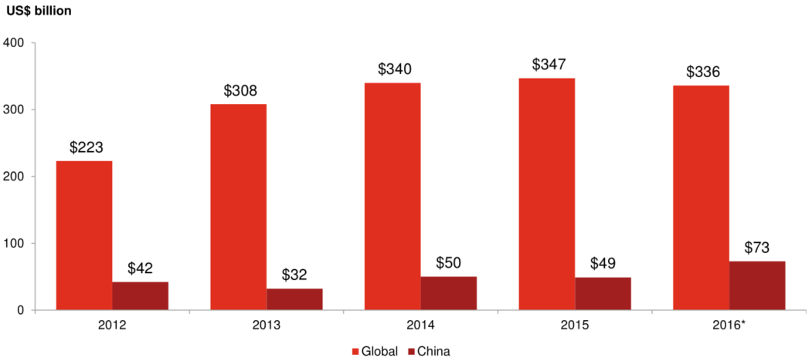
PE/VC Fund Raising for China and the World

Slide 8
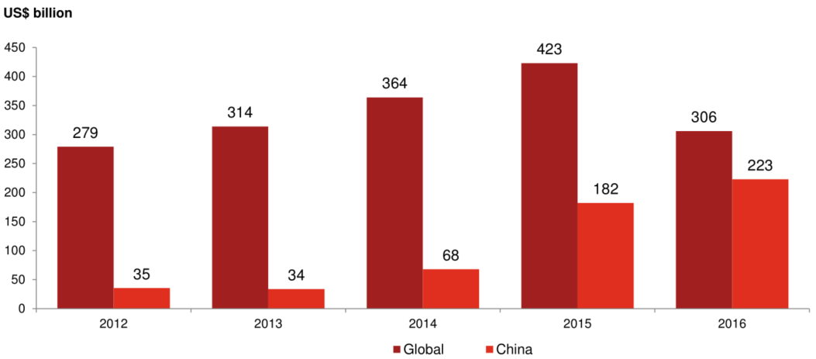
PE/VC Deal Value in China and the World

Slide 9
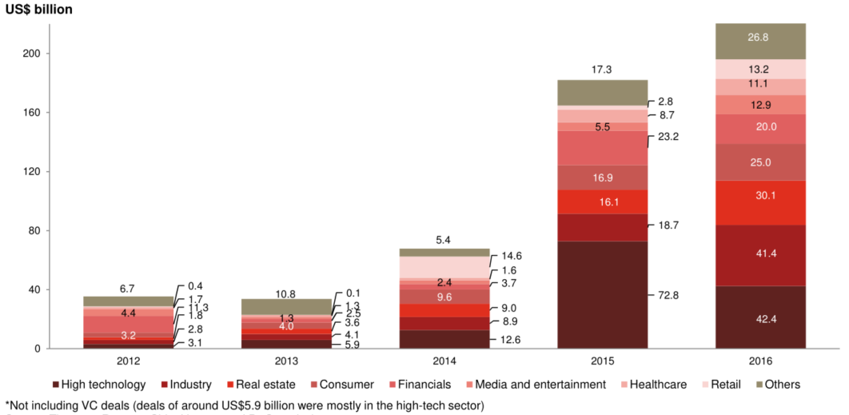
Deal Value in China by Sectors

Slide 10
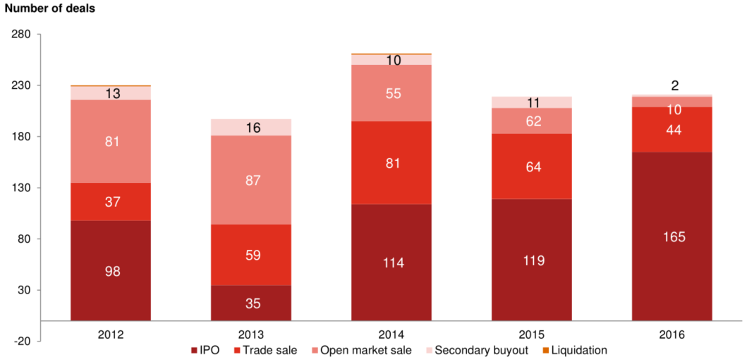
Exit Types for PE/VC

Slide 11
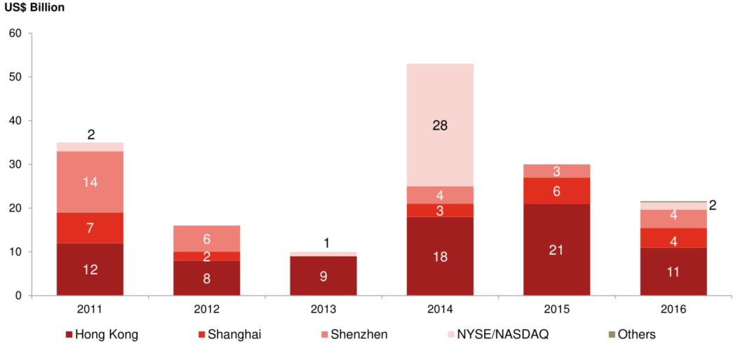
Locations and Exit Values of IPO

Slide 12
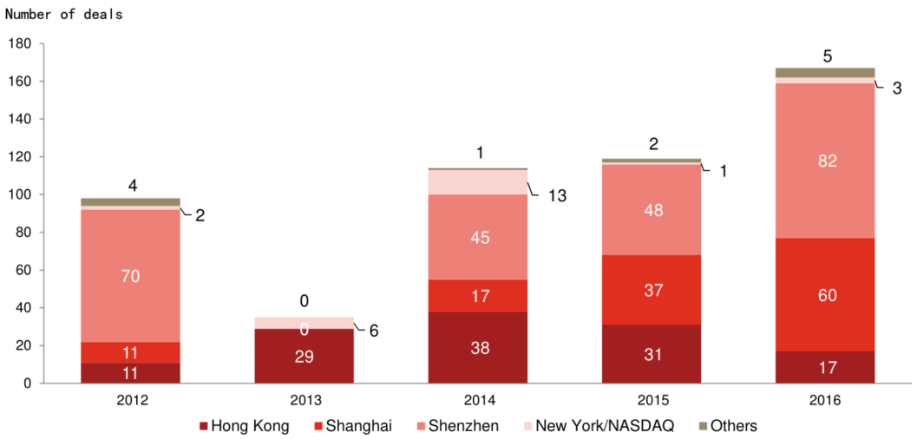
Locations and Exit Volumes (number of deals)
Notes:
All graphs from 5 to 12 are from PWC.

Slide 13
Contributions of the Private Equity Investment to the Chinese Economy
The bank-dominated financial system is not conducive to innovations.
Private equity investment is an indispensable complement to the financial system by making risky investment in industries with no state guarantee or collaterals.
Many well known Chinese firms were backed by foreign PE/VC’s.
Domestic PE/VC’s are also growing fast.
The boom of private equity helps the transition of the financial system from a bank-dominated one to a multi-polar one. The financial transition is essential for the transition of the Chinese economy from one that is dominated by manufacturing and construction to a more balanced one.

Slide 14
Content
Private Equity Investment
Bond Market

Slide 15
The Structure of the Chinese Bond Market
The exchange bond market
  Shanghai, Shenzhen
  Order-driven
  Participants: small and medium-sized institutions and individuals
The interbank bond market
  Quote-driven OTC market
  Participants: large institutional investors
Notes:
The interbank bond market was established in 1997. All commercial banks move their repo and bond trading out of the Shenzhen and Shanghai stock
exchanges and into an interbank market operating through an electronic trading system.

Slide 16
The Importance of Bond Market
It is an important form of direct financing, which reduces reliance on the banking system for credit.
As an asset, bond enjoys better liquidity. Hence lower cost for the issuing company.
The bond market is an important channel for the transmission of monetary policy.
The bond market enables financial institutions to better manage liquidity.
  Repo
  Reverse repo

Slide 17
Increasing Share of Bond Financing

Slide 18
Market Value of Bonds

Slide 19
Repo and Reverse Repo

Slide 20
The Opening-Up of the Bond Market
In February 2016, the People’s Bank of China threw wide open the doors to the interbank bond market.
Banks, insurers, securities firms, asset management companies, pension funds and nonprofit endowments can now enter the market without prior approval.
In July 2017, the Shanghai Bond Connect was established, which would allow foreigners to buy onshore Chinese bonds without the need for an onshore account.

Slide 21
Other Financing
Entrusted loans
Trust loans
Undiscounted bankers‘ acceptances
Informal lending

