Slide 1
Financial System (part 2)
Junhui Qian
2018

Slide 2
Content
Stock Market
  A history
  Characteristics
  Booms and busts

Slide 3
A History before 1949
Securities trading in Shanghai began in late 1860s.
The first stock exchange appeared in 1891.
"Shanghai Securities & Commodities Exchange" and "Shanghai Chinese Merchant Exchange" started operation in 1920 and 1921, respectively.
These two exchanges merged into one, Shanghai Stock Exchange, in 1929.
In Dec 1941, SSE was halted after Japan occupied the Shanghai international settlement.
In 1946, SSE resumed trading, before closing in 1949.

Slide 4
History in the Reform Era
In 1984, stocks and corporate bonds emerged in Shanghai and a few other cities.
In 1990, Shanghai Stock Exchange re-opened.
In 1992, China Securities Regulatory Commission (CSRC) was established.
Inn 1994, the Company Law was introduced, which clarified the rules on share issuing and transfer.
In 1997, CSRC was given the regulatory authority over the Shanghai and Shenzhen stock exchanges.
In 1998, CSRC was elevated to the ministerial rank.
In 1999, the Securities Law came into effect.
In 2005, the reform of non-tradable shares (股权分置改革) was carried out.
Notes:
The quota system for IPO was abolished after the Securities Law was introduced.

Slide 5
The Ratio of Tradable Shares

Slide 6
The Reform of IPO
The quota system before mid-1999.
The verification system was introduced in mid-1999.
The IPO pricing mechanism was constantly evolving.
  Pre-fixed P/E ratio
  Cumulative auction (negotiation between issuer and underwriters)
  Cumulative price inquiry with a cap on the offering P/E ratio
The transition from verification system to a registration system with a market-based IPO pricing is still ongoing.

Slide 7
The Expansion of the Stock Market

Slide 8
Recent Development
In Mar 2010, margin buying and short selling were introduced.
In Apr 2010, the stock index future was introduced.
In Nov 2014, Shanghai-Hong Kong Connect started to operate.
In Dec 2016, Shenzhen-Hong Kong Connect started to operate.
A Shanghai-London Connect is in talks.

Slide 9
The Current Standing in the World
The Shanghai Stock Exchange is now the 4th largest stock market by market capitalization at 5.0 USD tn.
The Shenzhen Stock Exchange is now the 8th largest stock market by market capitalization at 3.7 USD tn.
The Hong Kong Stock Exchange is the 7th largest stock market by market cap at 4.1 USD tn.

Slide 10
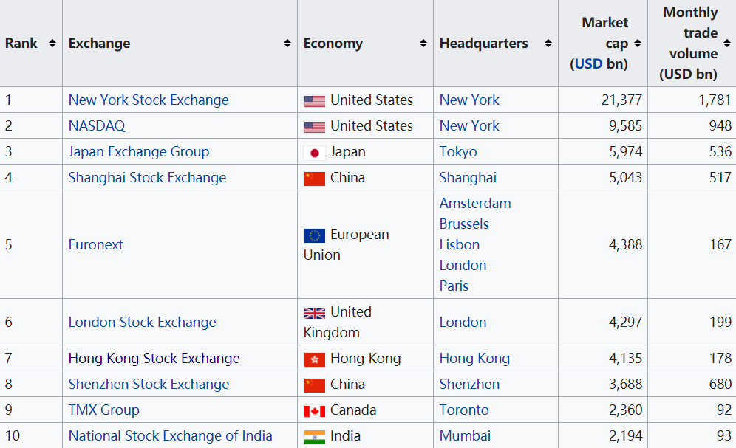
Major Stock Exchanges (ranked at Oct 2017 )

Slide 11
Characteristics of the Chinese stock market
One of the earliest in the world to adopt electronic trading
Segmented markets (A share, B share, H share)
Low contestability
Rationing of listing opportunity
Strict regulation, relatively weak law enforcement
Policy-driven market
Large turnover, especially on small-cap stocks

Slide 12
Hang Seng China AH Premium Index

Slide 13
Turnover Rate on Asian Stock Exchanges

Slide 14
Paternalism in the A-share Market
Restriction of daily volatility
Rare cases of delisting
Highly controlled IPO pace
Extremely limited short selling
Restrictions on seasoned equity offering by the listed companies.

Slide 15
The Opening-Up with Chinese Characteristics
B share markets
QFII and QDII mechanism
Shanghai-Hong Kong Connect (started on Nov 17, 2014)
Shenzhen-Hong Kong Connect (started on Dec 5, 2016)

Slide 16
B-Share Markets
Since 1991, listed companies in Shanghai and Shenzhen are allowed to issue B shares to foreign investors. By 1998, there are 106 B-share stocks (52 in Shanghai, 54 in Shenzhen).
Since 2001, domestic investors are allowed to trade B-share stocks.
As companies were allowed to list in Hong Kong, the B-share markets stagnated.

Slide 17
Booms and Busts

Slide 18
The Recent Two Boom-and-Bust Cycles
June 2001-June 2005: bear market
June 2005-October 2007: bull market
October 2007-June 2013: bear market
June 2013-June 2015: bull market

Slide 19
The Sources of Weakness during 2001-2005
The bear market started with a regulatory crackdown on frauds.
Worries over the reform of non-tradable shares
The panic over SARS.
High valuation

Slide 20
Volatile Changes in Valuation

Slide 21
The Weakness in 2008-2013
The global financial crisis.
A normalization of valuation.
After the stimulus package in 2009-2010, monetary and regulatory tightening followed.

Slide 22
The Bull Market of 2014-2015
High expectation on reforms and opening-up
  SOE reform
  Opening-up of the capital markets
Monetary loosening
Increasing leverage

Slide 23
The Stock Panics of 2015 and 2016
June-July, 2015
  Over valuation
  Crack-down on leverage
  Unfulfilled hopes for a MSCI inclusion
  Liquidity crunch
    Limits on daily volatility
    Voluntary suspension of trading
August, 2015
  Liquidity crunch due to the unwinding of hedge fund positions
January, 2016
  Panic selling due to the introduction of circuit breakers

