Slide 1
Financial System (part 1)
Junhui Qian
2018

Slide 2
Content
Basics
The Reform of the Financial System
The Banking System
Recent Trends

Slide 3
What is a financial system?
Financial system is the collection of rules and institutions that facilitate the allocation of financial resources between savers and borrowers.
  Banks
  Insurance
  Capital market
    Equity market
    Bond market
  Derivatives market
  Others

Slide 4
What Does the Financial System Do?
Financing
  Provide financing to households and enterprises.
Saving
  Provide financial products to savers (investors).
Information
  Generate information on enterprises and investment projects so that risk can be priced and resources can be efficiently allocated.
Control
  Impose discipline on managers of public companies

Slide 5
Content
Basics
The Reform of the Financial System
The Banking System
Recent Trends

Slide 6
The Financial System Before The Reform
Monobank: People’s Bank of China
It is both the central bank and the commercial bank.
The monobank system collects savings, channels funds to work units according to plans. No information is generated from the process.
The role of the monobank system is passive, accommodating the needs of the planner. The monobank system does not impose discipline on managers of the work units.

Slide 7
Financial Deepening
Before the reform, financial wealth of the country was limited, mostly in the form of deposits (claims on the monobank).
As the transition from the planned economy to the market economy started, more financial wealth (relative to income) had been created and held as claims on banks and enterprises. This process is often called “financial deepening”.
The financial deepening may be measured by the ratio of financial assets to national income. More conveniently, it is often measured by M2/GDP.

Slide 8
Financial Deepening

Slide 9
Financial Broadening
Financial broadening refers to an increase in the variety of financial institutions and instruments.
Over the past three decades, China had transformed the monobank into a sophisticated banking system, had developed stock and bond markets, derivatives market, etc.
During the development, there appeared a wide variety of institutional investors (mutual funds, insurance companies, private equities, hedge funds, etc.) and financial products.

Slide 10
Content
Basics
The Reform of the Financial System
The Banking System
Recent Trends

Slide 11
The Banking System
Large commercial banks
Mid-sized commercial banks
City commercial banks
Rural commercial banks
Rural cooperative banks
Rural credit unions
Postal saving bank
Financial asset management companies
Trust companies
Notes:
As of 2014, there are 3 policy banks, 5 large commercial banks, 12 mid-sized commercial banks, 133 city commercial banks, 665 rural commercial banks, 89 rural cooperative bank, 1596 rural credit unions, 1 postal saving bank, 4 financial asset management companies, 68 trust companies, etc.
As of 2014, the total asset of the banking system amounted to RMB 172.3 trillion, while the total liability was RMB 160 trillion.
The bank system employs 3.76 million people at the end of 2014.

Slide 12
Bank’s Fiscal Responsibility
In 1980s and 1990s, banks often lent money to SOE’s to keep them afloat.
“The reform without losers” was partly achieved by absorbing losses by the financial system, the banking system in particular.
After the Asian Financial Crisis, the banking reform was given priority.
Notes:
The stock market, in 1990s, also had fiscal responsibility, as it became a financing source for SOE’s.

Slide 13
Banking Reform
The stock problem: the clearing-up of NPLs
  Establishment of asset-management companies (one for each of the Big Four)
  Recapitalizations (equity investment by Huijin (汇金))
The flow problem: transformation of the obedient state-owned banks into real commercial banks.
  In 2004, CCB and BOC restructured into joint-stock corporations wholly owned by Huijin.
  CCB then invited strategic investors (BoA and Temasek) and listed on HKEX.
  BoA pledged to be an active partner, dispatching a 50-person technical assistance team to CCB headquarters and gaining a seat on the board of directors.
  Other banks followed.
Notes:
The AMCs purchased nonperforming loans at face value from the
Big Four commercial banks.The loans they purchased were those made before
1996; there was thus an attempt to erect a kind of “firewall” between the bad
old lending decisions made before the downsizing of the SOE sector and the
newer lending, which in theory at least should be relatively better and more
responsive to the market.
To pay the Big Four for the loans, the AMCs themselves had to assume
1.4 trillion RMB in debt (which they did by issuing 820 billion in new inter-
est-bearing bonds, backed by the Ministry of Finance, and taking over from
the Big Four 580 billion in debt to the central bank.)

Slide 14
Interest Rate Liberalization
Interest rate policy as a financial repression.
Interest rate policy leads to inefficient allocation of financial resources.
Liberalization of interest rates on deposits and loans
  The ordering the interest rate liberalization: first foreign, then domestic; first money market, then loans, then deposits; first long-term big-denomination, then short-term small denomination.
  By Nov 2013, only the domestic deposit rate has a upper-limit.
  By Oct 2015, all interest rates are determined by the market.

Slide 15
Bank Capital Adequacy

Slide 16
Improvement in Banking Practice

Slide 17
Ranking of Global Banks by Market Capitalization
Rank | Bank | Country | Market cap. ($b, January 12, 2018)
1 | JP Morgan Chase | US | 390.934
2 | ICBC | China | 345.214
3 | Bank of America | US | 325.331
4 | Wells Fargo | US | 308.013
5 | China Construction Bank | China | 257.399
6 | HSBC | UK | 219.27
7 | Agricultural Bank of China | China | 203.244
8 | Citigroup | US | 203.165
9 | Bank of China | China | 181.469
10 | China Merchants Bank | China | 122.616

Slide 18
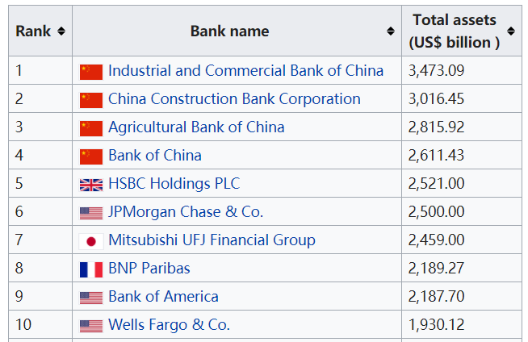
Ranking of Global Banks by Asset

Slide 19
Profitability

Slide 20
Ratio of NPL

Slide 21
Characteristics of the Banking Sector
It is dominated by state-owned banks.
The majority of loans are secured, either by collateral or guaranteed.
  Firms in the heavy industry are favored.
  SOEs and local government financing vehicles are favored.
Notes:
One implication is that the leverage ratio in the heavy industry and the state sector is typically high, while firms in the service sector find it difficult to obtain loans.

Slide 22
Content
Basics
The Reform of the Financial System
The Banking System
Recent Trends

Slide 23
Recent Trends
Toward the “fee for service” model
The rise of consumer lending
The rise of mid-sized commercial banks
Financial disintermediation
Interest rate liberalization

Slide 24
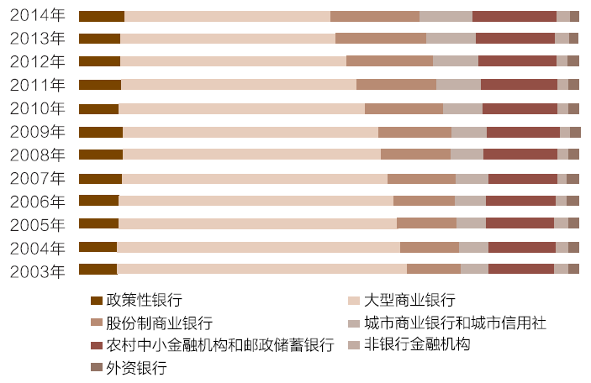
Market Share of Different Categories of Banks

Slide 25
Financial Disintermediation
Banking is a form of intermediate financing, meaning that savings are invested through the intermediation of banks.
Disintermediation occurs when people avoid the intermediation of banks by investing directly in securities (e.g., bonds and stocks) rather than leaving their money in savings accounts.
Since 2010, signs of financial disintermediation appeared in China
  The loan restrictions on real estate developers and local government financing vehicles.
  The rise of bond market.

Slide 26
Decline of Bank’s Importance in the Financial System

