Slide 1
RMB Exchange Rate and Internationalization
Junhui Qian
2018

Slide 2
Content
The evolution of RMB exchange rate regime
  Before 1994
  1994-2005
  2005-2015
  2015-2017
RMB internationalization
  Objectives
  Implications

Slide 3
RMB/USD Exchange Rate (Annual)

Slide 4
Exchange Rate Policy
In 1994, RMB official exchange rate was merged with the market rate.
The interbank foreign exchange market was established. The exchange rate was formally determined by the market. But PBC intervened heavily.
From 1995 to 2005, the RMB/USD was de facto pegged at 8.3, with a daily fluctuation capped in [-0.3%, 0.3%].
From July 2005, RMB no longer pegs USD. RMB started to appreciate gradually. From 2005 to early 2014, RMB appreciated around 37%.
In August 2010, China established the RMB offshore market (CNH market).

Slide 5
The Reform of the RMB Exchange Rate (since 2005)
Milestones | Date | Main changes
“7.21” Reform | 2005.7.21 | Introduce the managed floating mechanism, with a [-0.3%, 0.3%] fluctuation band around the central parity rate.
 | 2006.1.4 | Introduce market makers and a new mechanism for the setting of the central parity rate.
 | 2007.5.21 | Widen the fluctuation band to [-0.5%, 0.5%].
 | 2008.10.6 | Restrict volatility with the onset of the global financial crisis.
 | 2010.10.22 | End of crisis mode.
“4.21” Reform | 2012.4.21 | Widen the fluctuation band to [-1%, 1%]; Deregulate banks’ foreign exchange dealings.
“3.17” Reform | 2014.3.17 | Widen the fluctuation band to [-2%, 2%].
“8.11” Reform | 2015.8.11 | Let the central parity rate reflect market demand and supply (previous closing rate).
 | 2016.2.15 | Introduce the mechanism of “closing rate plus exchange-rate movements of a basket of currencies” for setting the central parity.
 | 2017.5.26 | Introduce a “counter-cyclical factor” into the central parity pricing mechanism.

Slide 6
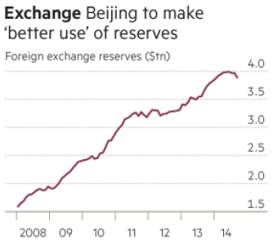
Why Floating Is Inevitable
China is an open, large, and diverse economy. The management of Chinese economy requires a more independent monetary policy.
Pegging is “expensive”. China has already accumulated too large a foreign reserve.
It has become a consensus to “let market play the crucial role”.

Slide 7
Why Floating is Difficult
Many State-Owned Enterprises (SOE) have debt denominated in foreign currencies (e.g., USD). And they do not hedge currency risks.
Stability is a dominant concern for policy makers.
  Large volatility, especially in the direction of depreciation, may result in a bad equilibrium.

Slide 8
RMB/USD Exchange Rate (Daily)
8.11 Reform

Slide 9
USD and RMB Indices (2014-2017)
8.11 Reform

Slide 10
USD and RMB Indices (2017)

Slide 11
Possible Sources of the RMB Weakness in 2015 and 2016
The unwinding of carry trade.
Corporations reduce USD debt.
Residents demand for currency diversification.
Over-valuation of RMB (against a basket of currencies).
The economic slow-down
The rising labor cost

Slide 12
A Trap of RMB Depreciation Expectation
Depreciation Expectation
Capital Flow Restriction
Capital Flow Dis-equilibrium
基本面

Slide 13
Why is CNY So Strong in 2017?
USD is weak.
The Chinese economy is resilient.
The control on capital outflow is strengthened.
The CNY shorts are covering their position.

Slide 14
Content
The evolution of RMB exchange rate regime
  Before 1994
  1994-2005
  2005-2015
  2015-2017
RMB internationalization
  Objectives
  Implications

Slide 15
The objectives of RMB internationalization
Invoicing in RMB
Trade settlement in RMB
Investment in RMB
A reserve currency

Slide 16
Why RMB Internationalization?
Help reduce currency risk in trade and investment ( to accommodate the forthcoming floating of RMB)
Less need for foreign exchange reserve
Seigniorage income.

Slide 17
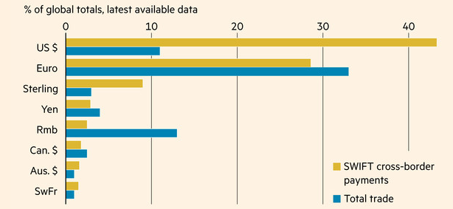
International Usage of RMB Lags Behind

Slide 18
Benefits of RMB Internationalization to the World
The international monetary system over-relies on USD as the dominant reserve currency, but the US fiscal future is highly uncertain. (The New Triffin Dilemma)
RMB internationalization would provide an alternative reserve currency which is backed by a strong flow of fiscal revenue.

Slide 19
RMB Joins the SDR Basket
IMF has accepted RMB as the fifth, and the third biggest, currency in the SDR (special drawing rights) basket.
This is a symbolic achievement for RMB, but also an important one.

Slide 20
The Implications of RMB Internationalization
The Chinese capital market will be fully open to the world, so that international investors can trade Chinese bonds and stocks.
The Chinese outbound investment would take off
  The foreign exchange reserve will decline as private outbound investment increases.

