Slide 1
Reform and Open-up (part 2)
Junhui Qian
2018

Slide 2
Outline
The reform of TVE’s
The reform of SOE’s
  Small and medium-sized
  Large SOE’s

Slide 3
Questions
What drove the reforms of TVE’s and SOE’s in 1990s?
How were the reforms carried out for different types of enterprises?
What did these reforms achieve?
What problems remained?
Notes:
Anticipatory Ownership Reform Driven by Competition: China's Township-Village and Private Enterprises in the 1990s

Slide 4
Small and Medium-sized Enterprises (SME) in China
Rural
  Township and Village Enterprises (TVE)
  Household and private enterprises
Urban
  Urban collectives
  Urban household and private enterprises
  Other ownerships (mainly joint-ventures)
Since early 1970s, the county and city governments have taken control of all small and a large proportion of medium-sized SOE’s.

Slide 5
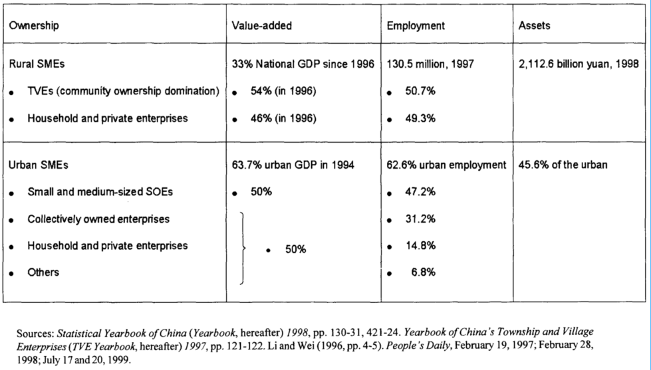

Slide 6
The Challenges to TVEs in 1990s
The market conditions became less favorable to TVEs.
The expansion of TVEs led to mechanism degeneration.
  The objectives of community government were in conflict with those of a profit-maximizing enterprise.
  Corruption among community officials and TVE managers were growing.
    TVEs as “purses” of the community government
    TVE as an “ownerless” asset.
Runaway debt
Notes:
The objectives of community government would include employment, local prosperity, financial revenue for local spending, etc.

Slide 7
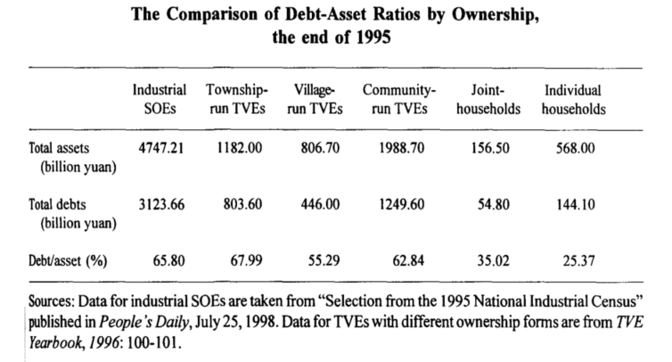
Debt-Asset Ratio for Different types of Enterprises

Slide 8
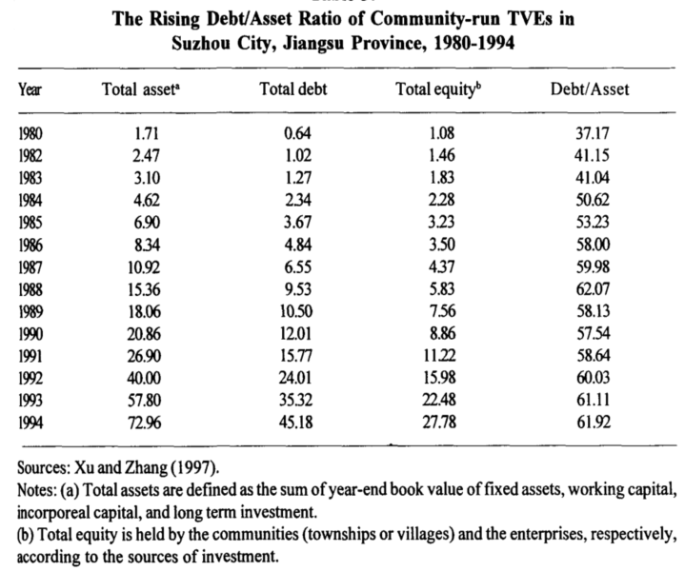
Runaway Debt on TVEs: the Case of Suzhou

Slide 9
Why There Was So Much Debt?
Market competition intensified and profit margins for TVEs were eroded. Investment relied more on debt than internal saving.
Expansion of community conglomerates made it more capable to guarantee more loans for TVEs.
Individual TVE had the incentive to acquire more loans, knowing the community would bail it out if it could not repay the loan (“soft-budget-constraint problem”).
Notes:
The “soft-budget-constraint problem” for each individual TVE would bankrupt the whole community. In order to get rid of the unlimited liability it holds for its TVEs and avoid the threat of community
bankruptcy, the community government with many highly leveraged TVEs has strong incentive to initiate ownership reform program within the community. -Sun (2000)

Slide 10
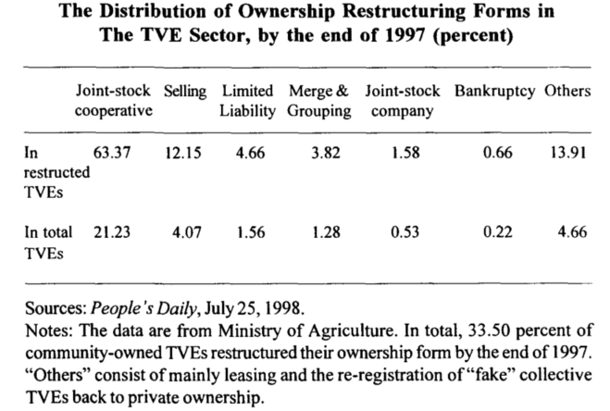
The Rise of Joint-Stock Cooperatives (JSC)

Slide 11
How JSC works
Among the diverse forms of TVE ownership restructuring, the dominant one is the JSC.
  Managers and employees own a majority of the total share of the firm.
  The local government may hold a large part of shares in the name of community citizens.
  In addition to the shares held by the insiders and local government, there usually exist some (or even large) shares of outside equity which carry one vote per share.
  A representative form of governance is usually employed based on "one-person-one-vote" or "one-share-one-vote" or a combination of both voting principles.
Notes:
The firm is closely held, implying that ownership shares are typically not freely marketable, although subscribed shares can be transferred within the community.
The local government’s role has been increasingly transformed from sole owner and supervisor of the firm to one more similar to that of a major venture capitalist.

Slide 12
Inter-Jurisdictional Competition as a Driver for Ownership Restructuring
Since local officials’ promotion were connected with the economic performance of his jurisdiction, there were fierce competitions across provinces, cities, counties, and rural communities (i.e. township and villages)
The competition induced local government to provide a hospitable environment for attracting investment and to a lesser degree, labor.
The competition induced the promotion of markets, the experimentation of reform initiatives, and the emulation of good practices.

Slide 13
What JSC Achieved
Reduced debt/asset ratio by 10 percentage points in average.
It is widely reported that JSCs’ performance improved significantly, contributing to the continued miracle of TVEs.

Slide 14
Outline
The reform of TVE’s
The reform of SOE’s
  Small and medium-sized
  Large SOE’s
The opening-up
Industrialization and urbanization

Slide 15
Phases of SOE Reform
1956-1978: Decentralization (企业下放)
1979-1982: Autonomous management (企业自主)
1983-1992: Contract responsibility system (承包责任制)
1993-2003: Ownership restructuring (改制)
2004- : Management of capital (管资本)

Slide 16
The Self-Defeating SOE reforms of 1979-1992
The supply of energy and materials were rigid.
  Non-state entry was minimal.
  The import of energy and materials was also tightly controlled.
Whenever an SOE reform was pushed forward (autonomous management, contract responsibility, etc.), production was stimulated, driving up prices of energy and materials.
Inflation followed and became uncontrollable. So did corruption become more apparent.
The reform was deemed a failure.

Slide 17
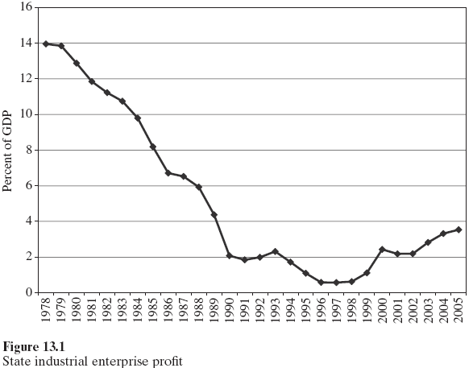
State Industrial Enterprise Profit

Slide 18
The Soft-Budget Constraint Problem
A soft budget constraint is said to exist whenever a loss-making company continues to receive financing.
To give more discipline to enterprise managers, grants gave way to bank loans (拨改贷). However, due to the soft-budget constraint problem, bank loans soared.

Slide 19
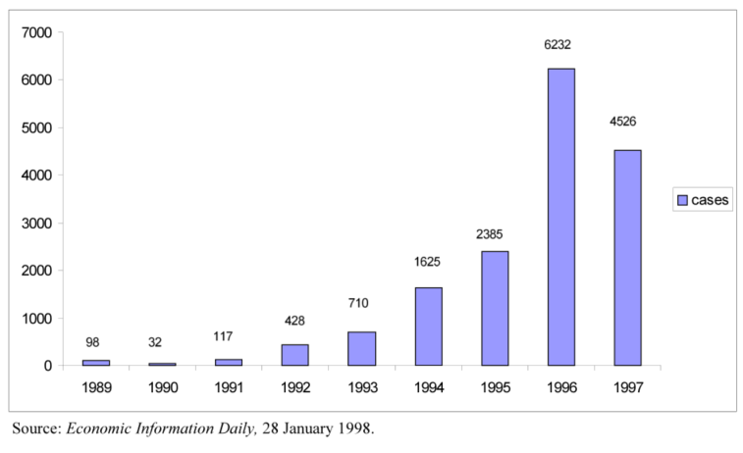
Bankruptcy in China (1989-1997)
Notes:
The vast majority of bankrupted enterprises were small and medium-sized SOEs.

Slide 20
Why Were SME-SOEs Prone to Failure?
Often in competitive industries.
Too small to enjoy economy of scale.
Too bureaucratic to enjoy the flexibility that often comes with smallness.
As a result, local governments had every incentive to get rid of them.

Slide 21
Grasping the Large and Letting the Small Go
The Company Law of 1994 paved way for the diversification of ownership of the SOE’s, including privatization.
The 15th Communist Party Congress (Sep 1997): Grasping the large and letting the small go.
The “large” were often controlled by the central government, while the “small” were often in control of local governments.
The “large” were (and are) often protected by entry barriers (real or regulatory), while the “small” were often subject to market competition.

Slide 22
Governance Reform
Objectives:
  (Incentive) Turn the SOE’s from socialist work units into profit maximizing companies.
  (Constraint) Make the management responsible for the solvency risk.
Practices:
  Separation of the enterprise from the government.
  Introduce competition by breaking monopolies.
  Listing
    As a whole (整体上市)
    Essential parts (剥离上市)

Slide 23
Public listing of SOE’s
Almost all national champions (telecoms, transport, energy and finance) have been listed in stock exchanges in Shanghai, Shenzhen, Hong Kong, and New York.
The typical practice is: (i) form a limited corporation for asset injection and eventual listing; (ii) invite “strategic investment” in the corporation from big-name western investors such as Goldman Sachs, Warren Buffet, and the likes; (iii) and IPO simultaneously or sequentially at various stock exchanges.
Many smaller SOE’s controlled by local governments have also been listed in Shanghai, Shenzhen, and Hong Kong.
A listed company not only obtains an additional source of financing, but also introduces external monitoring of the management.

Slide 24
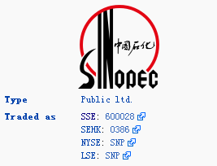
Case Study: The Reform of Sinopec (I)
About Sinopec:
  Sinopec Group is one of the big two oil companies in China and is the world's fifth biggest company by revenue. Its business include oil and gas exploration, refining, and marketing; production and sales of petrochemicals, chemical fibers, chemical fertilizers, and other chemical products; storage and pipeline transportation of crude oil and natural gas; import, export and import/export agency business of crude oil, natural gas, refined oil products, petrochemicals, and other chemicals.
  In 2009, it was ranked 9th by Fortune Global 500, becoming the first Chinese corporation to make the top ten and in 2010 it was ranked 7th.

Slide 25
Case Study: The Reform of Sinopec (II)
China Petrochemical Corporation (Sinopec Group), the parent of the listed Sinopec Corp., is established in July 1998 on the basis of the former China Petrochemical Ministry.
Strategic investors of Sinopec include BP, Exxon Mobile, etc.
The Sinopec Corp. issued H-shares and A-shares at overseas and home respectively in October 2000 and August 2001, respectively, and was listed on stock markets in Hong Kong, New York, London, and Shanghai. The total number of shares of Sinopec Corp. was 86.7 billion, in which Sinopec Group owns 75.84%, international investors own 19.35%, and domestic investors own 4.81%.
In 2014, Sinopec initiated the so-called mixed-ownership reform. It plans to sell more shares to strategic investors in the private sector.

Slide 26
Other Measures to Harden the Soft-Budget Constraints
Banking reform turned state banks into commercial banks.
Tax reform weakened the link between SOE’s and their bureaucratic superiors.
Social security reform and housing reform helped reduce the bargaining power of SOE’s.

Slide 27
The Achievement of SOE Reform
After downsizing, splitting, and restructuring, many loss-making large SOE became profitable again.
The downsizing of SOE released redundant labor for non-state enterprises.
The associated housing reform helped improve the allocation efficiency of labor.

Slide 28
What Problem Remained?
The state share remains too large
  No proper monitoring of SOEs
  No market discipline
Incomplete separation between the enterprise and the government
  Key personnel's are appointed, evaluated, and promoted as government officials.
  SOE enjoys implicit guarantee from the government.
Lack of incentives for enterprise management to generate profit and dividend
  Strong incentive to build empire
  Weak incentive to control cost

