Slide 1
Reform and Open-up (part 1)
Junhui Qian
2018

Slide 2
Outline
The reform of the countryside
The rise of TVE
The dual-track system

Slide 3
Questions
How was reform started?
What were the factors behind the immediate success of the rural reform?
What were the limitations of the HRS?
What factors were behind the rapid development of township and village enterprises (TVE)?
How were private enterprises legalized in a socialist country?
Why was the dual-track approach popular? And how did it work?
Was gradualism a design, or a product of recurring battle between reformers and conservatives.

Slide 4
Background of the Reform
Domestic
  New leaders were much less ideological than their predecessors.
  Living condition stagnated for a long time (a lost two decades), especially the farmers.
  Improved relation with the US helped to look outward for new ideas.
International
  Most planned-economy countries experienced similar economic stagnation.
  The market economies of “East Asia Tigers” (Hong Kong, Singapore, South Korea, and Taiwan) experienced high growth.
  Ideological shift to the right (US & UK)

Slide 5
It Started from the Countryside
In desperate situations, local cadres and farmers experimented new institutional arrangements to increase output.
In one notable example, 20 households in Xiao Gang Village (小岗村), Feng Yang of Anhui Province (安徽凤阳), chose to use an old scheme: production contract at the household level (包产到户).
This scheme was experimented in 1961 and was very successful. But it was considered “capitalistic” and thus forbidden.
In 1978, however, the farmers won the political gamble. The provincial leader approved the practice.

Slide 6
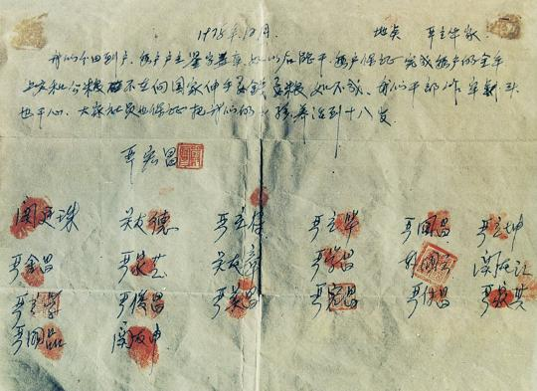
The Contract of Xiao Gang Village (1978)
Notes:
This last sentence reads, “If unsuccessful and we cadres go to prison or get killed, please make sure raising our kids till they reach 18.”
The local cadres’ worry was not unwarranted. Even in the official document of the 4th plenary of the 11th Conference in 1979.9, production contracting to the households was still prohibited.

Slide 7
Household Responsibility System
There were many other schemes that were experimented in different areas. But the one experimented in Xiao Gang Village eventually became the norm, with the name “Household Responsibility System” (HRS, 家庭联产承包责任制).
Farm households took over management of a specific plot of land, subject to a contractual agreement that they turn over a certain amount of procurement (low price) and tax (zero price) grain after the harvest.
The solution was controversial, but it received support from the leadership. After all, it was not a privatization.
Notes:
The half reform sowed the seeds for long-term malaise for the rural.
The other side of the controversy: the household-based production
model is not consistent with socialism. Since “mechanization is the
answer to agricultural development,” and mechanization requires
economies of scale, how can household-based production be the
right move? People holding the second view regard it as regression
rather than reform. They believe that other reforms produced the
growth in 1978–84, including those for fertilizer, scientific research,
and mechanization, as well as the price and market reform.

Slide 8
Problems the HRS Solved
Lack of incentives
  In HRS, farmers keep the residual profit
Asymmetric information in supervision
  Process supervision
  Result supervision
Due to the lack of incentives and the difficulty of supervision, farm collectives were unable to realize the scale of economy.

Slide 9
The Limitation of HRS
Reduced the scale of farm operation.
Land fragmentation.
Rigid rules for land transfers.
Weak property rights on the contracted land.
  Hinders investment for long-term growth.
  Unable to use land as collateral.
  Unable to use land as an instrument for saving.
Notes:
A study by Wan and Cheng (2001) finds that while economies of scale for overall farm size are minimal, output loss due to fragmentation of landholdings is significant and large.
Wan, Guanghua and Enjiang Cheng. February 2001. “Effects of Land Fragmentation and Returns to Scale in the Chinese Farming Sector.” Applied Economics. 33(2), pp. 183–194.

Slide 10
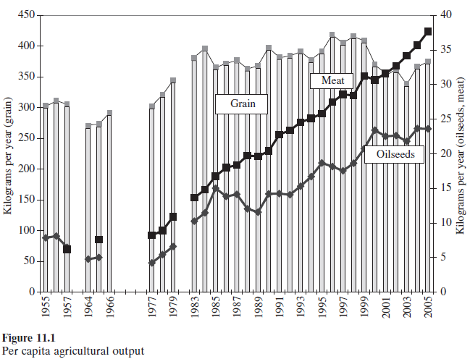
The Immediate Result
By 1984 grain output had surged to 407 million tons, more than one third higher than in 1978, and farmers actually reduced working days.
There was enough grain for everybody in China, and the history of shortage of food was over!

Slide 11
One Success Leads to Another
The instant success of the agricultural reform strengthened the position of the reformers, on the top and down in the grassroots.
Rural enterprises were allowed to grow and prosper.
  The rising income of farmers
    Drove up demand for consumer goods.
    Provided savings for continued investment.
  The rising productivity of farming released labor supply
Rural enterprises further enriched farmers, creating a virtuous circle.

Slide 12
Outline
The reform of the countryside
The rise of TVE
The dual-track system

Slide 13
The Rise of Township and Village Enterprises (TVE)
Starting in the 1950s and continuing through the 1970s, rural communes and brigades were encouraged to develop collectively owned industrial enterprises, which were later called TVE’s.
Fiscal reform in 1980s gave local governments the scope to develop and rights to retain revenues from TVE’s.
TVE’s were outside the production plan. They were allowed to produce and market goods in shortage, and even to compete with some of the existing state-owned enterprises.
Although some SOE’s faced more competition, most benefited from the rising demand for consumer and industrial goods.
Hence the agricultural reform and the development of TVE was a Pareto improvement.

Slide 14
Different Models of TVE’s
Southern Jiangsu Model
  Organized by collectives (with some capable leaders), capital intensive manufacturing, relatively closed to migrant workers.
Wenzhou Model
  Private small businesses, high degree of division of labor,
Pearl Delta Model
  Foreign, or foreign-collective jointly owned, trade processing, open to migrant workers.

Slide 15
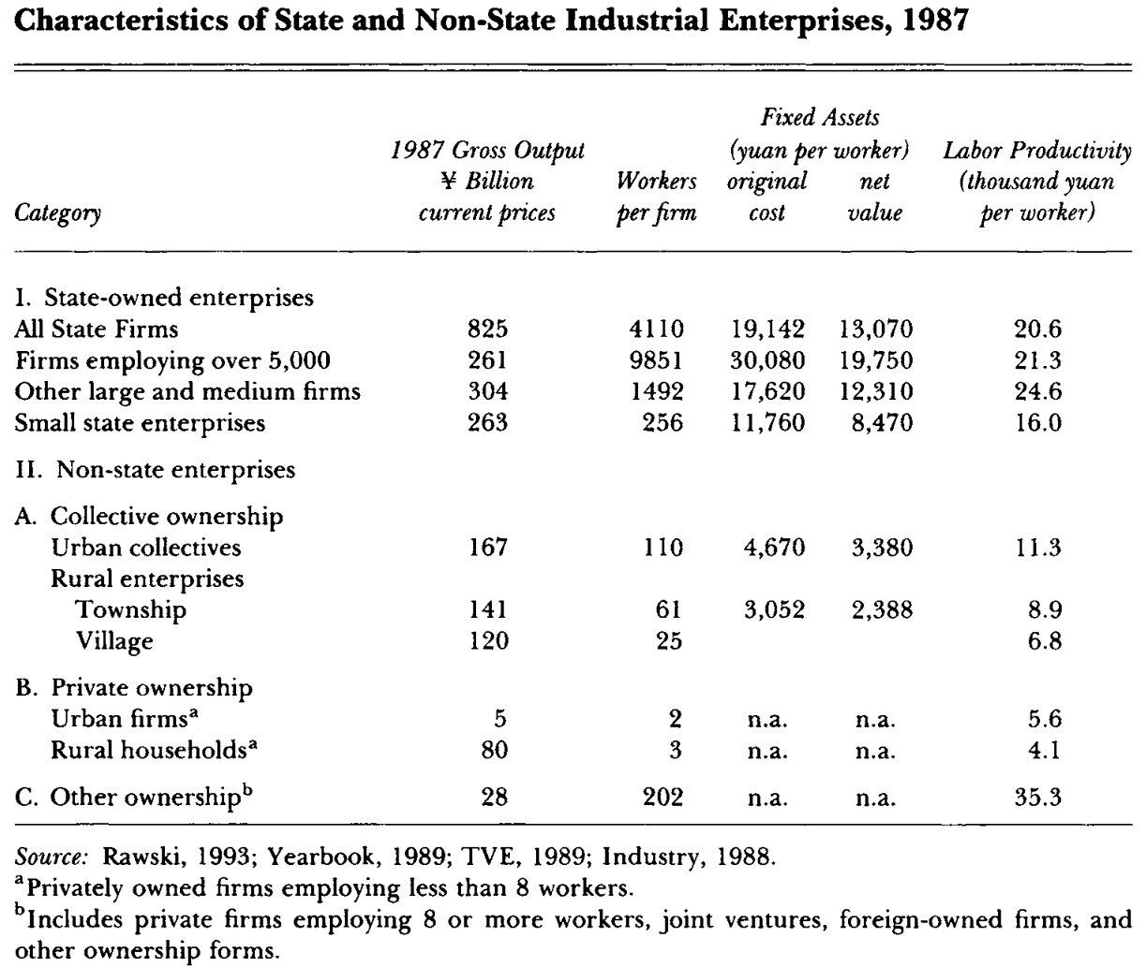
Characteristics of TVE
Notes:
TVE was

Slide 16
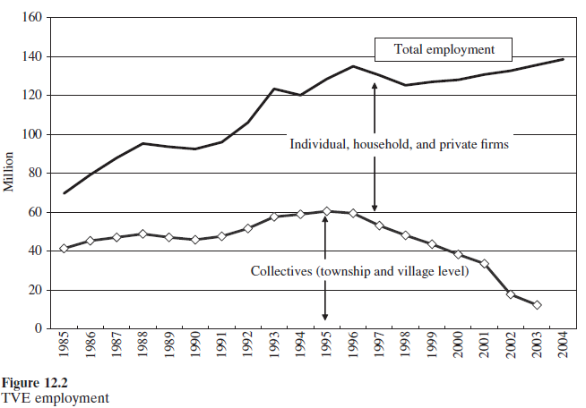
TVE Employment

Slide 17
Legitimization of Private Ownership
Some entrepreneurs disguised their firms as collectives, thus gaining the shelter of a “red hat” that falsely signified public rather than private ownership; others purchased informal protection from powerful individuals or agencies.
A succession of amendments to China’s 1982 constitution slowly expanded recognition of the non-state economy.
  “complement” to the state sector (1988)
  “important component” (1999) of the “socialist market economy” (itself a new term dating from 1993).
  The “Law on Solely Funded Enterprises,” which took effect in 2000, guarantees state protection for the “legitimate property” of such firms, but without using the term “private” or specifying any agency or process to implement this guarantee.
  “citizens’ lawful private property is inviolable.” (2004)
  2007: Law on Property Rights, for the first time, explicitly places privately held assets on an equal footing with state and collective property.

Slide 18
Outline
The reform of the countryside
The rise of TVE
The dual-track system

Slide 19
Dual-Track System
The reform was carried out without a grand blueprint. The old plan-economy rules and institutions were maintained, while the market approach was experimented, first in the rural and then in the cities.
The dual-track system was an important feature in the Chinese transition from the planned economy to a market economy.
In a dual-track system, there were typically two prices, one official (nominal, plan) and the other market price.
Producers, after fulfilling the requirements of the planner (or procurement target for the farmer), could sell their products to the market at market prices.
In sourcing for factor inputs (energy, materials, etc.), producers could purchase more than the planner allowed from the market at market prices.

Slide 20
The Reach of Dual-Track Approach
The dual-track approach was taken everywhere
  Grains
  Materials and energy
  Labor
  Foreign exchange
  Loans
  Shares (tradable and non-tradable)
The approach is still popular today.
Notes:
There were permanent labor and contract labor.
From 1984, bank loans started to replace budgetary appropriation as the chief source of funding for industrial enterprises (拨改贷).

Slide 21
Price of Grain Coupons
There were two prices for grains, the negotiable price (议价) and the nominal price (平价). The former reflects market condition and is generally higher than the latter, which is determined by the local government.
With grain coupons, one can buy grains at the nominal price, in effect enjoying the government subsidy.
In 1980s, the grain consumption of urban residents declined, thanks to more consumption of non-grain food (meat, egg, etc.). As the quantity of grain coupon issued to urban families changed little, a “grey market” emerged to exchange grain coupons.
On the demand side of the grain coupons, there were
  Migrant workers
  Enterprises that use grains as inputs (e.g., liquor-making)
Notes:
Question: how would the price of grain coupons change when there was a harvest?
One can also use grain coupons to buy things directly.
There were “national coupons” and “local coupons”. The former were obviously more expensive.
《二十世纪八十年代粮票交易现象探析》，张学兵，中共党史研究，2009年第7期。

Slide 22
Profiteers of the Dual-Track System
The existence of two prices for one commodity brought a large number of profiteers or arbitragers (倒爷).
Profiteers could obtain quotas from some government agency to purchase some commodity (e.g., coal, steel) at the plan price and then re-sell it to the market at market price, harvesting huge profit instantly.
For those with deep connections with the planning agency, there was a more accurate name for these profiteers: official profiteers (官倒).

Slide 23
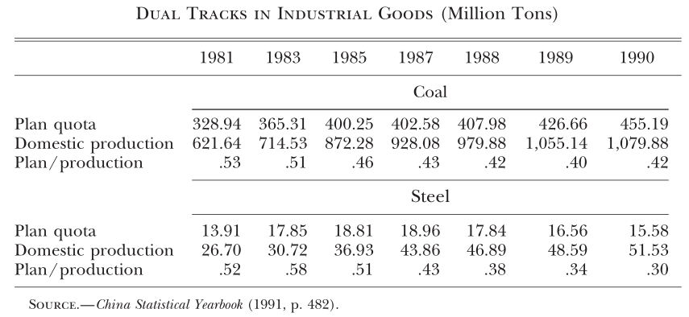
Growing out of the Plan

Slide 24
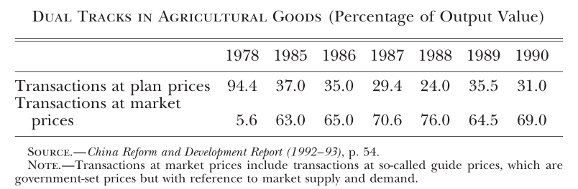
Agricultural Goods
Notes:
Table from Lau, Qian, and Roland (2000), Reform without losers: an interpretation of China’s dual-track approach to transition, Journal of Political Economy, 108 (1), 120-143.

Slide 25
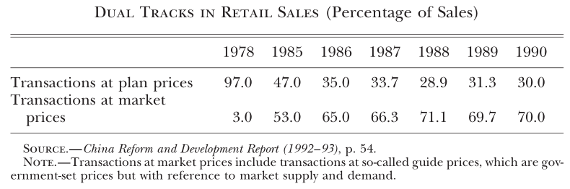
Retail Sales

Slide 26
The Pain of Transition
The widespread profiteering, along with recurrent inflation, undermines the political support for the reform.
The periodic retrenchment of reform made economic cycles more volatile
  “Once loosen, chaos; once tighten, death.” (一放就乱，一管就死)
  Two steps forward, one step back.

Slide 27
The Cycle of Reform-Retrenchment
When important reform was carried out, which invariably came with some decentralization of decision making on investment, demand would outpace supply. Inflation rose. As commodity prices rose, profiteering also intensified.
Then the central government would cut investment projects, often by re-centralization and reign in reform experiments. The economy would then cool down dramatically.
As there was no alternatives, reform would be restarted after a period of economic malaise.
Notes:
The most serious setback was 1989-1991.

Slide 28
Growth Despite Gradualism
Gradualism of Chinese reform is not by design, but a product of the shifting balance of power between the reformers and the conservatives.
Despite the slow reform in 1980s and early 1990s, China achieved rapid growth because
  Market force, once allowed, strengthened itself.
  As international trade and investment was encouraged, export-led growth started, taking advantage of the extremely low cost of labor.

