Slide 1
The Planned Economy and Its Legacies
Junhui Qian
2018

Slide 2
Outline
Why China adopted economic planning
How the planned economy worked (failed)
Policy instability

Slide 3
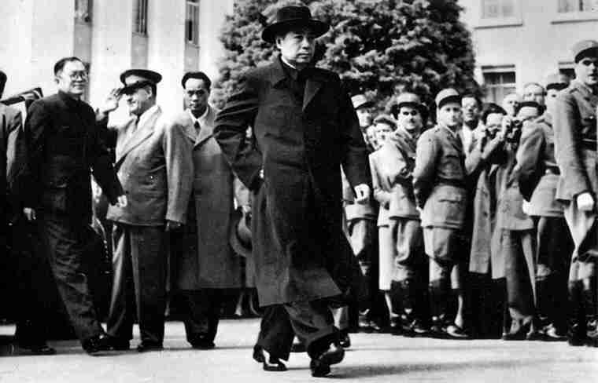
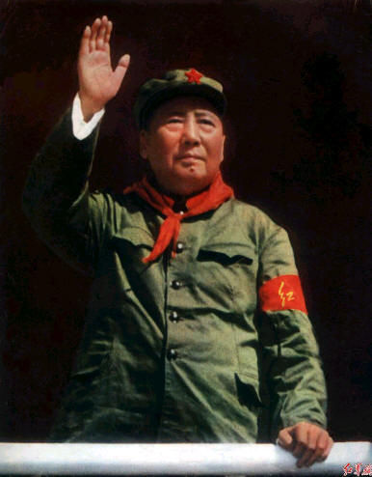
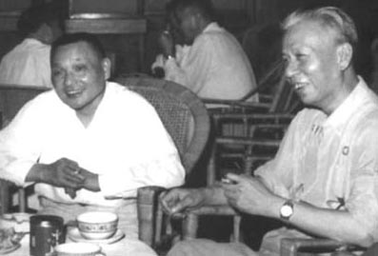
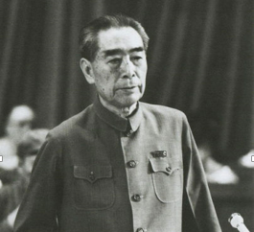
Remember a few names…
Zhou Enlai, 1955, in Bandung of Indonesia.
Mao Zedong, in cultural revolution
Deng Xiaoping (left) and Liu Shaoqi (right)
Zhou Enlai, the Premier, 1976

Slide 4
Why China Adopted Economic Planning
After the foundation of PRC, China followed the Marxism-Leninism ideology that calls for centralized planning of the economy.
Planned economy (or command economy) was generally considered feasible, and even superior.
The Soviet Union’s planned economy was apparently successful.
Paul Samuelson: “Contrary to what many skeptics had earlier believed, the Soviet economy is proof that... a socialist, command economy can function and even thrive.”
There was a national priority to develop the heavy industry, despite limited funding.
The Chinese leaders wanted to speedily transform its weak agrarian economy into a powerful industrial economy.

Slide 5
The Curse of Heavy Industry
Development of heavy industries in an agrarian economy goes against the market force
Labor was cheap and capital expensive.
Requires huge amount of initial capital expenditure and takes a long time before generating returns.
The state takes administrative measures to ensure substantial surplus for the heavy industry.
Suppress prices of inputs (wage)
Monopoly status (the private ownership of productive assets is abolished)
Low wage calls for low cost of living for industrial workers.
Low price of food necessitates low income of farmers.
Migration of farmers to the cities is forbidden (through the Hukou system).

Slide 6
How the Planned Economy Works
Every five year, the central government makes a five-year plan that outlines social and economic development initiatives to be accomplished in the next five years.
Local governments play important roles in the draft and implementation of the five-year plan.
Factory managers implement production plans, given the resources (worker and materials).
They do not make decision on what to produce, where to source, and whom to sell. All profits belong to the government, who allocates the profit according to the plan.
Consumers do not have a say in what to produce, either. They buy what are available on the market and what “coupon” they have.
Because the prices of the consumer goods are kept artificially low, ration is implemented for almost every goods, through “coupons” issued by the government.

Slide 7
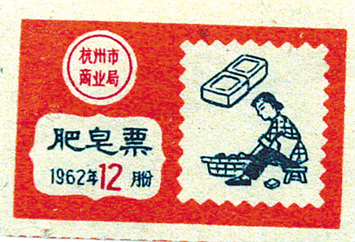
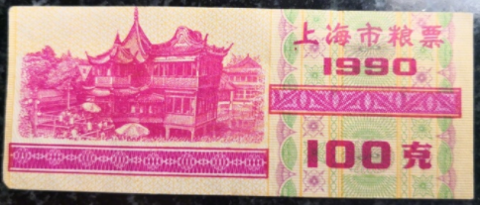
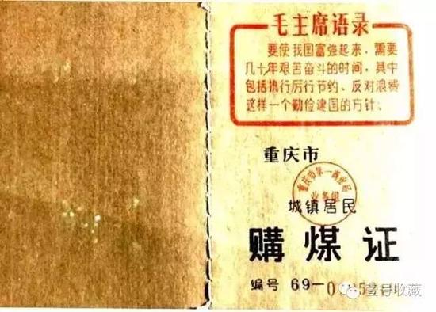
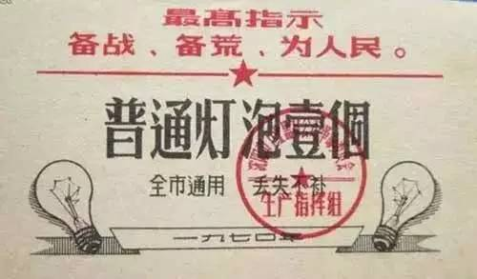
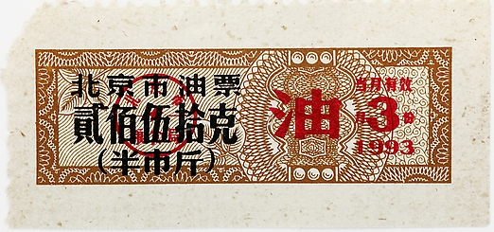
Ration Coupons

Slide 8
The Birth of Grain Coupons
Among all coupons, the grain coupon was the most important.
Food rationing was not designed by the planer, but the product of necessity.
From 1950 to 1953, urban population increased dramatically (due to the large-scale industrial investment), putting stress on the grain supply.
To keep the grain price low for industrial workers, the central government established the “uniform-procurement uniform-sale” system (粮食统购统销制度) in 1953.
Compulsory procurement of grains from farmers.
Rationing of grains in the cities.

Slide 9
Regional Grain Self-sufficiency
Because the price of grain was kept artificially low, provinces with comparative advantages in farming are reluctant to “export” grain to other provinces.
The equilibrium of this game was regional grain self-sufficiency.
“The mayor is in charge of the vegetable basket, and the governor takes care of the rice sack.”
This is but one example of fragmentation under economic planning. The cost is of course economic efficiency.
Economic planning was supposed to take advantages of the scale of economy. But the price distortion and the institutional responses make the economy fragmented, unable to realize the scale of economy.
Notes:
Self-sufficiency also characterizes each unit (say, factory). A large unit would have everything, from kindergartens to hospitals.

Slide 10
Characteristics of Chinese Planned Economy
Similarity with the Soviet Union
Ownership
Command-based resource allocation
No role for price in resource allocation
Micro-management of factories
Chinese characteristics
More decentralized: local governments play important roles
Big-push industrialization with limited urbanization

Slide 11
Big-push Industrialization

Slide 12
Big-Push Industrialization
Investment share was high.
Most (more than 80%) of investment went to heavy industry.
Industry’s share of GDP climbed from 18% in 1952 to 44% in 1978, while agricultural share declined from 51% to 28%.
Thanks to price distortions, the state-owned enterprises were relatively profitable, despite the inefficiency.
A modern tax system was not necessary, since the government could raise from the monopoly of farm and industrial goods more than 25% of GDP as budgetary revenues.

Slide 13
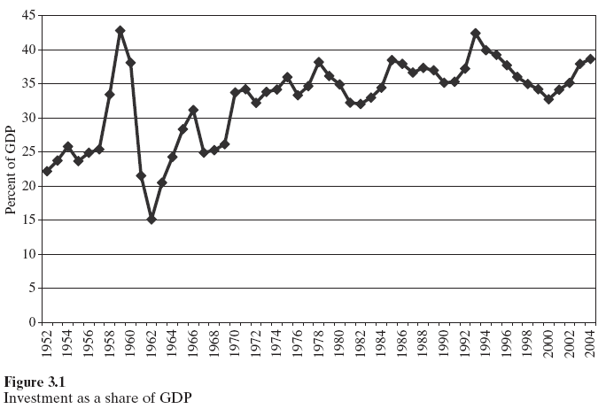

Slide 14
Limited Urbanization

Slide 15
Urban-Rural Dichotomy
Growth driven by the investment in heavy industries did not raise labor demand proportionally. Job opportunities were not enough for urban residents, let alone rural migrants.
Urban residents worked at the government or SOE’s and their income were much higher than farmers.
To maintain stability in the cities, a strict Hukou (户口) system was established to prevent migration from rural to urban.
Thus a urban-rural dichotomy was institutionalized.

Slide 16
Compare with Industrialization in Hong Kong and Taiwan
Industrialization was started from the light industries, producing consumer goods, often for export. Gradually heavier industries also developed as demand for machines increased and private savings accumulated.
Since light industries are generally labor-intensive, urbanization took place naturally as the economy grew.
Household income and private saving grew along with the economy.

Slide 18
Assessing the Big-Push Industrialization
Misallocation of resources
Absence of incentives
In terms of aggregate output, China achieved at best mediocre growth.
In terms of welfare improvement for the average Chinese people, the achievement was even less applaudable. The living standard of Chinese people was even lower than the number suggests.

Slide 19
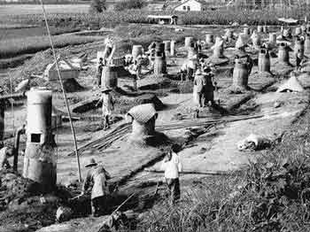
The Great Leap Forward
“Steel Mills” in the countryside
Grains from “harvests” were hauled away.

Slide 20
Great Famine (1959-1961)

Slide 21
Causes of the Great Famine
Official explanation: bad weather.
Bad policies and bad management.
Free meals in the commune kitchen exhausted food stock.
Zealous cadres encouraged wrong practices like dense planting, in an effort to increase land productivity. Mao genuinely believed in the hyperbole of 10,000jin/mu (亩产万斤).
Reduced incentive for individuals in large communes.
Average size of a commune was 10,000 farmers and 4,000 hectares of land.
The communes were broken down to “production teams”, which contained 20 to 30 households.
Compulsory participation of cooperatives.
The article of “Free to join and free to exit” in the 1956 National People’s Congress articles of association disappeared in 1958 and did not come back until 1978.
The false reporting of harvests in the local and the true procurement of grains from the starving countryside.
Notes:
Commune kitchen was abolished after 1959.

Slide 22
Policy Instability
Economic recovery 1949-1952
The twin-peaks of the first five-year plan 1953 and 1956
Retrenchment: The “Hundred Flowers” of 1956-1957
The Great Leap Forward 1958-1960
Retrenchment: Crisis and Readjustment 1961-1963
Launch of the “Third Front” 1964-1966
Retrenchment: The Cultural Revolution 1967-1969
Preparation for war 1970
Retrenchment: Consolidation and drift 1972-1976
The leap outward and the end of Maoism 1977-1978
A final turning point: The Third Plenum of 11th CCP Central Committee, Dec 1978

Slide 23
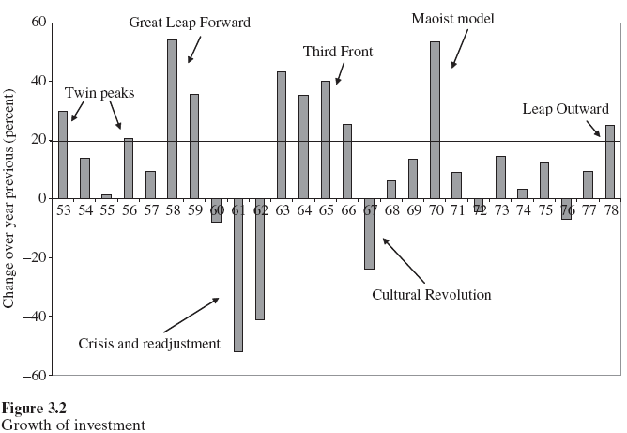

Slide 24
Cultural Revolution (1966-1976)

Slide 25
Legacies of the First Three Decades of PRC
The economy stagnated at an extremely low level.
Almost everybody was a loser by the end of the Cultural Revolution.
On one hand, there was a deep willingness to experiment and reform.
On the other, political stability was treasured.

