Slide 1
Geographic and Historical Settings of Chinese Economy
Junhui Qian
2018

Slide 2
Content
The geographic setting
A brief history of Chinese economy
Before 1949

Slide 3
Why geography is important?
Agriculture depends on geography and precipitation.
“Initial conditions” for recent development.
The geography setting provides the natural boundary for the clustering of people and business.
The location and distribution of rivers and coasts

Slide 5
Provinces and Regions
China has 31 province-level administrative units, including 22 provinces, 4 municipalities under national supervision, and 5 autonomous regions of ethnic minorities.
There are large and small ones, old and new ones, rich and poor ones.
China has the longest combined land border in the world.
China's coastline along the Pacific is bounded by the Bohai, Yellow, East China and South China seas.

Slide 7
Landscape
Mountain ranges and high plateaus sit in the west.
Alluvial plains are in the east.
Mongolian plateau in the north features grasslands.
In the south, there are predominately hills and low mountain ranges.

Slide 9
Climates
There are roughly five climate types in China
Tropical
Subtropical monsoon
Temperate monsoon
Temperate continental
Mountainous
Partly due to the high altitude of the Tibetan plateau, it is very dry in the northwest.

Slide 10
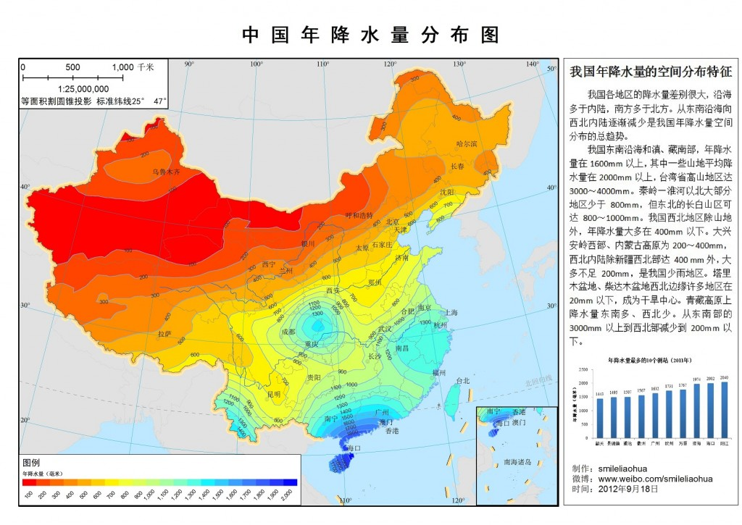

Slide 13
Rivers
Major rivers include
Yangtze
Yellow
Xi
Huai
Amur
The deltas of Yangtze and Xi are economically the most important.
The Great Canal, from Beijing to Hangzhou, is the longest as well as one of the oldest canal in the world. It played an important role in the ancient economy of China.

Slide 14
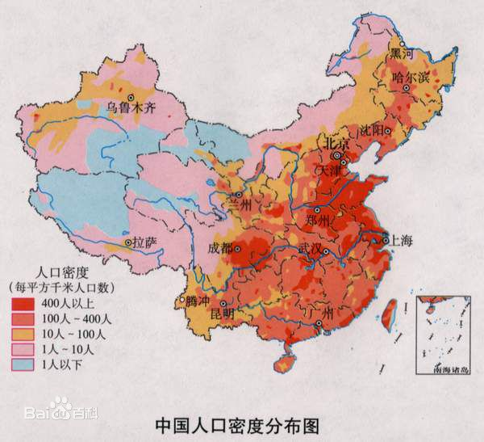

Slide 15
The Chinese Economy Before 1949

Slide 16
Historical Division
Ancient history:
Xia dynasty c. 2070 – c. 1600 BC
Shang dynasty c. 1600 – c. 1046 BC
Zhou dynasty c. 1046 – 256 BC
Western Zhou
Eastern Zhou
Spring and Autumn
Warring States
Dynasties (221 BC-1911)
Republic of China (1911-1949, 1949- on Taiwan)
People’s Republic of China (from 1949, on mainland)

Slide 17
Dynasties (221 BC-1911)

Slide 18
The Traditional Economy
Dominantly agricultural
Small-scale household economy
Signs of commercialization emerged:
Sophisticated institutions (Money, large organizations, advanced commercial procedures, legal and customary institutions, banks)
Rather competitive markets for products, land, and labor.

Slide 19
From 《便民图纂》, a Ming book on agriculture in Taihu area.

Slide 20
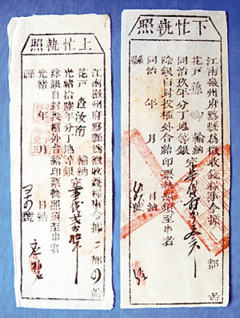
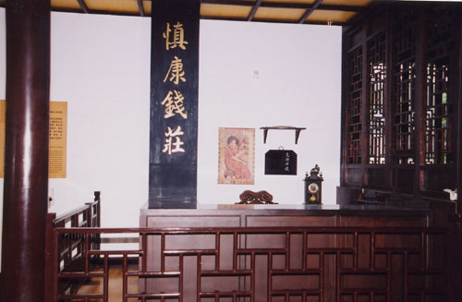
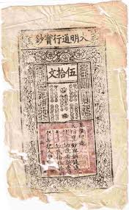
Paper money of Ming Dynasty
A Traditional Bank
A Certificate of Tax

Slide 21
Small Government
Around 1800, one government worker per 32,000 people.
What the government does:
Maintain a military
Courier/postal/transport service
Dams, canals, and public works
Local security and law suits
Disaster relief

Slide 22
A Simplistic Model
After years (decades) of chaos, a new dynasty would bring peace and stability to China.
Farmers start to live better. And as they have more children, population increases.
The new dynasty would repair and construct dams and canals, so that more land would be available for more population.
Arable land is limited, but population continues to expand, diminishing return to labor and hence standard of living.
During the decline of the dynasty, farmers would face increasing burden of tax, as politically important groups manage to lower or even waive their share.
With limited funding and widespread corruption, the public works (dams, canals,) would be left dilapidated and bandits would appear.
Eventually, there would be large-scale of farmers uprising or/and barbarian invasion, ending the rule of the dynasty.
The cycle repeats.

Slide 23
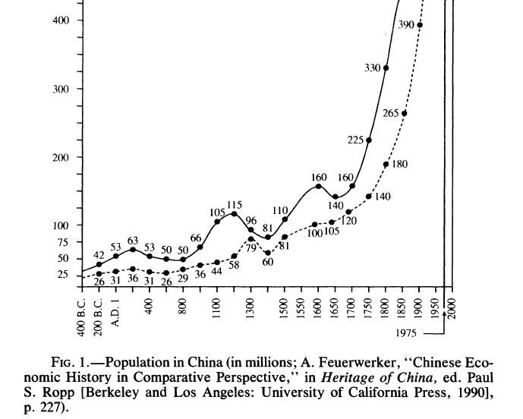
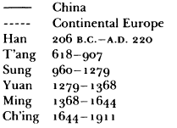

Slide 24
The ultimate crisis of the traditional economy
Population growth on the limited land and stagnant technology
“The Chinese peasant is like a man standing on tiptoe up to his nose in water—the slightest ripple is enough to drown him.” (Tawney, 1930s)
Failure of government
Widespread corruption
Too small, especially compared with the population boom in 18 and 19 centuries.
Challenge from the west
The opium import in 19 century caused a severe monetary deflation.

Slide 25
Why the Industrial Revolution Did Not Originate in China?
Needham’s puzzle: Why was China's science and technology so far in advance of other civilizations historically, only to fall in modem times?
Lin (1995) points to the missing scientific revolution in China, which in turn may be due to the contents of civil service exams and the criteria of promotion.

Slide 26
1912-1937
Rapid industrialization (8%-9% annual growth in factory production)
Treaty ports (e.g., Shanghai)
Manchuria
There were two good intervals:
1914-1918 (WWI)
1927-1937 (“The Nanjing Decade”)
Modern education expanded rapidly.
Open to the world
About 100,000 Chinese students went abroad (Japan, US, Europe)
As of 1936, around 370,000 foreigners were resident in China
Shanghai was the financial center of the far east.

Slide 27
1937-1949
War-time economy
Increased State Intervention
Before the war, there had been no significant public sector
By the early 1940s, state-run firms accounted for 70% of all capital and 32% of all labor in unoccupied area.
Hyperinflation

Slide 28
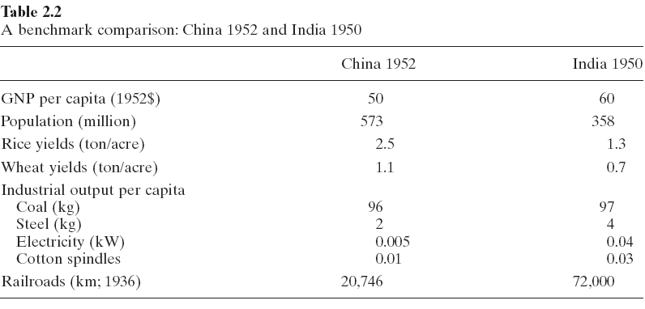

Slide 29
Summary
Geographically, China is big and diverse.
The traditional economy is household-based and agricultural. The modernization of Chinese economy had been bumpy, frequently interrupted by wars and revolutions.
People’s Republic of China was been founded in desperate economic situation.

